Slide 2
Survey Summary 2022
Seafood Producers Association of Nova Scotia

Slide 3
Overview
Bank | Last Survey | Surveyed this year
Middle | 2021 | YES
Banquereau | 2019 | NO
Sable | 2021 | YES
German | 2021 | YES
Browns South | 2021 | NO
Browns North | 2021 | YES
Georges Bank (monitoring stations) | 2021 | YES
Georges Bank 'a' | 2021 | YES
Georges Bank 'b' | 2021 | YES

Slide 4
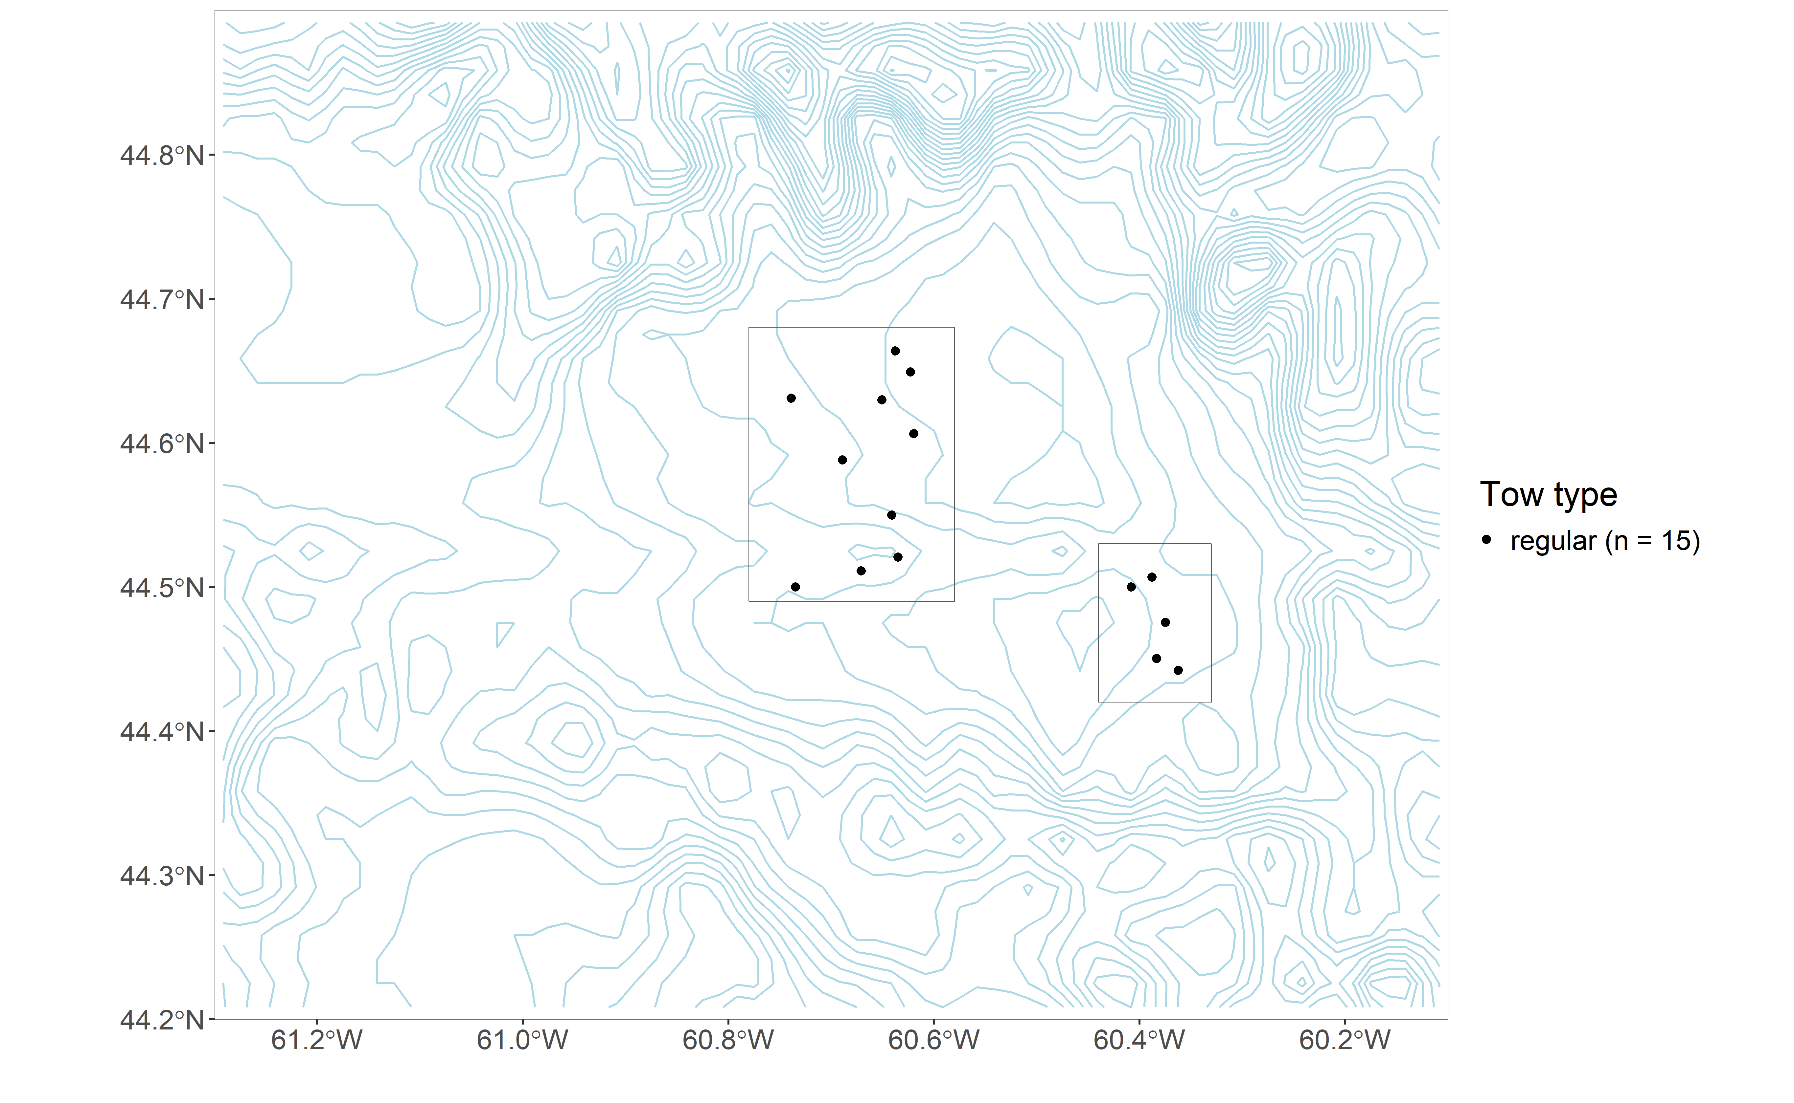
Middle Bank

Slide 5
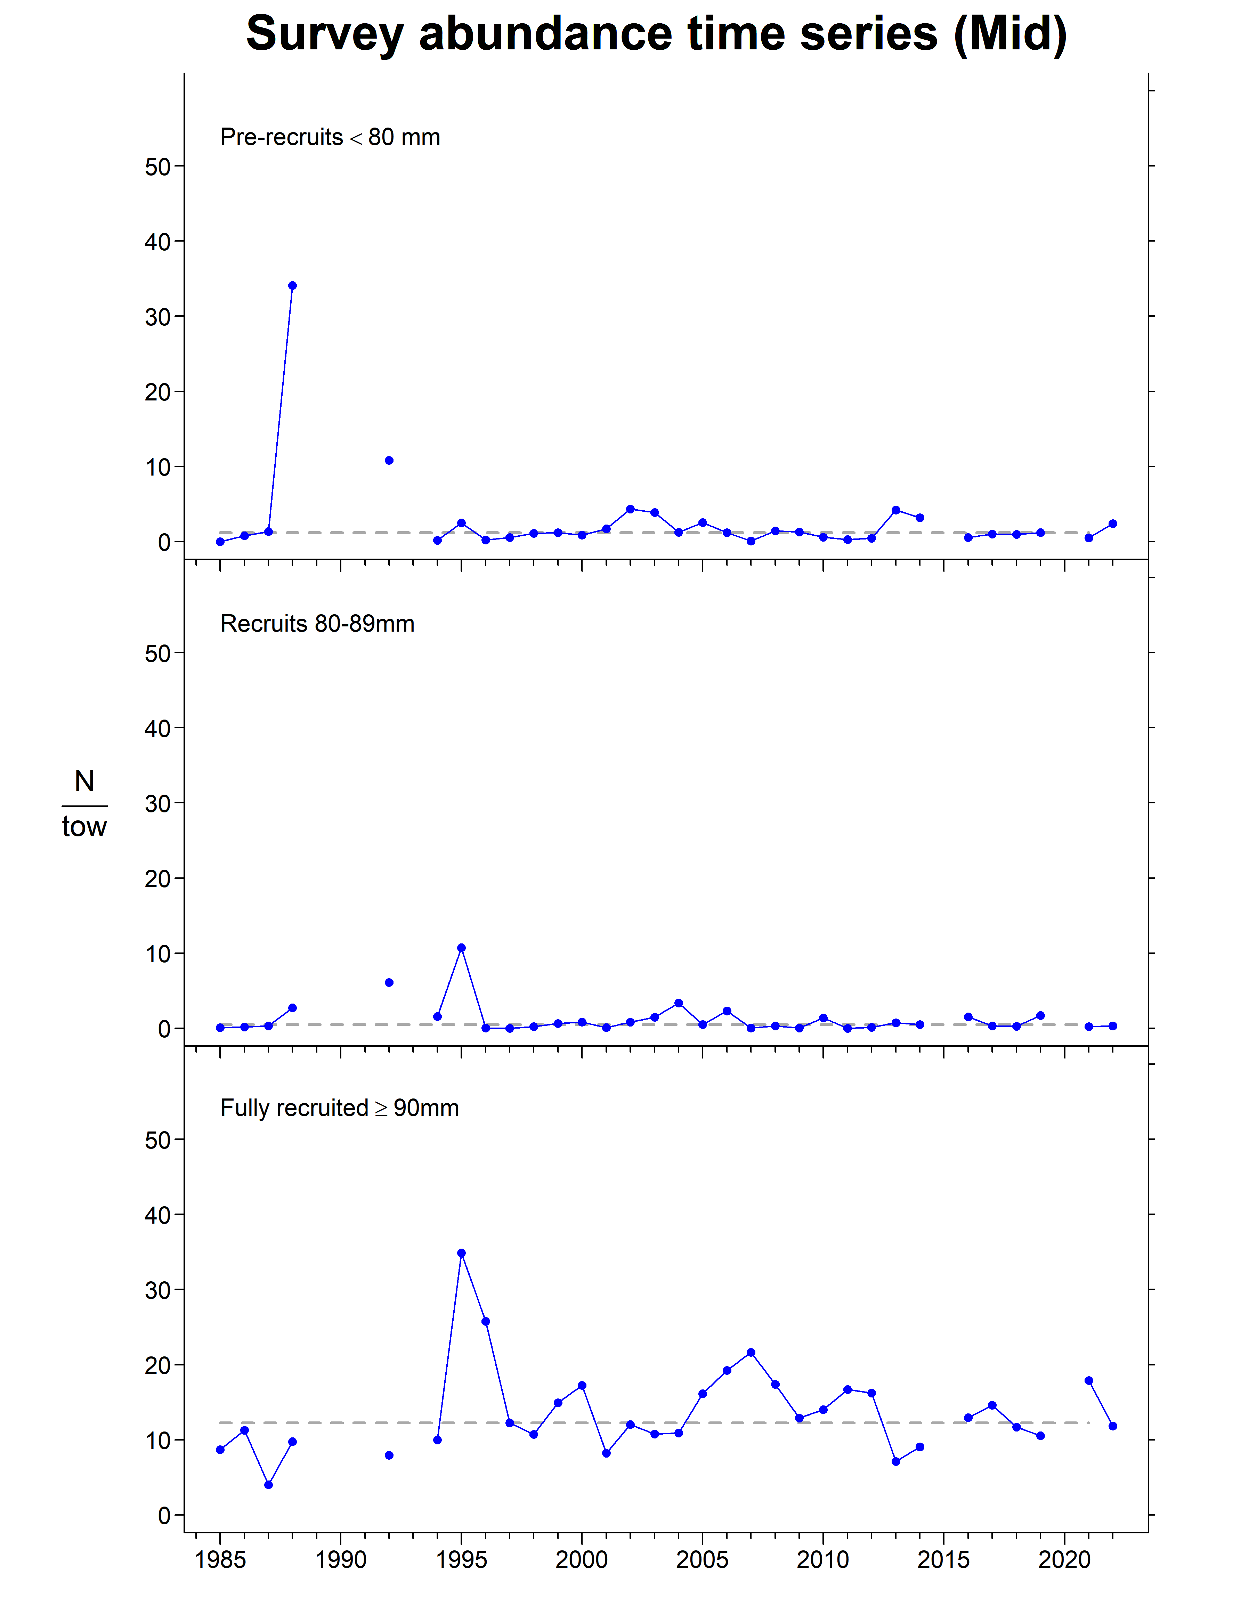
Middle Bank

Slide 6
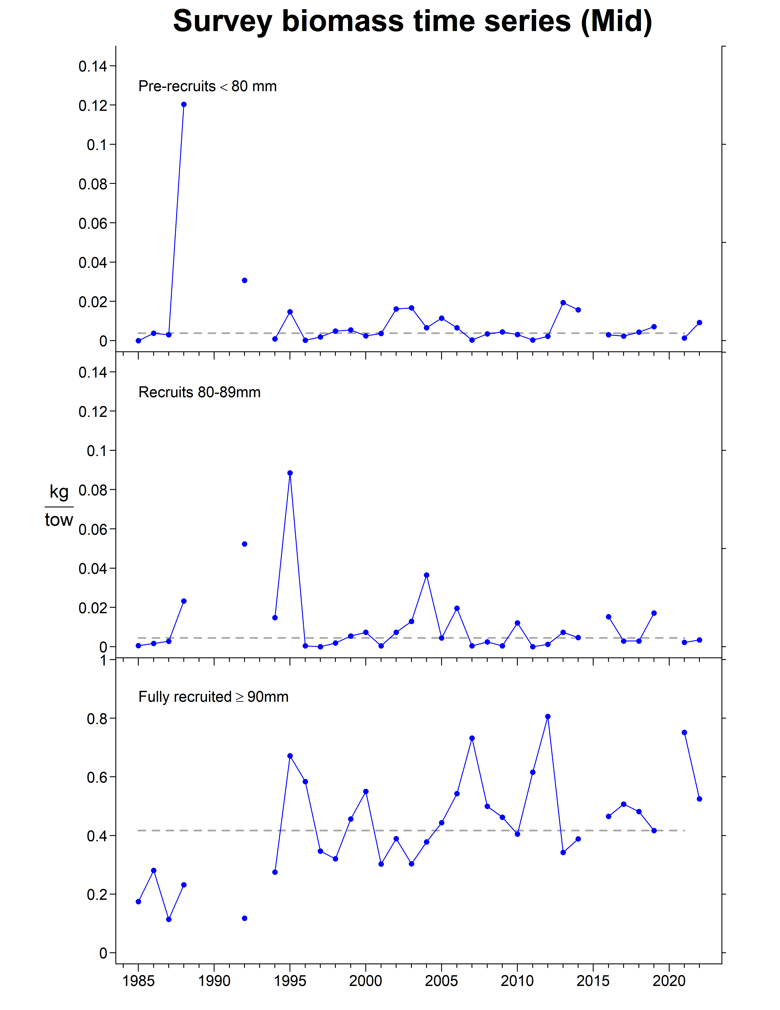
Middle Bank

Slide 7
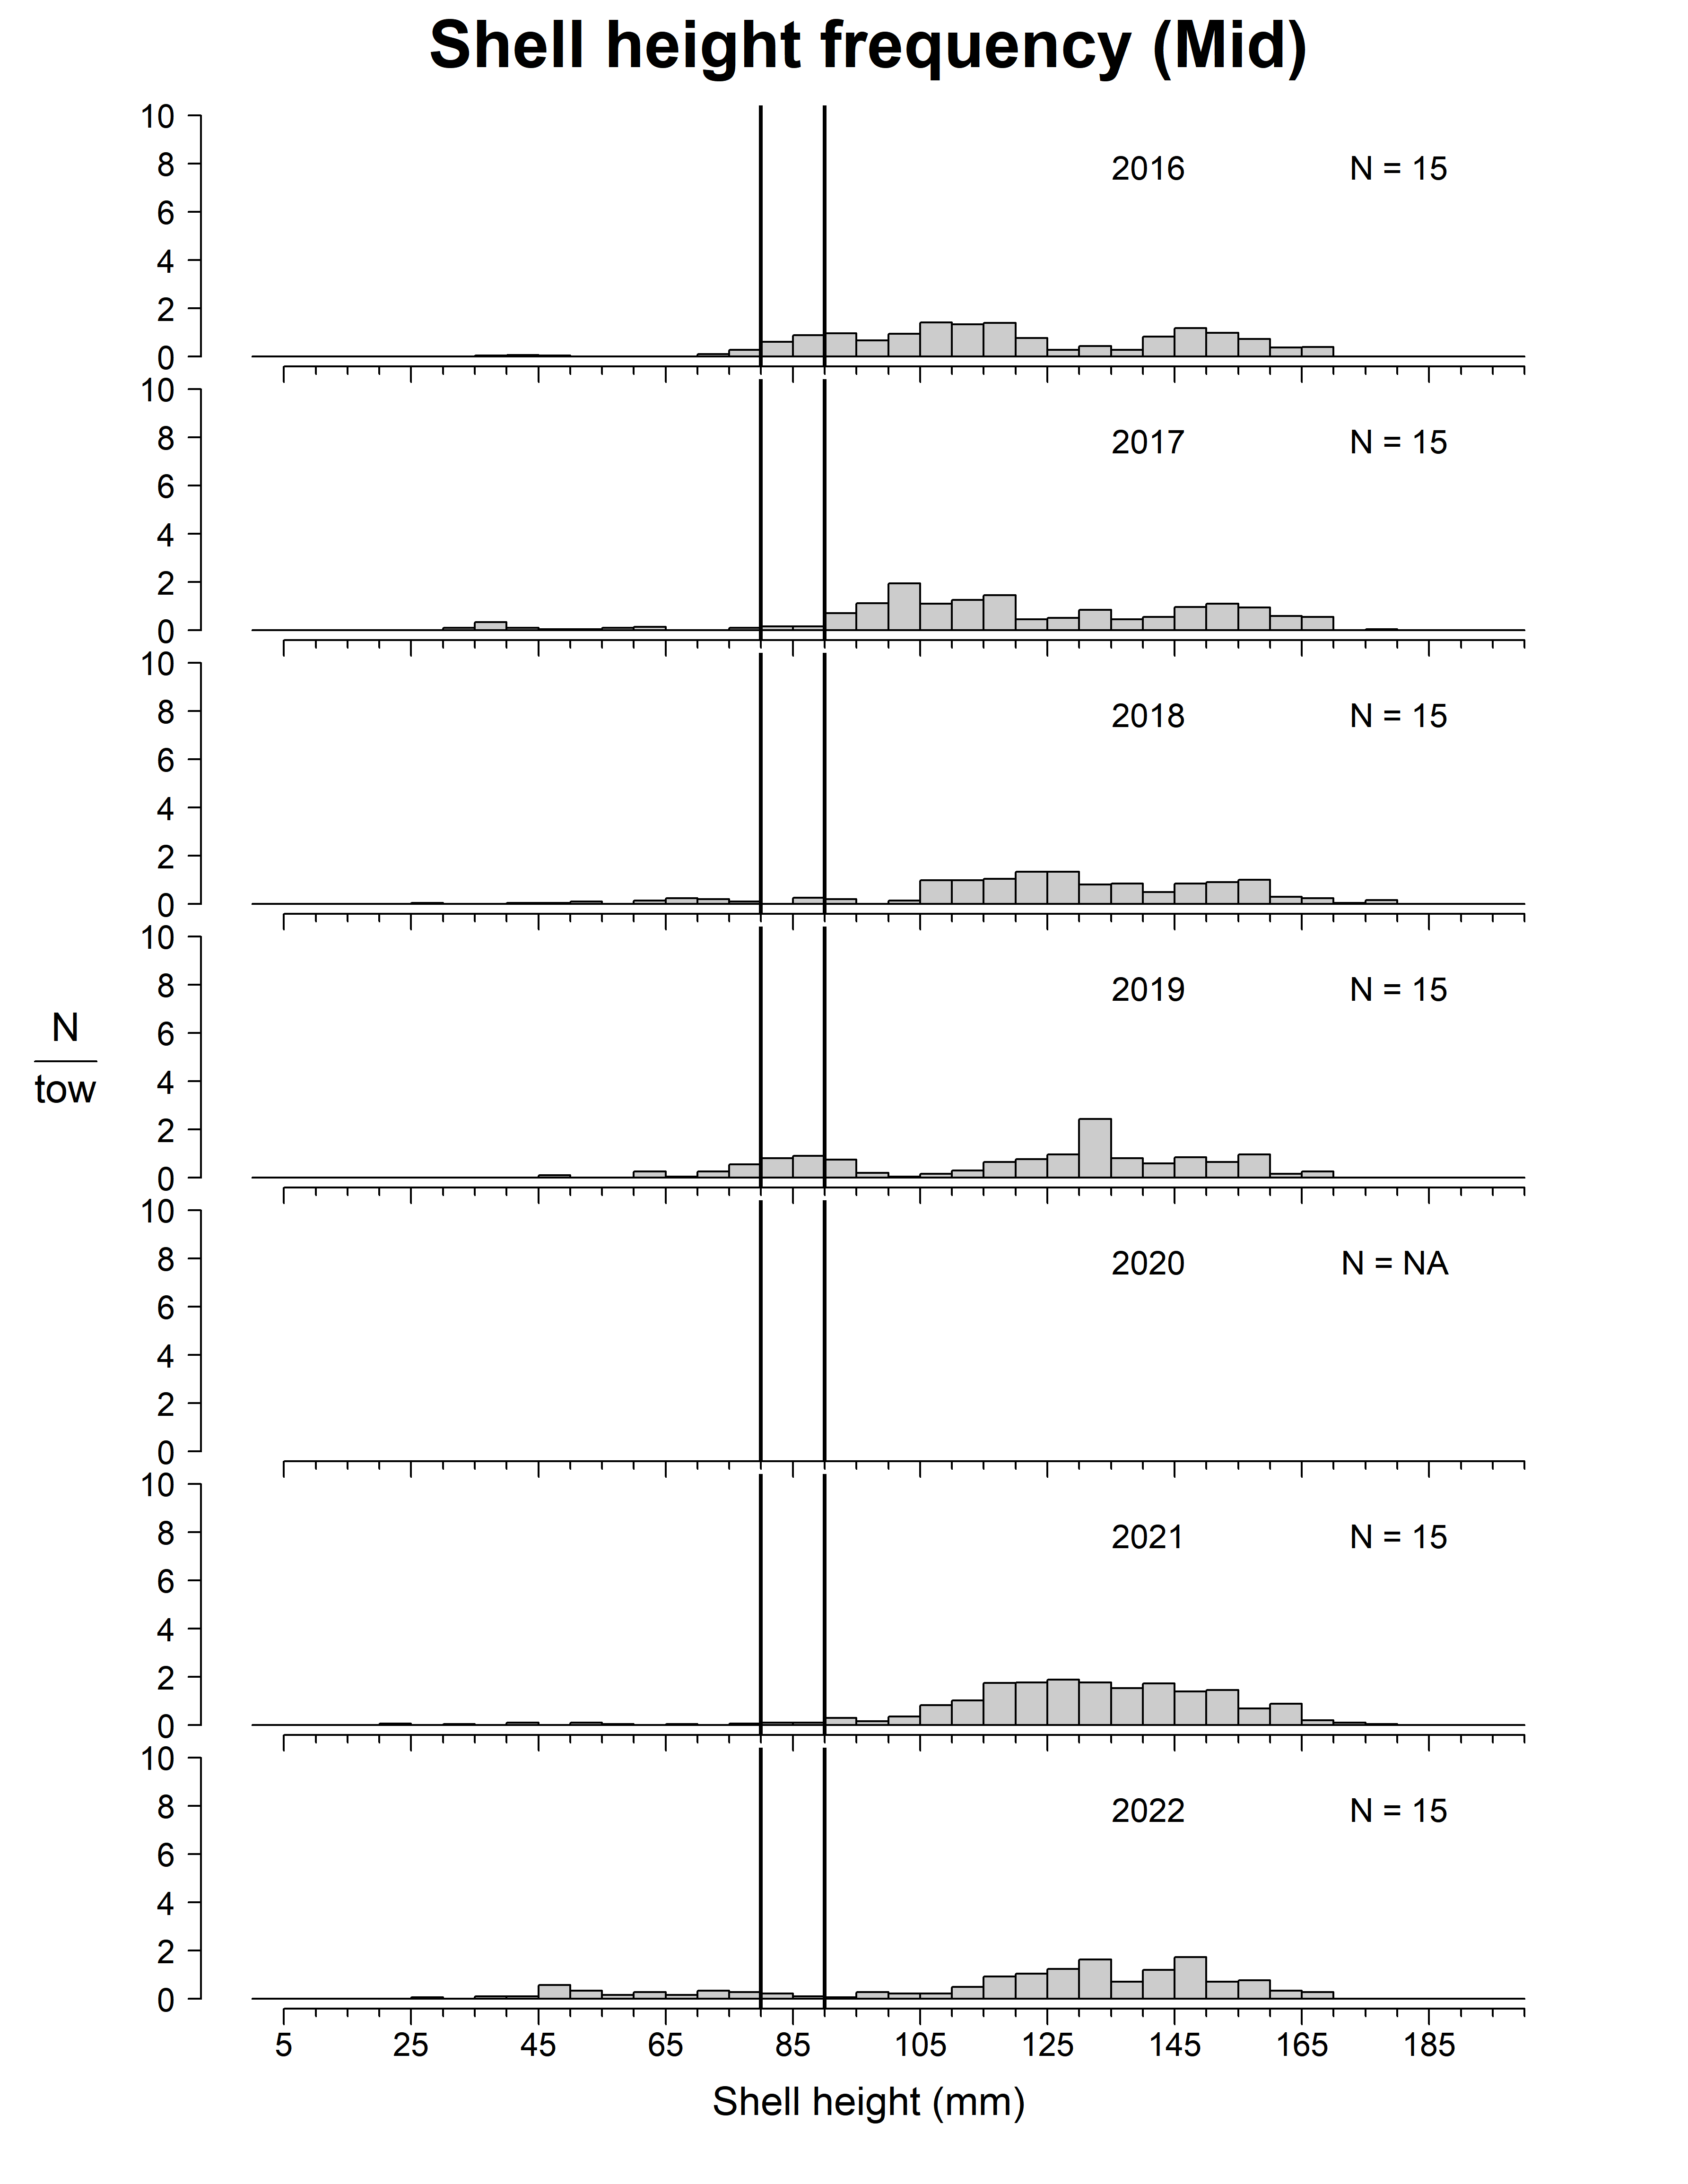
Middle Bank

Slide 8
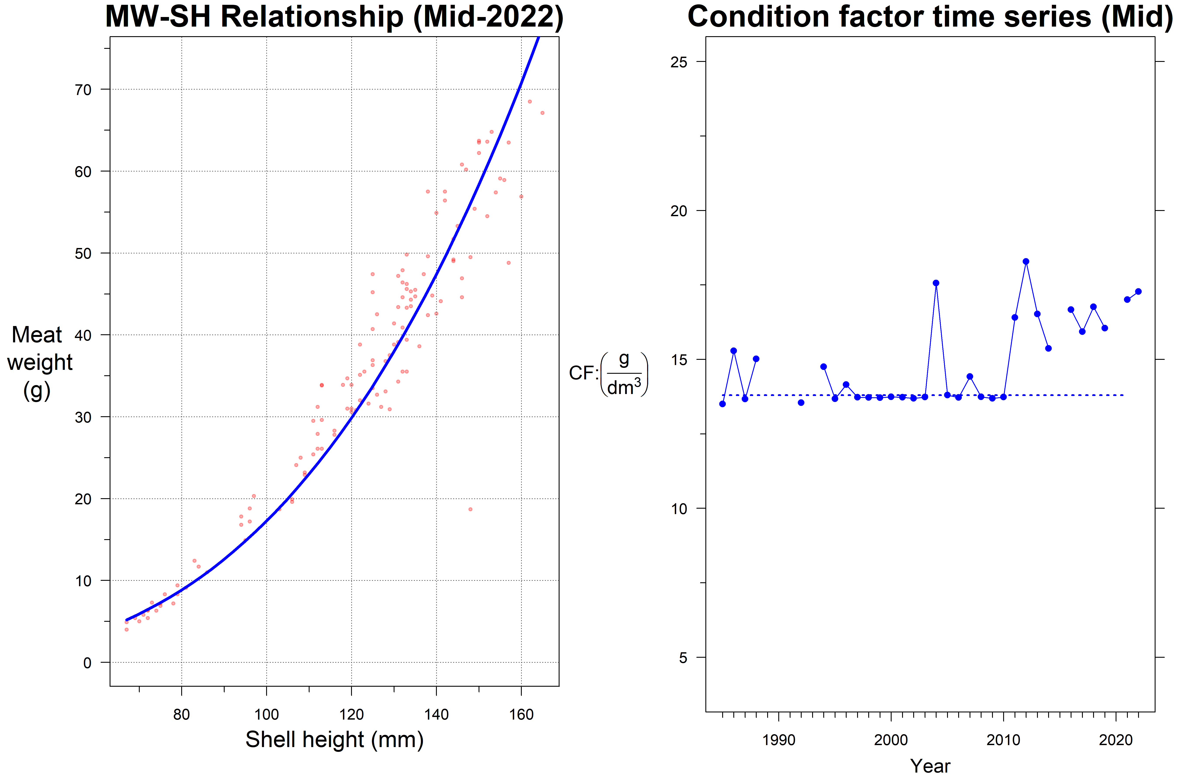
Middle Bank

Slide 9
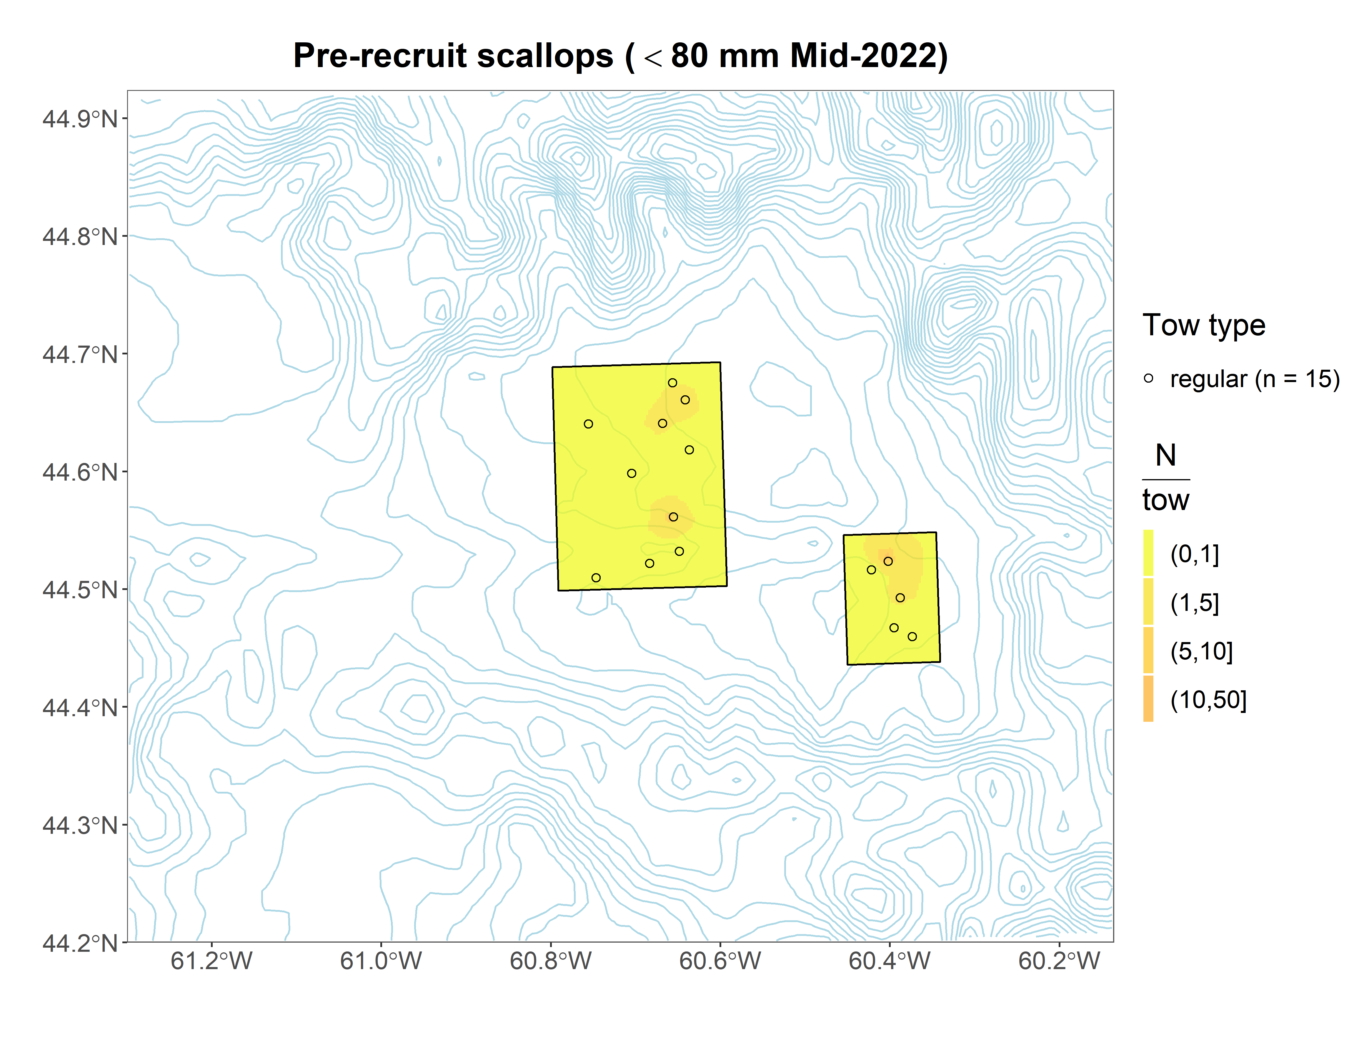
Middle Bank

Slide 10
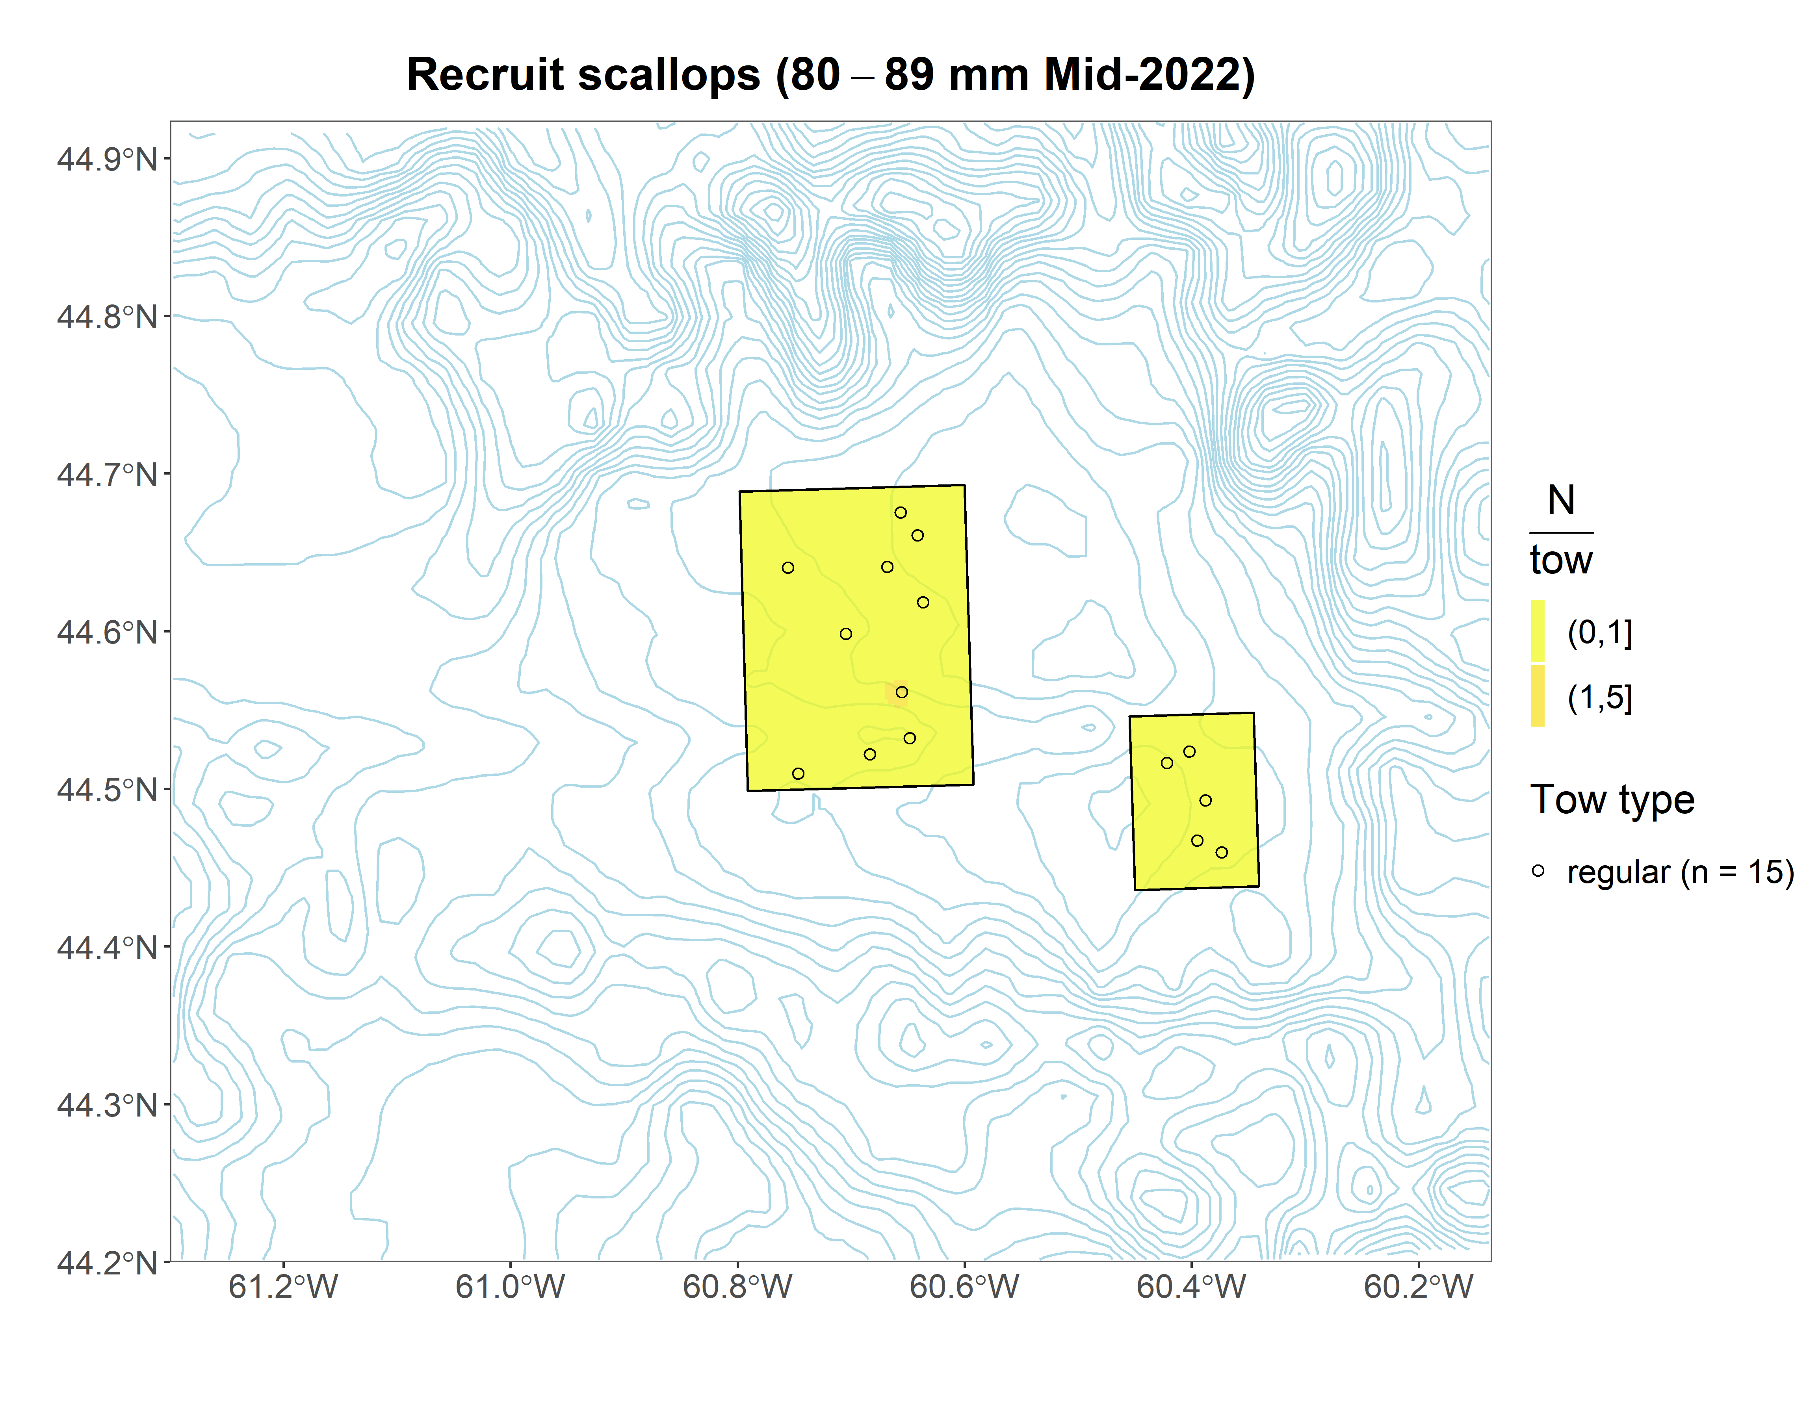
Middle Bank

Slide 11
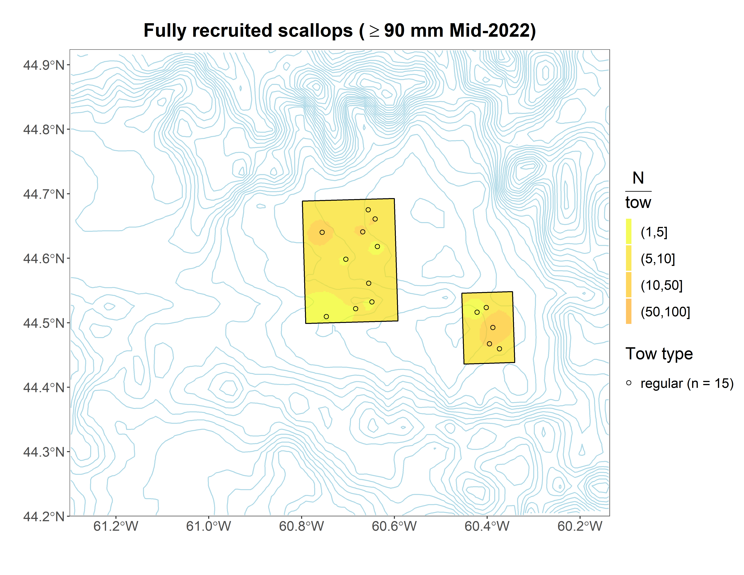
Middle Bank

Slide 12
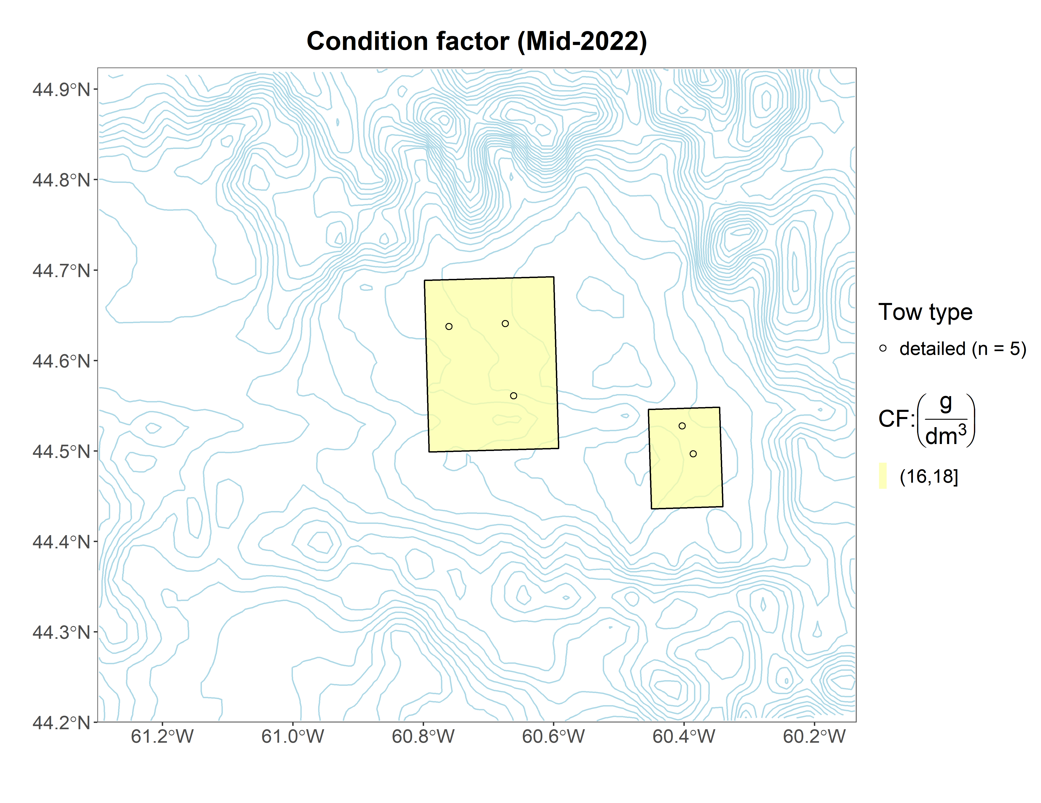
Middle Bank

Slide 13
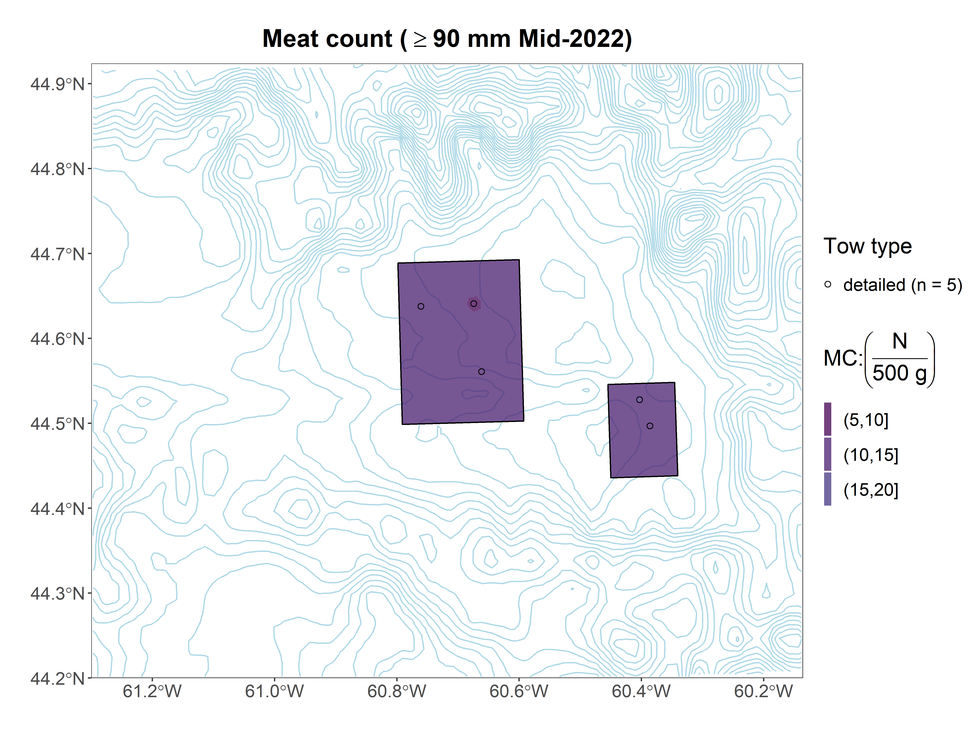
Middle Bank

Slide 14
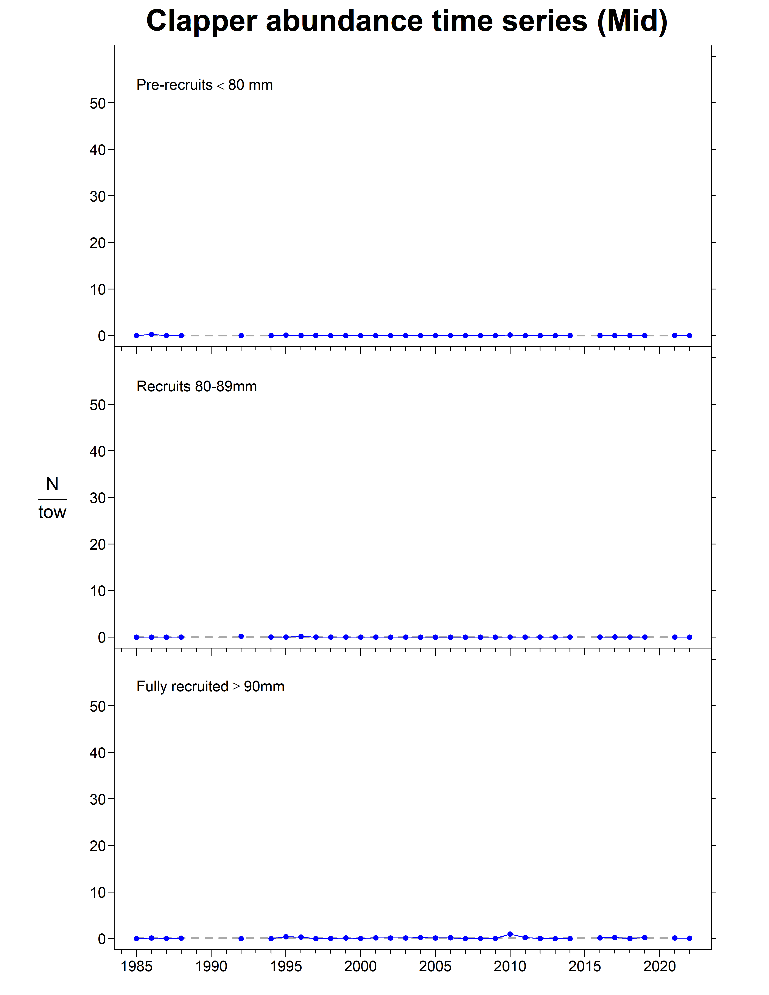
Middle Bank

Slide 15
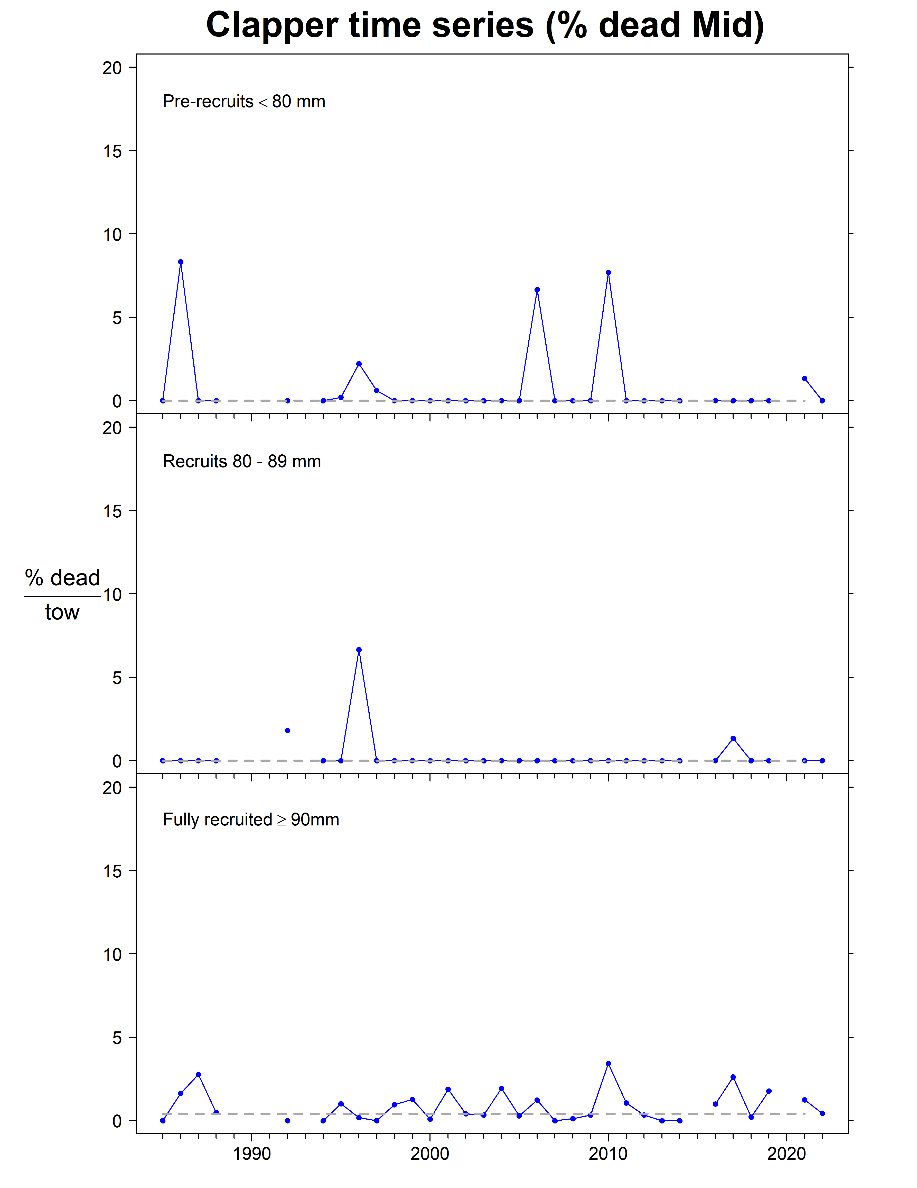
Middle Bank

Slide 16
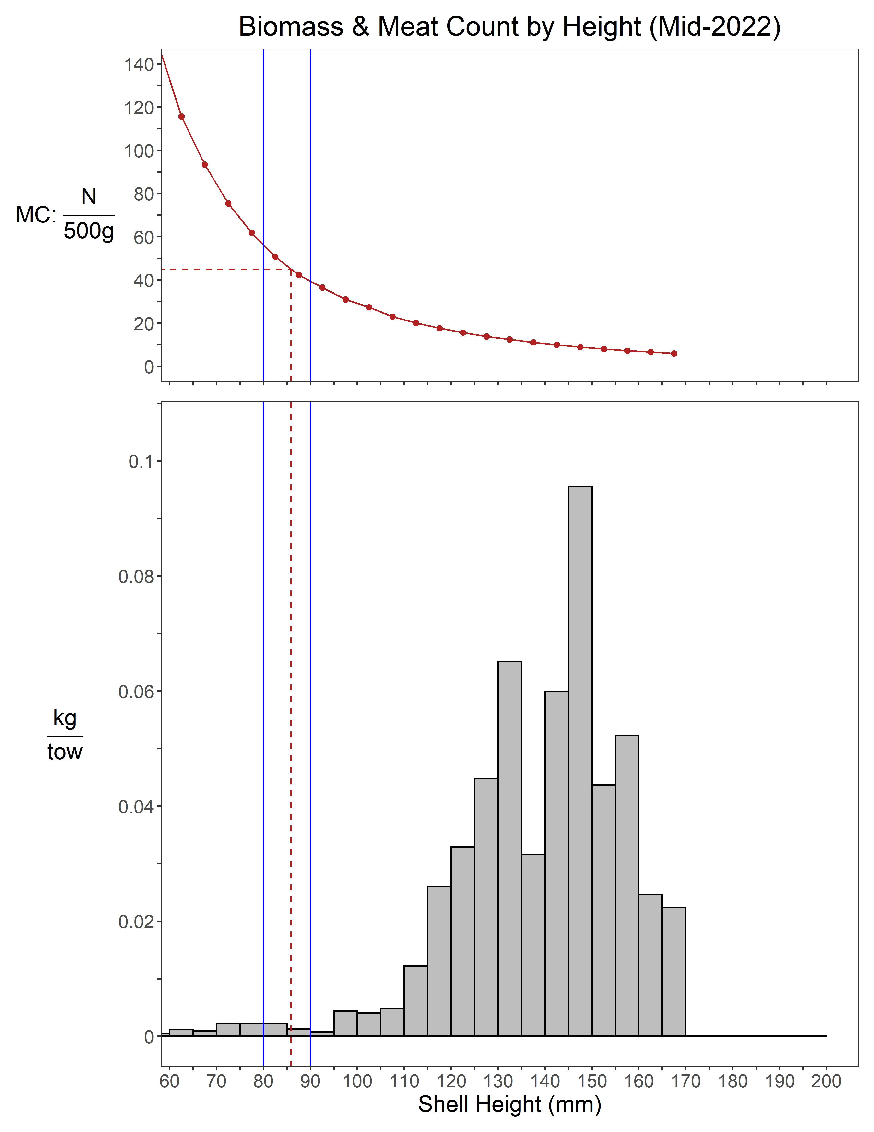
Middle Bank

Slide 17
Middle Bank
Summary
Abundance
Pre-recruit: +80% since 2021, above LTM
Recruit: +37% since 2021, below LTM
Fully-recruited: -34% since 2021, near LTM
Biomass
Pre-recruit: +86% since 2021, above LTM
Recruit: +37% since 2021, below LTM
Fully-recruited: -30% since 2021, above LTM
Condition factor
was similar to 2021, above LTM

Slide 18
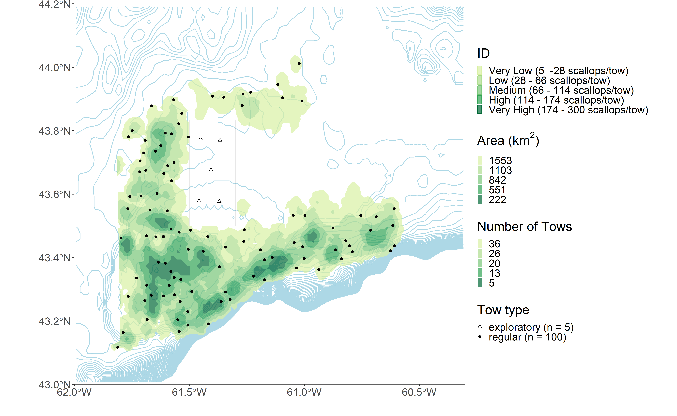
Sable Bank

Slide 19
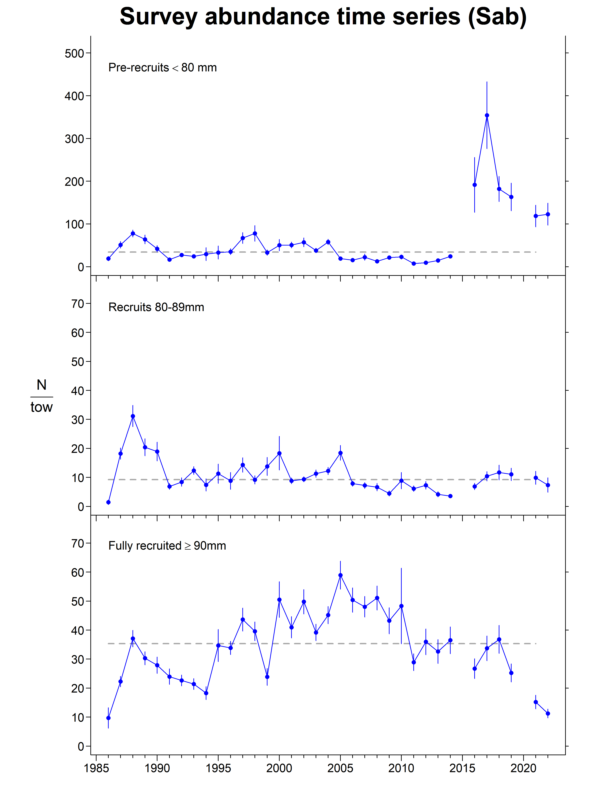
Sable Bank

Slide 20
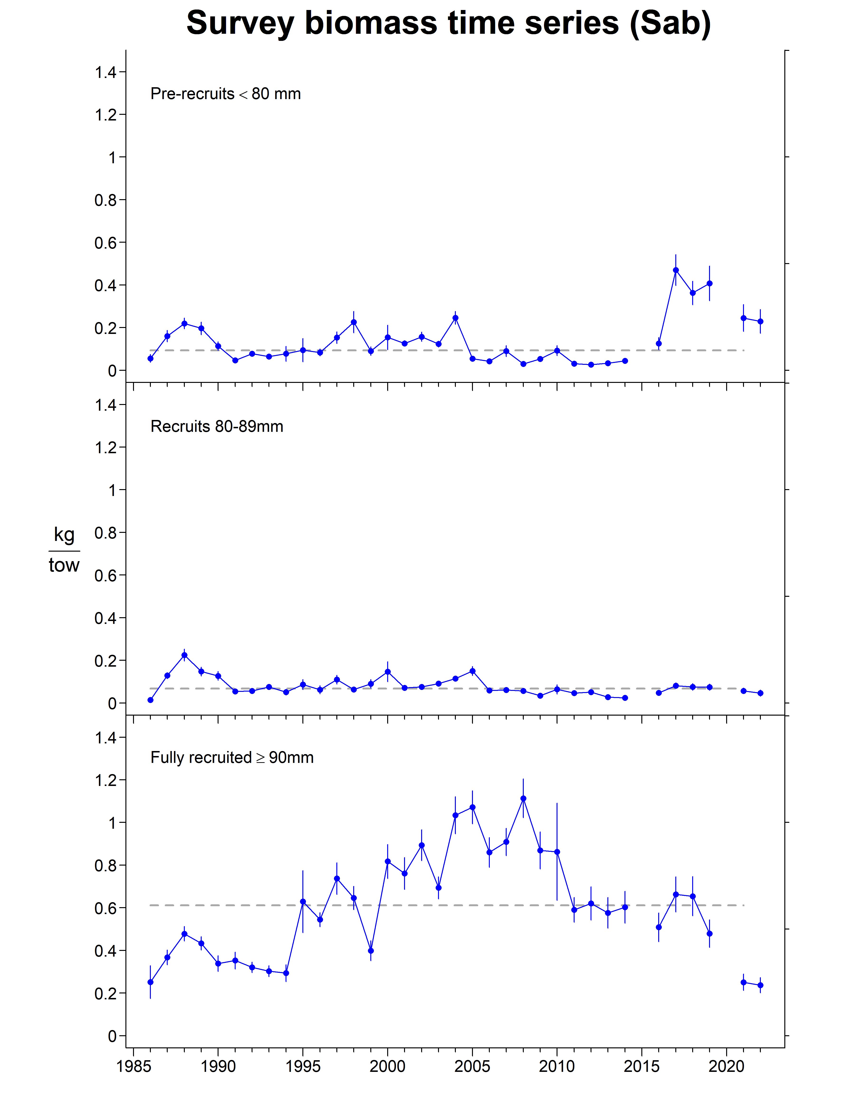
Sable Bank

Slide 21
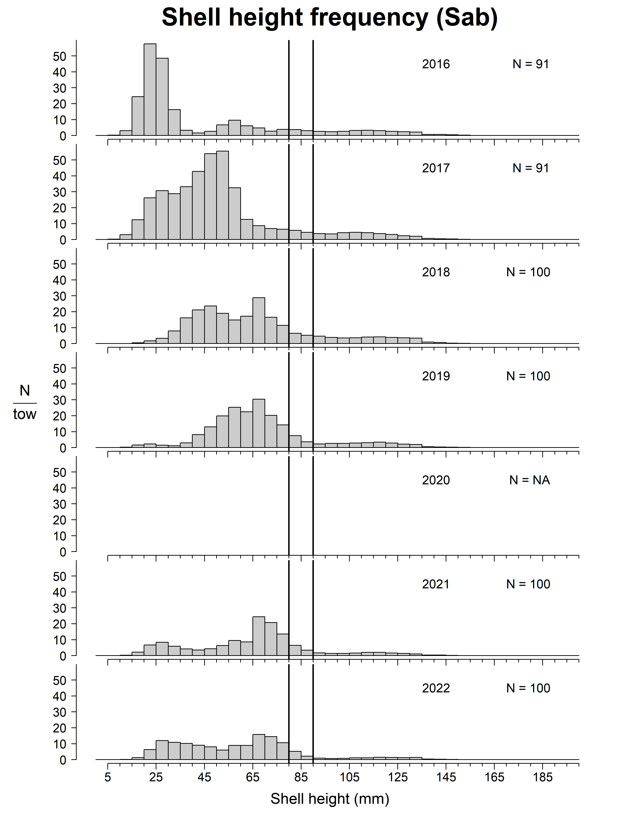
Sable Bank

Slide 22
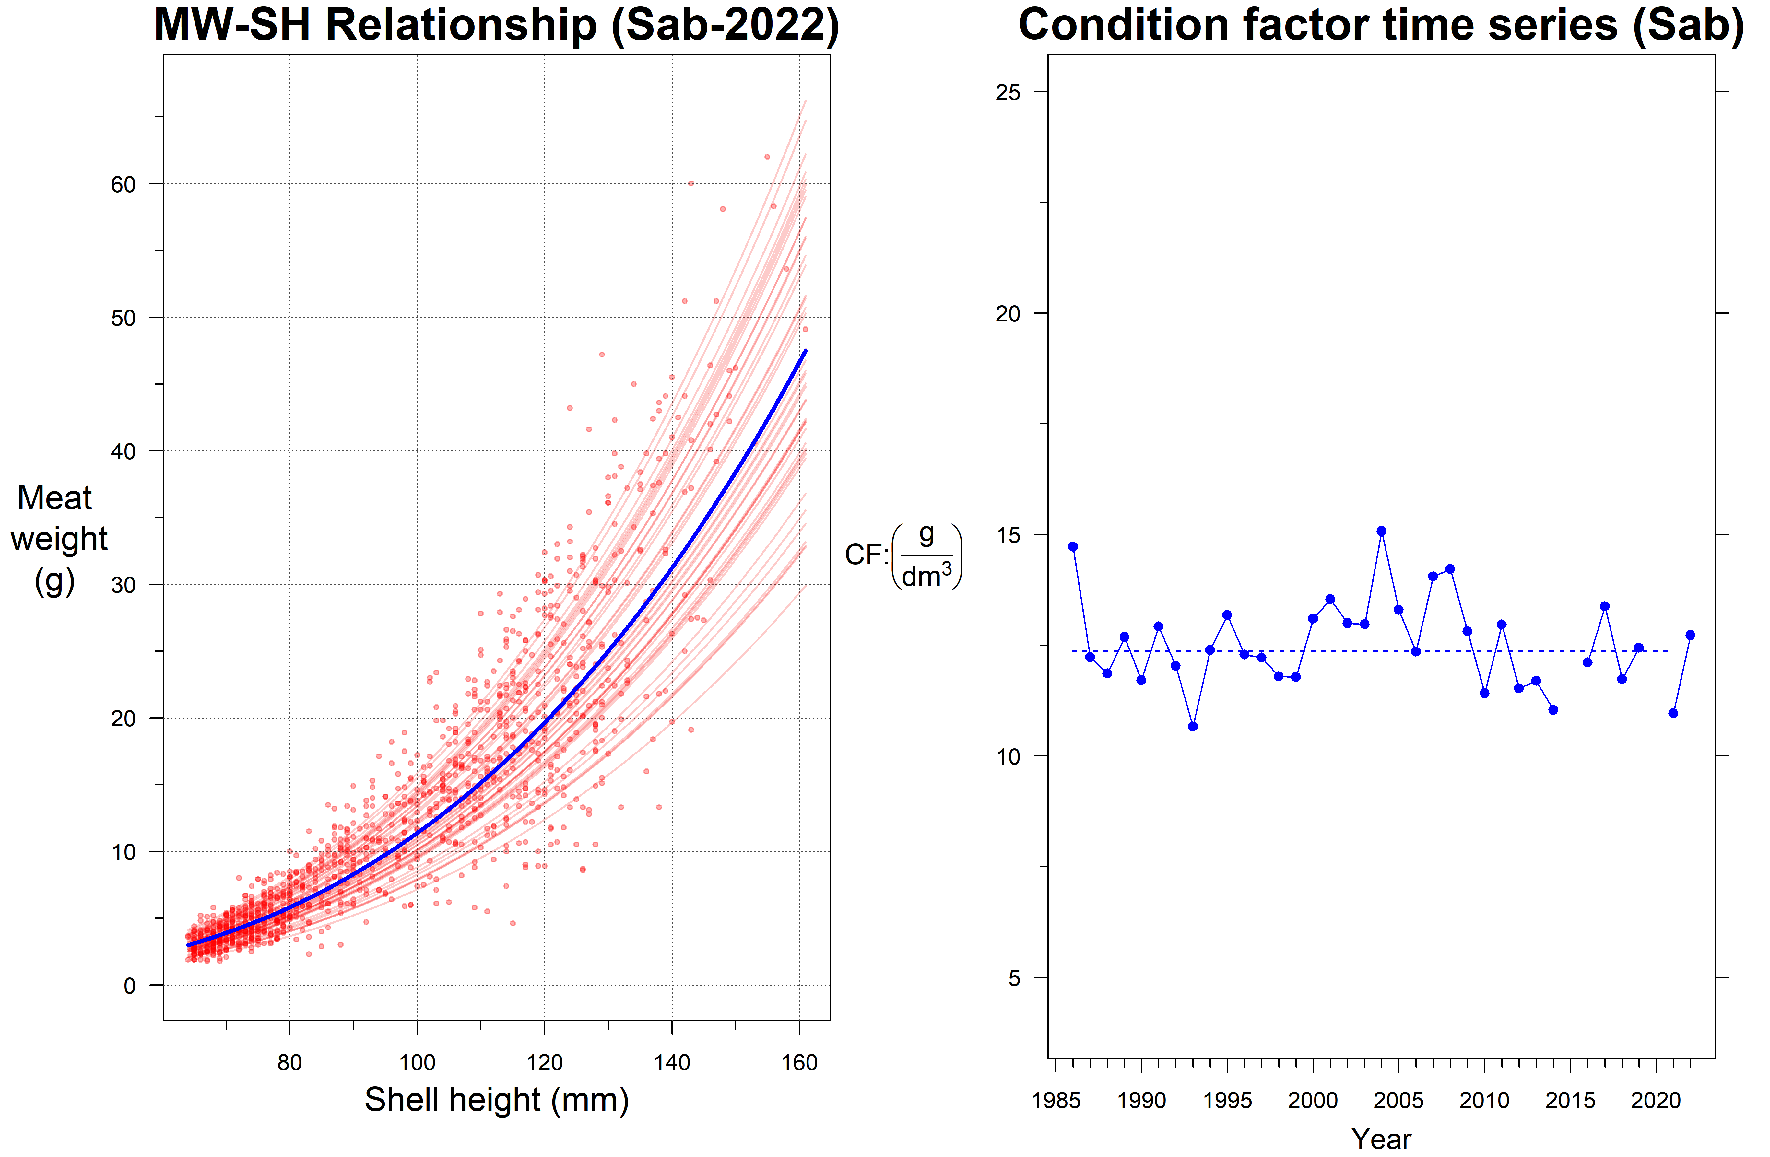
Sable Bank

Slide 23
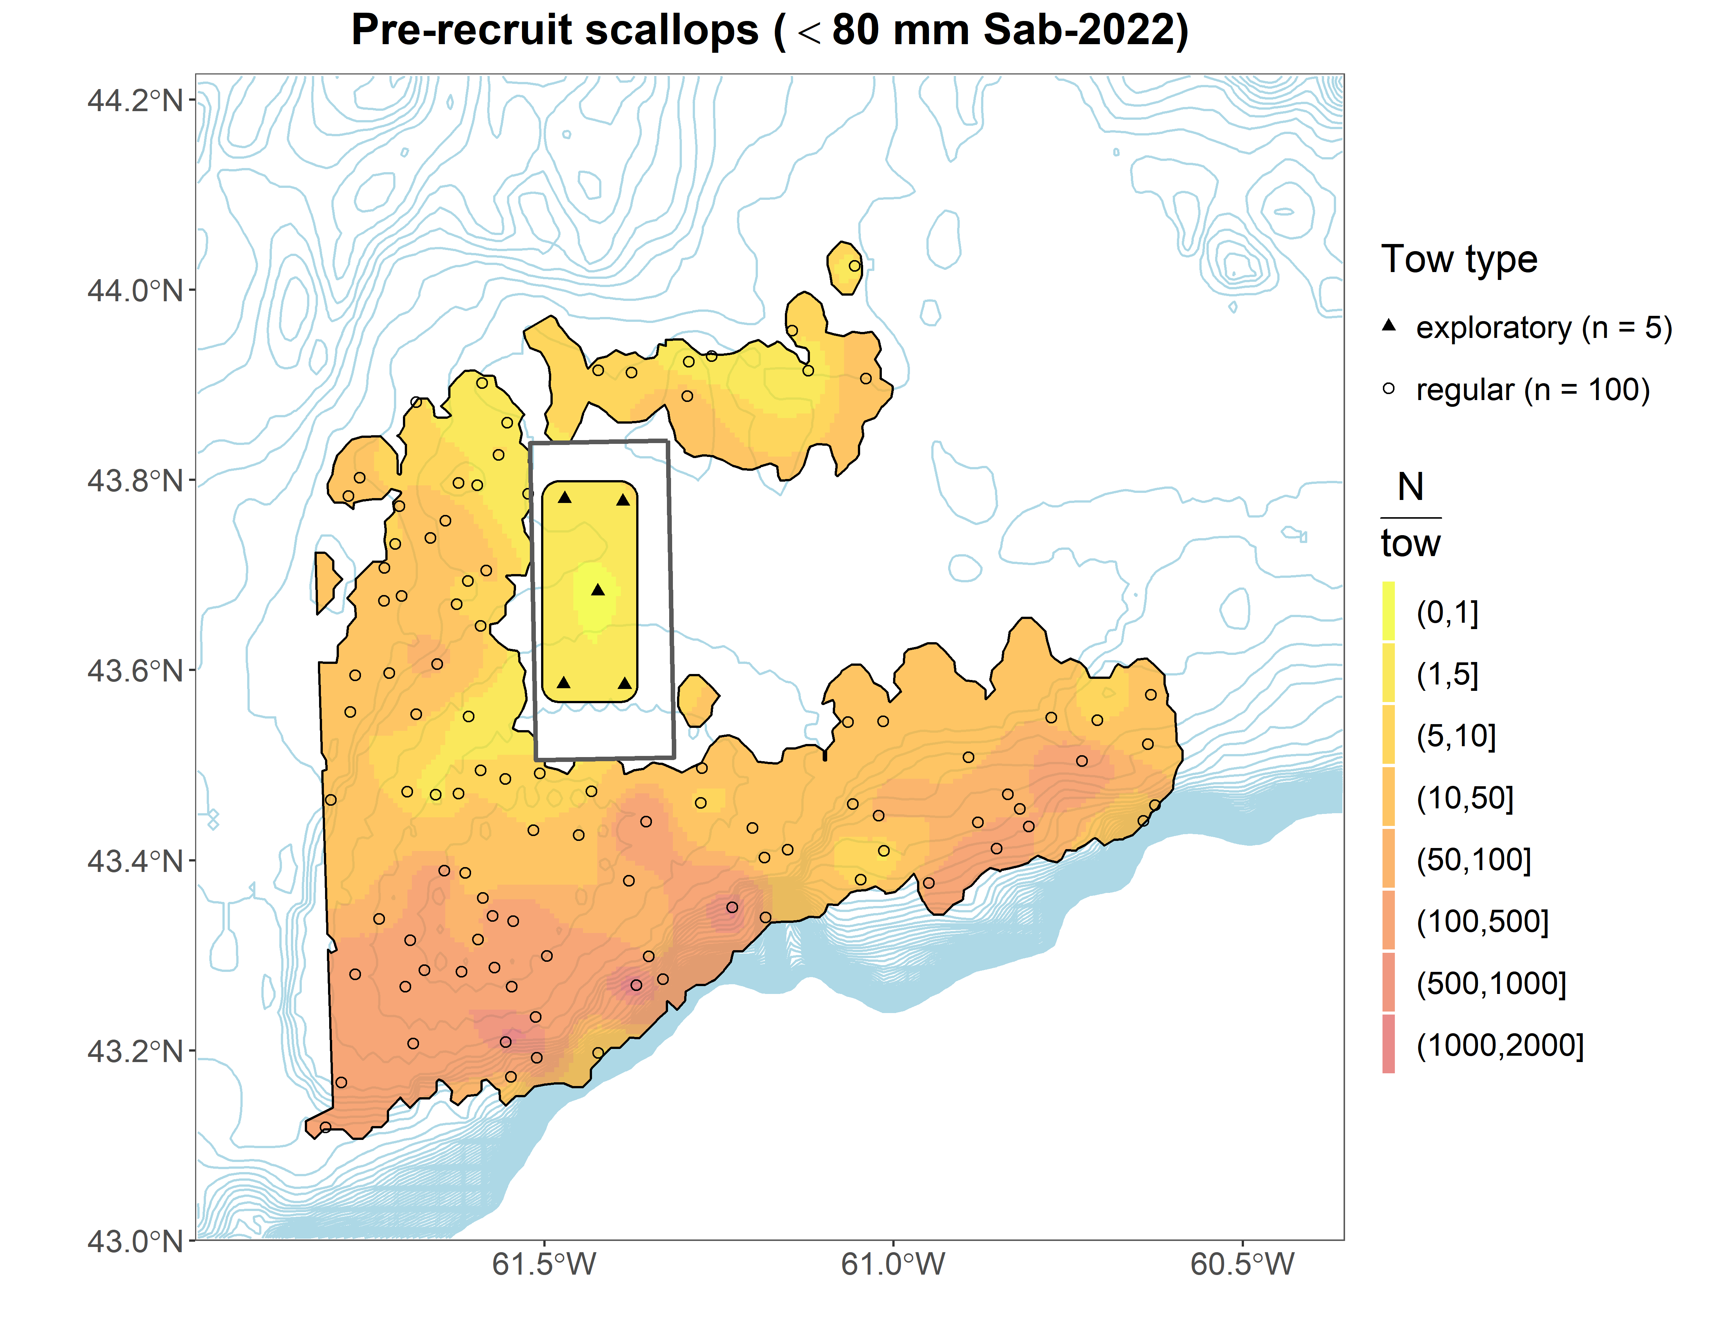
Sable Bank

Slide 24
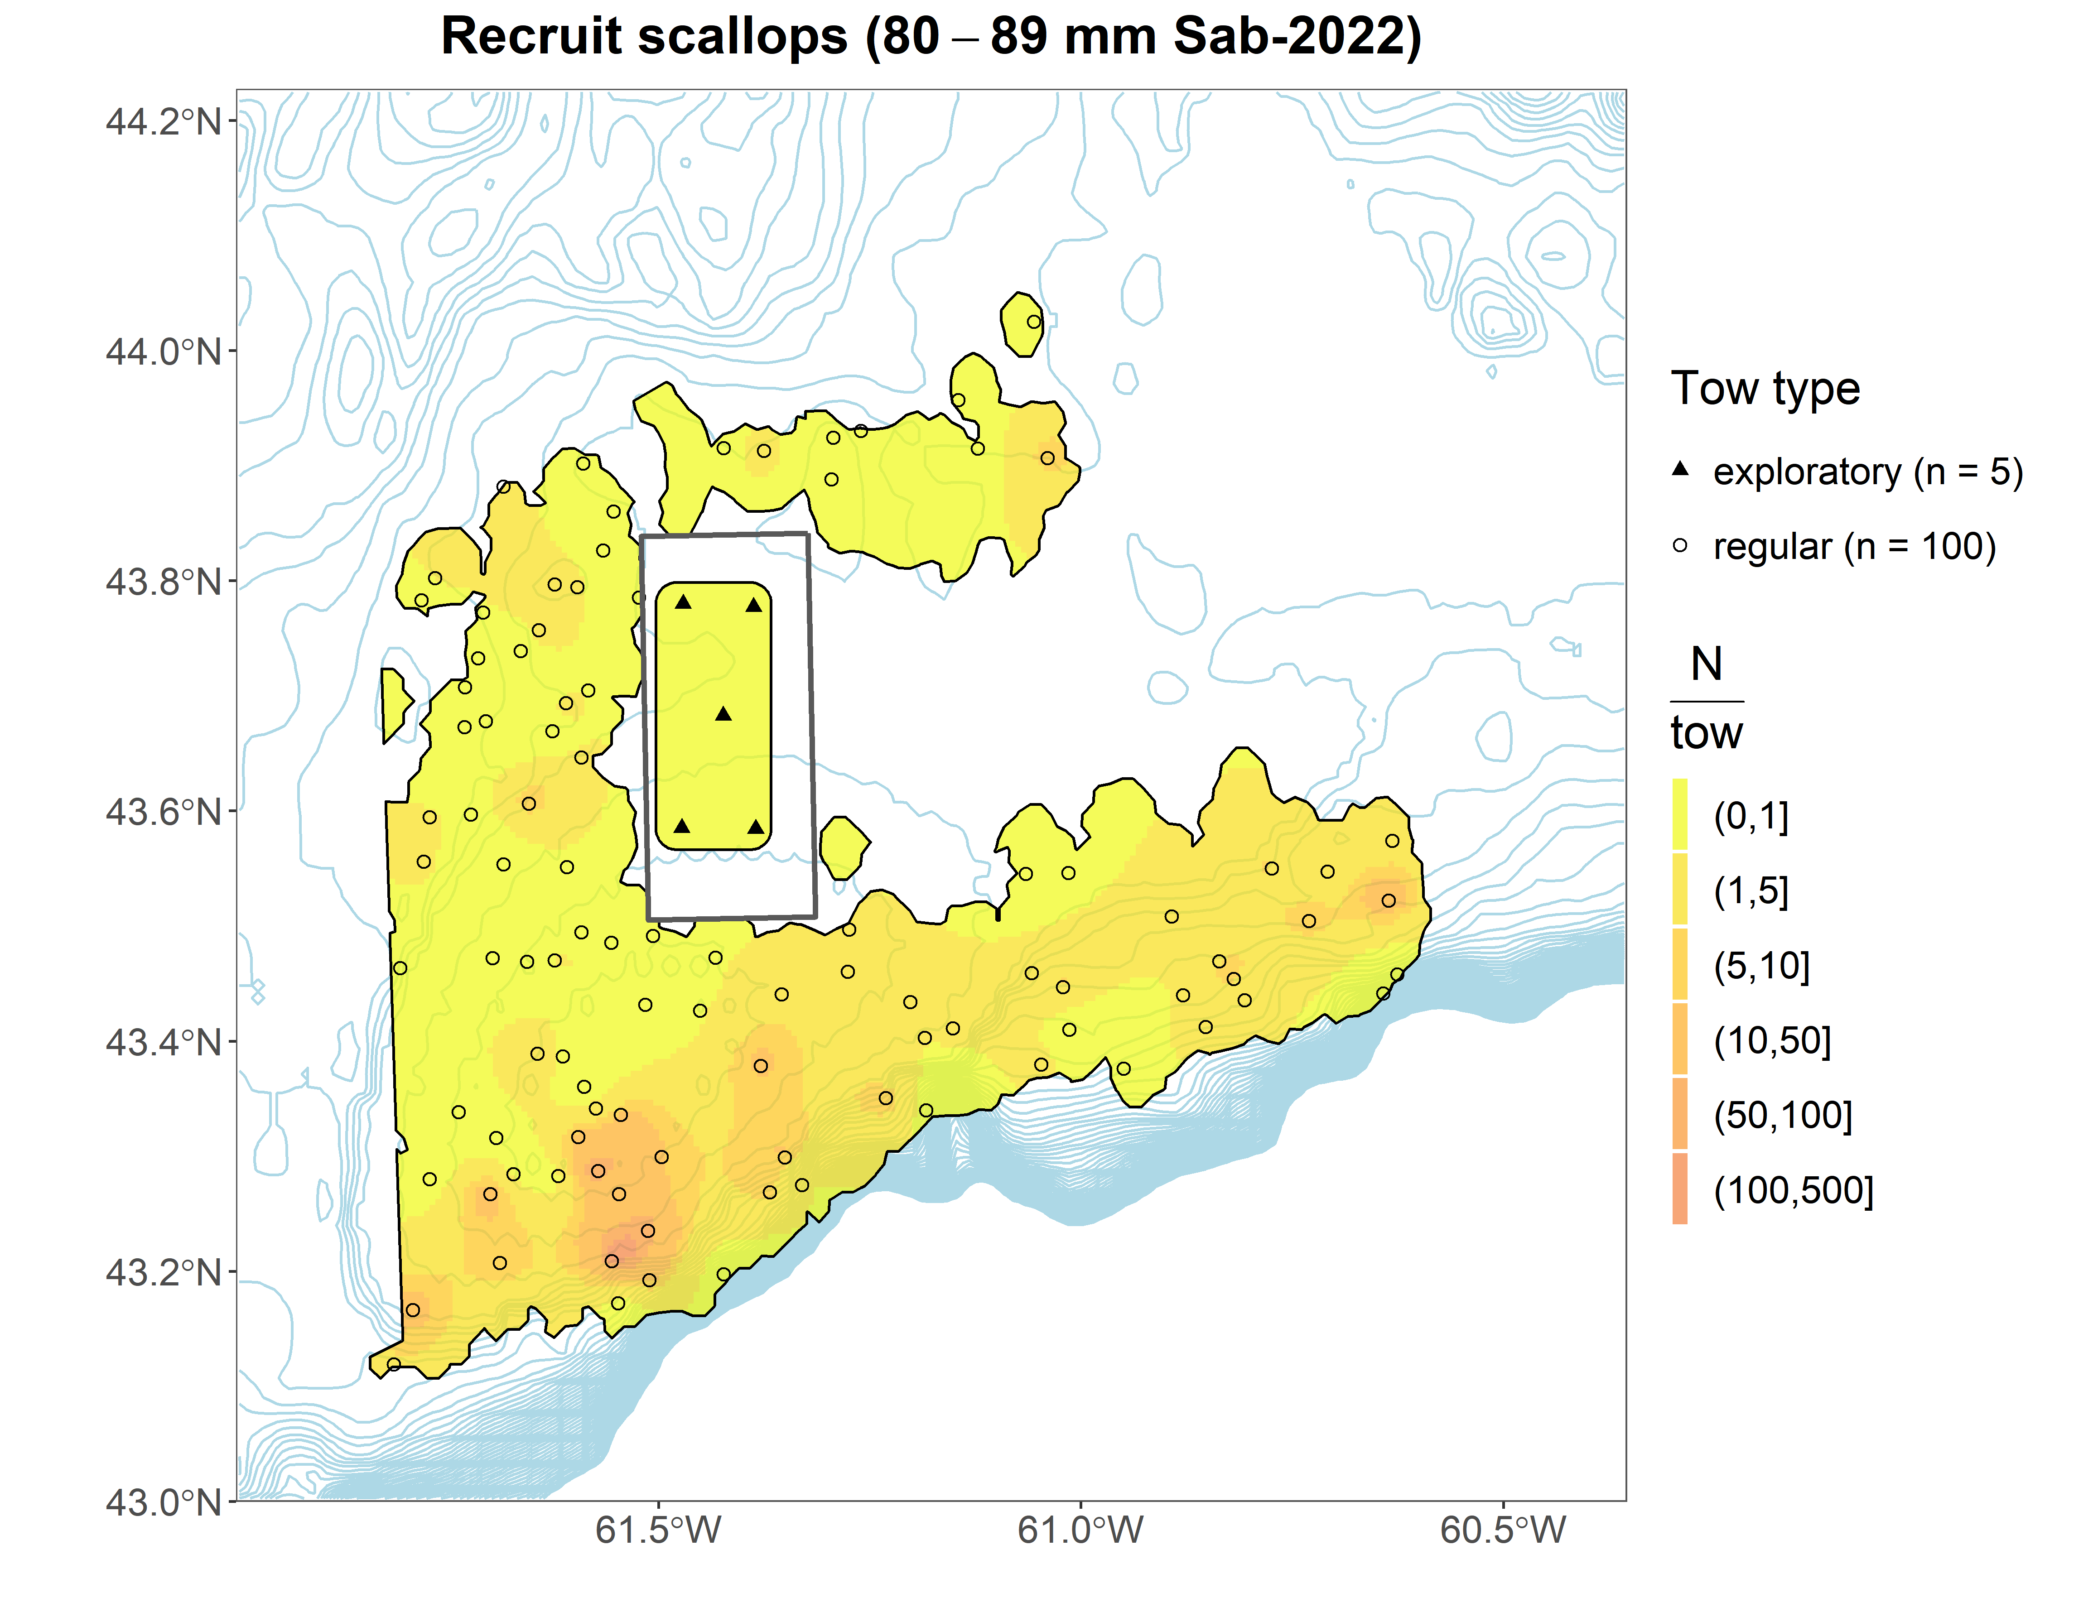
Sable Bank

Slide 25
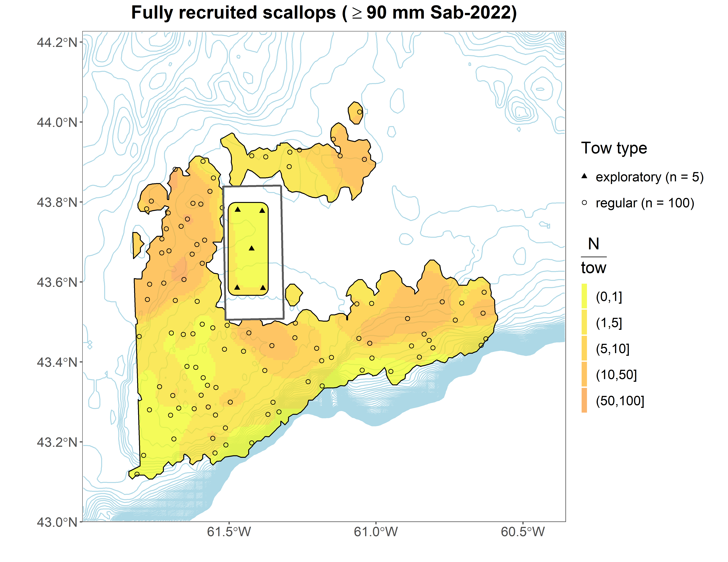
Sable Bank

Slide 26
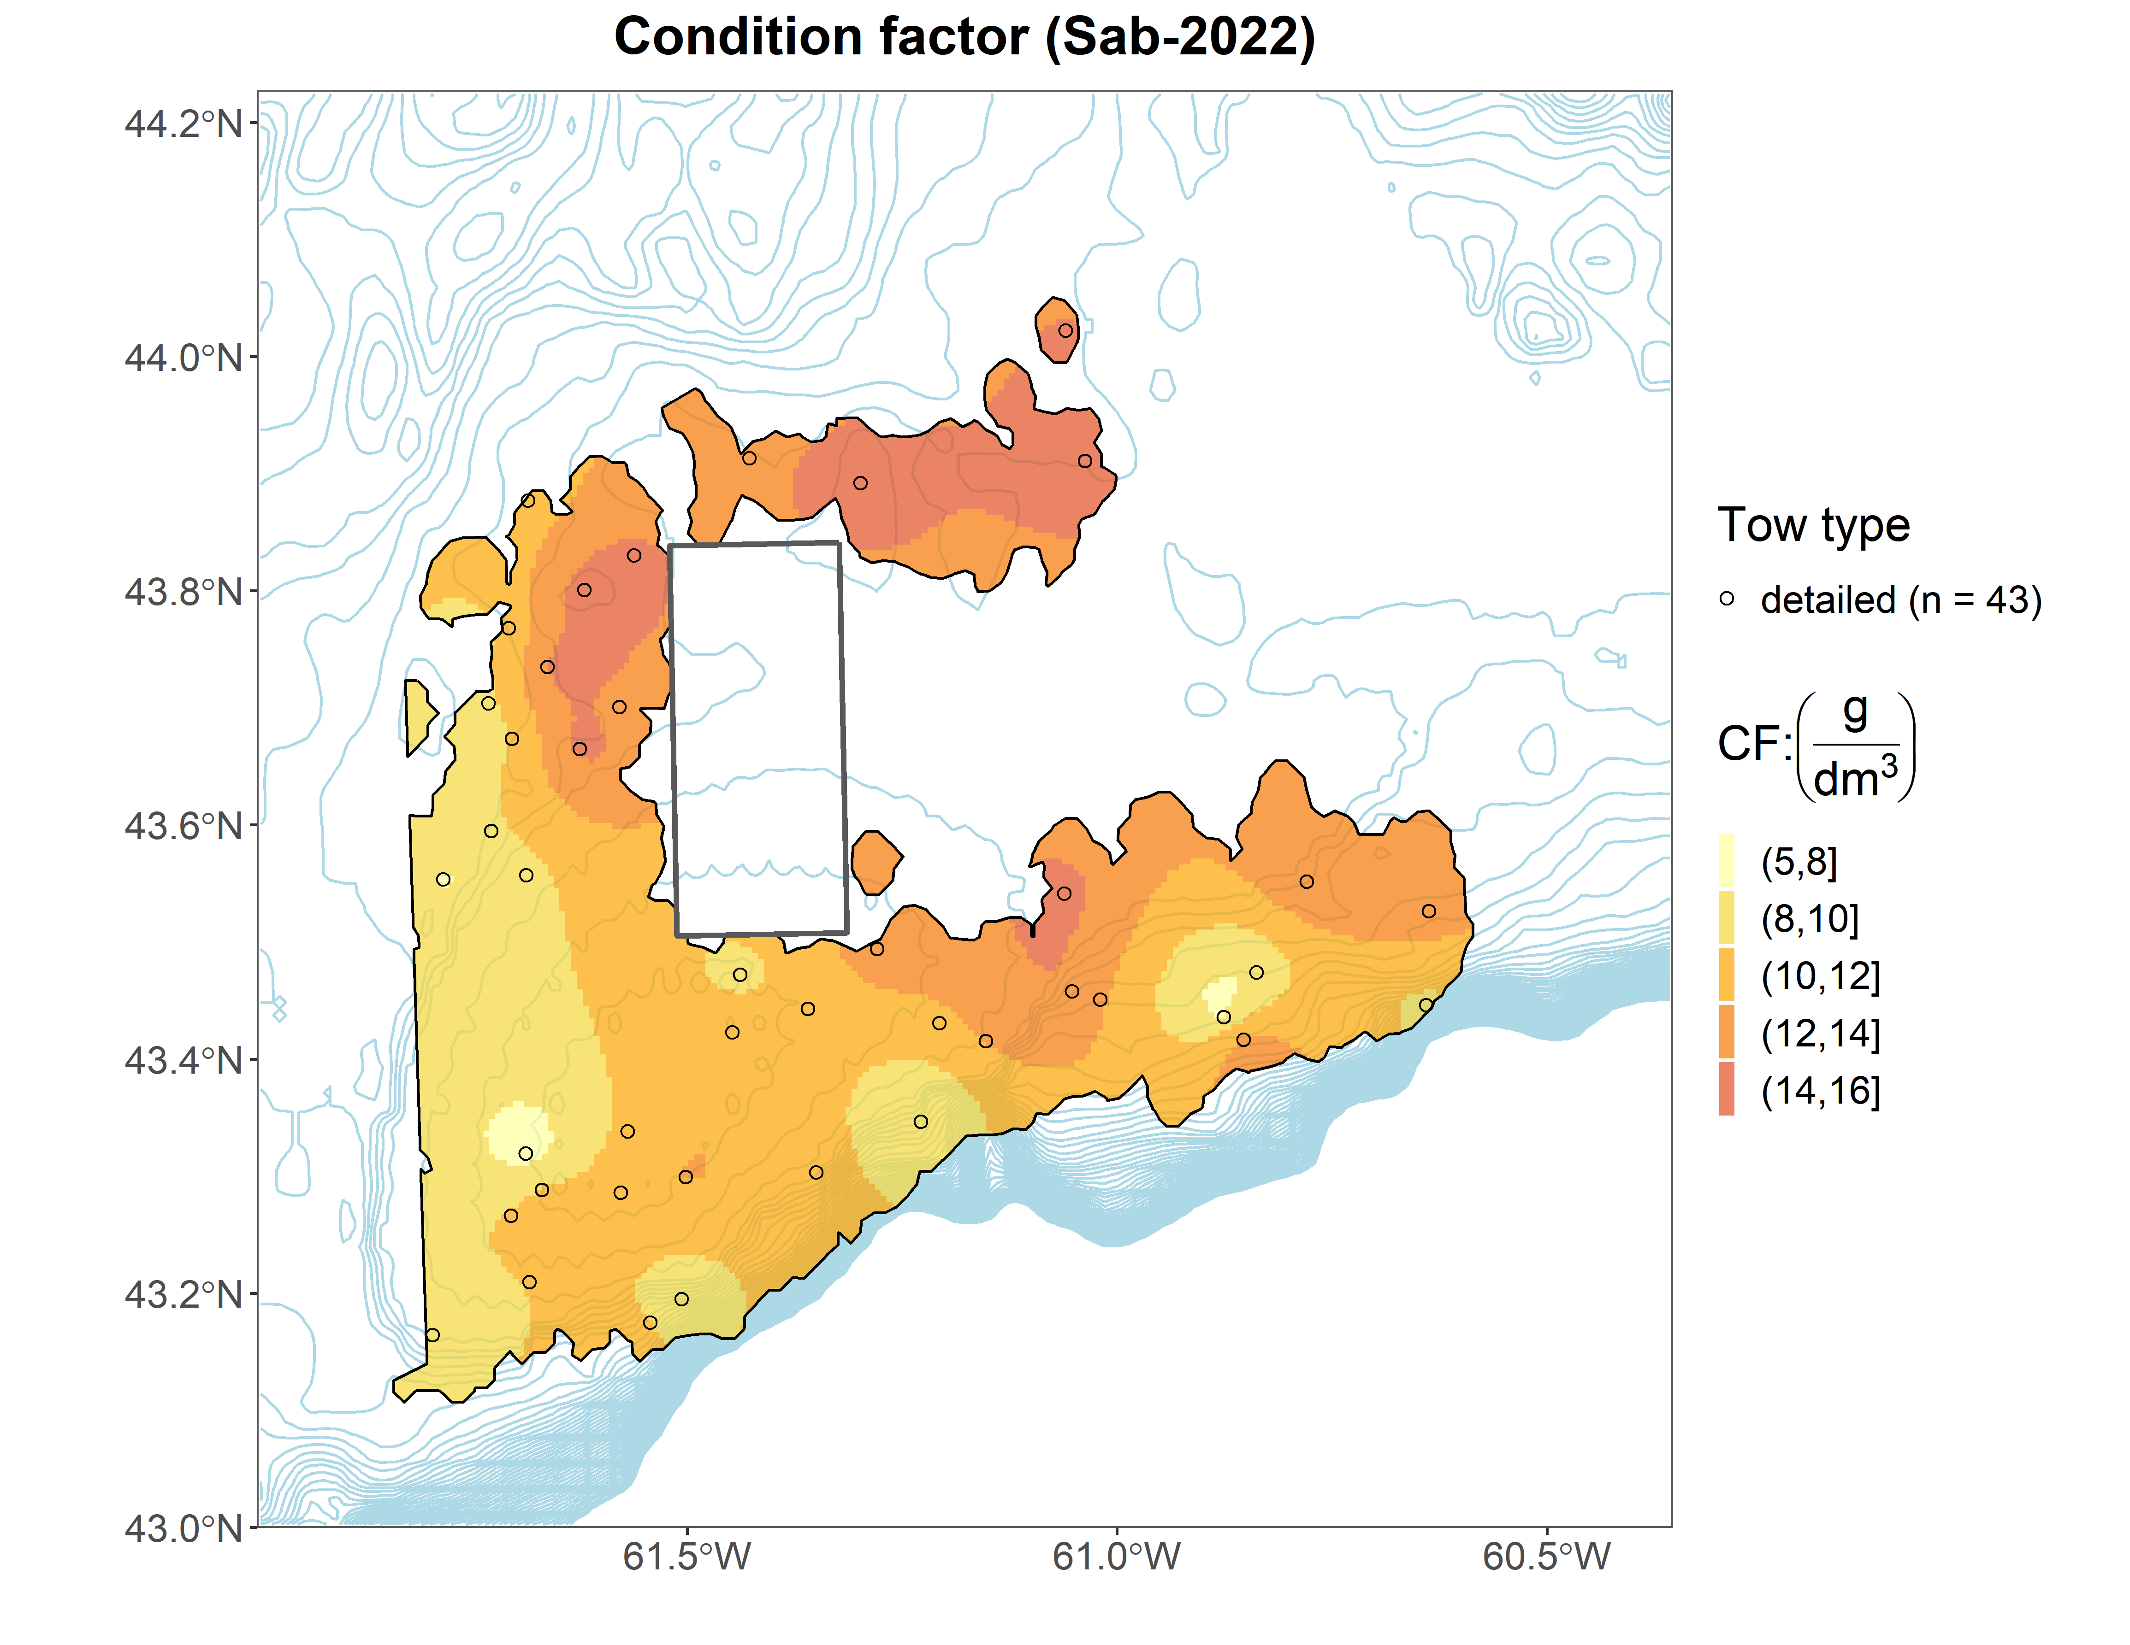
Sable Bank

Slide 27
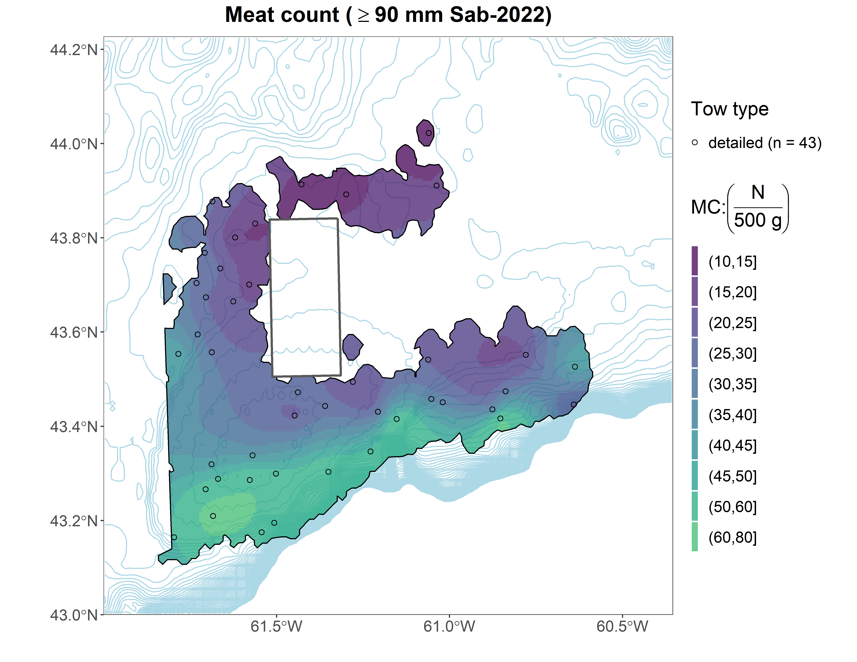
Sable Bank

Slide 28
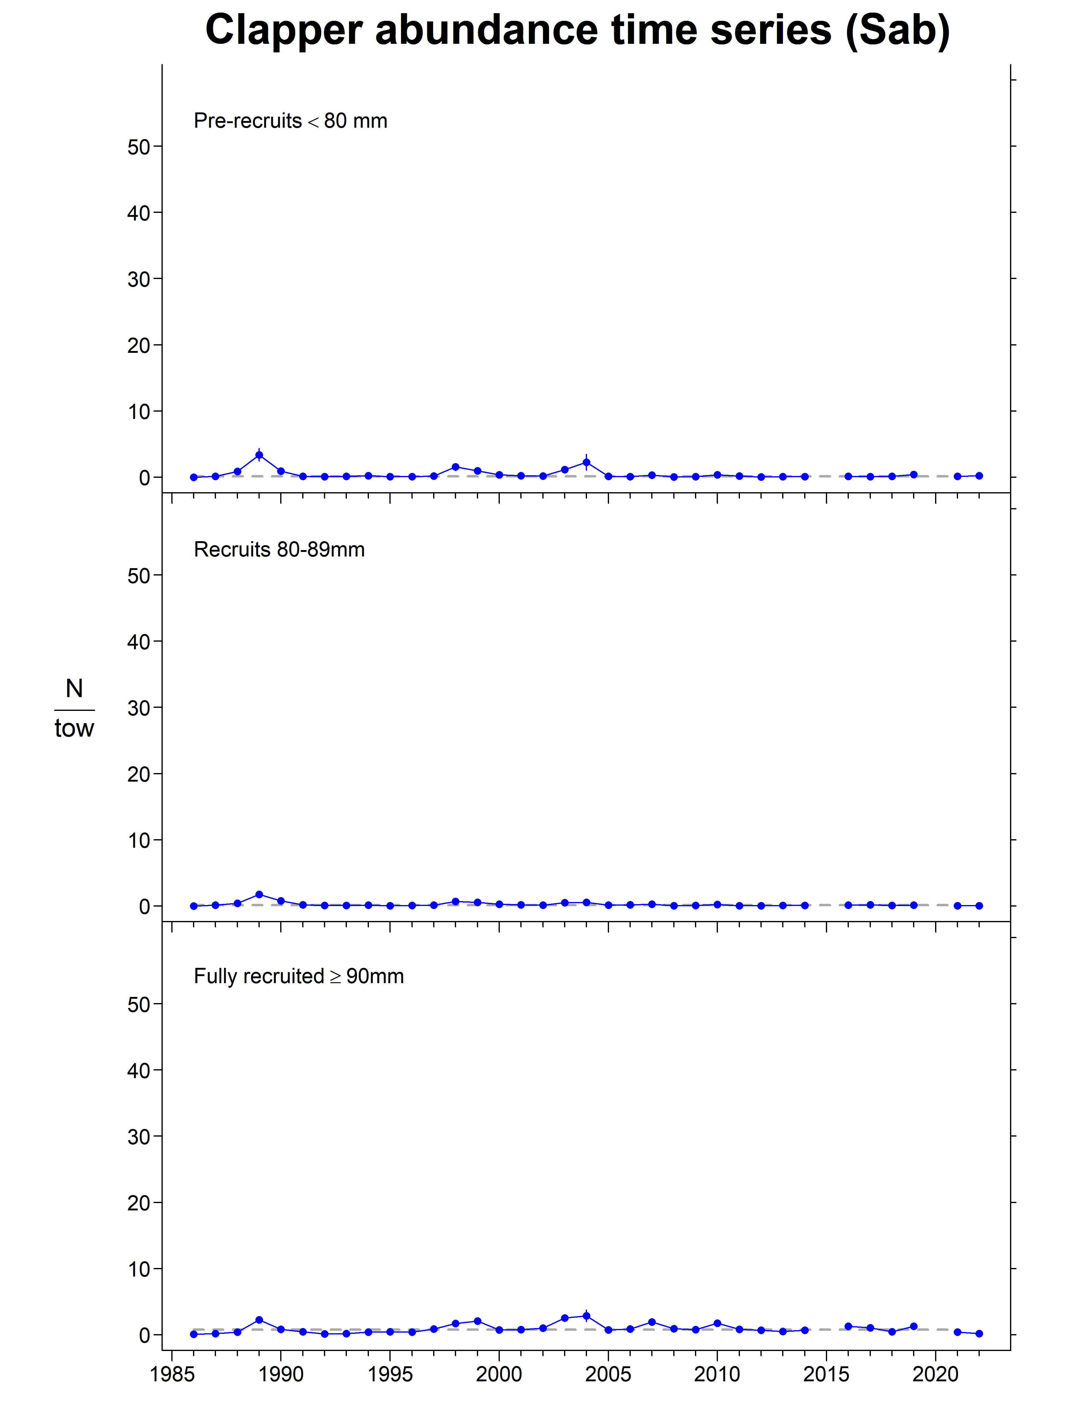
Sable Bank

Slide 29
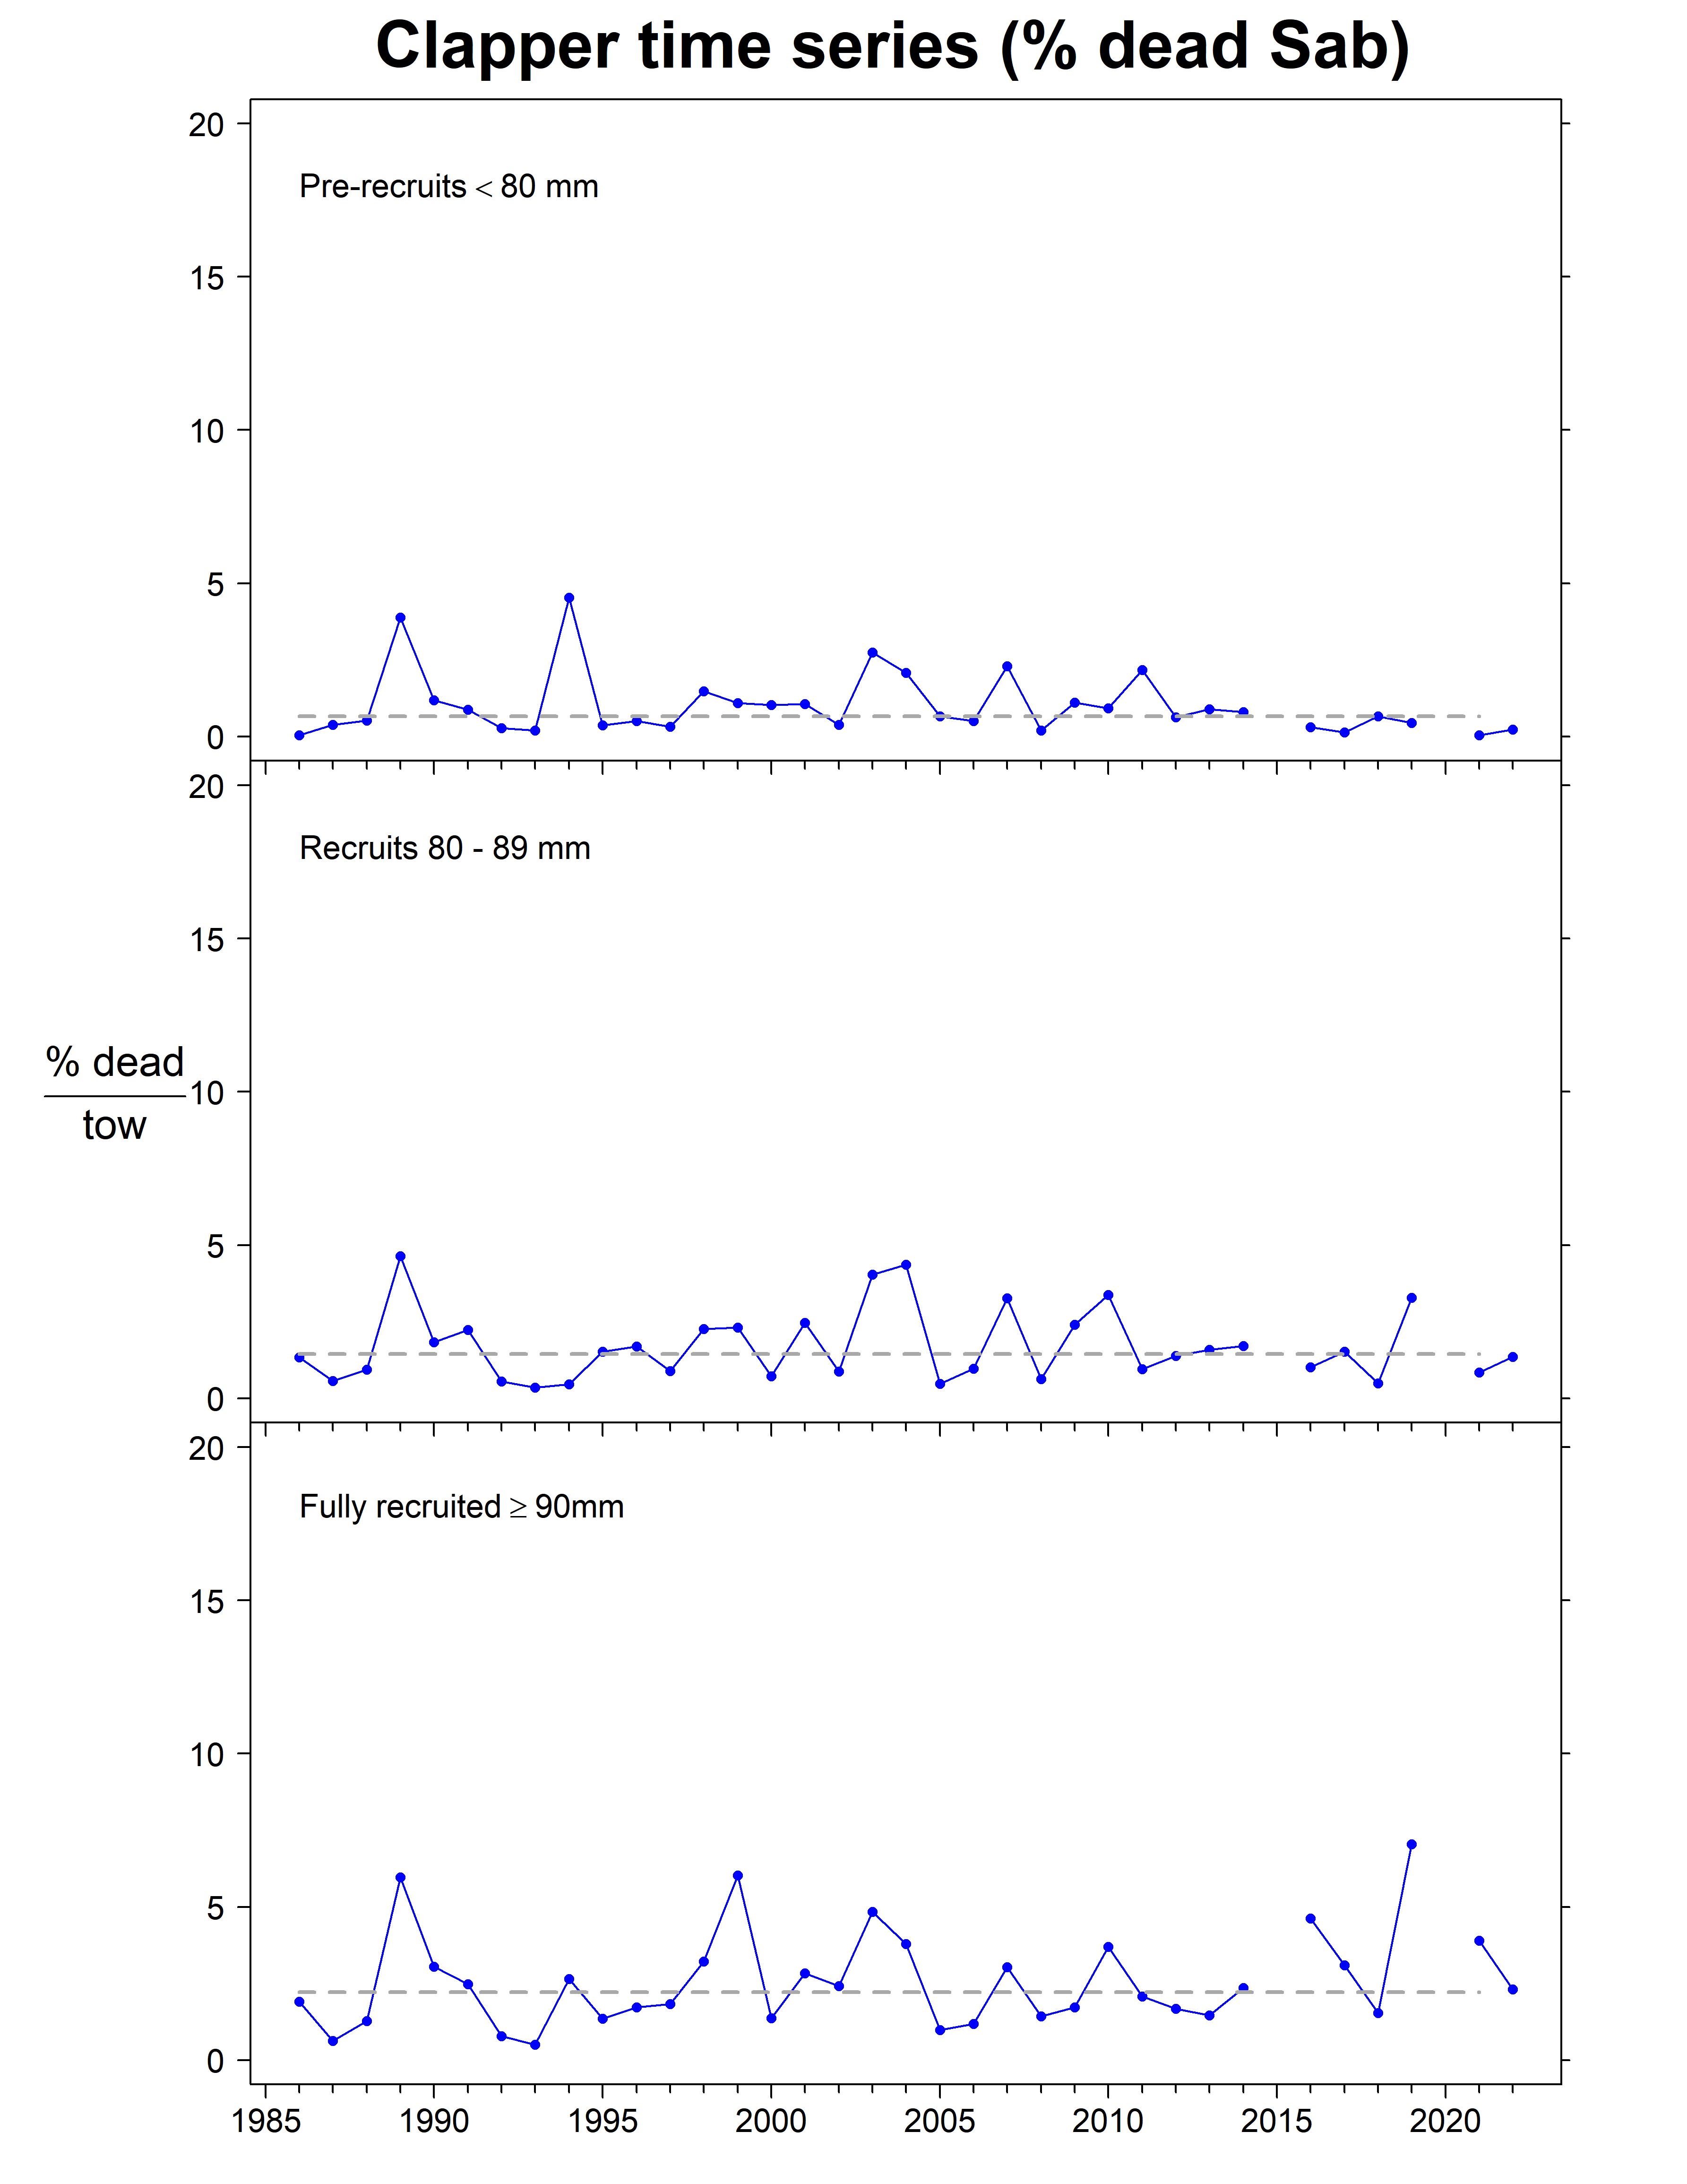
Sable Bank

Slide 30
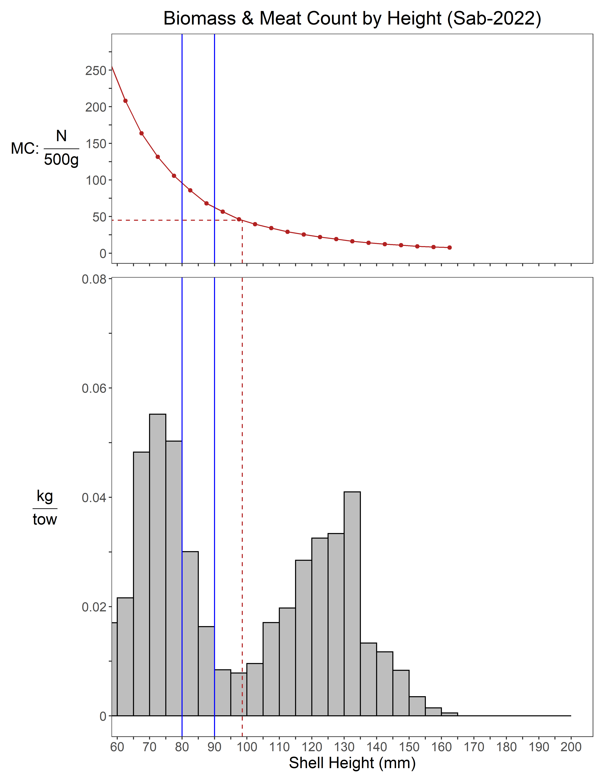
Sable Bank

Slide 31
Sable Bank
Summary
Abundance
Pre-recruit: +3.5% since 2021, above LTM
Recruit: -25% since 2021, below LTM
Fully-recruited: -26% since 2021, below LTM
Biomass
Pre-recruit: -6.5% since 2021, above LTM
Recruit: -19% since 2021, below LTM
Fully-recruited: -5.5% since 2021, below LTM
Condition factor
increased since 2021, above LTM

Slide 32
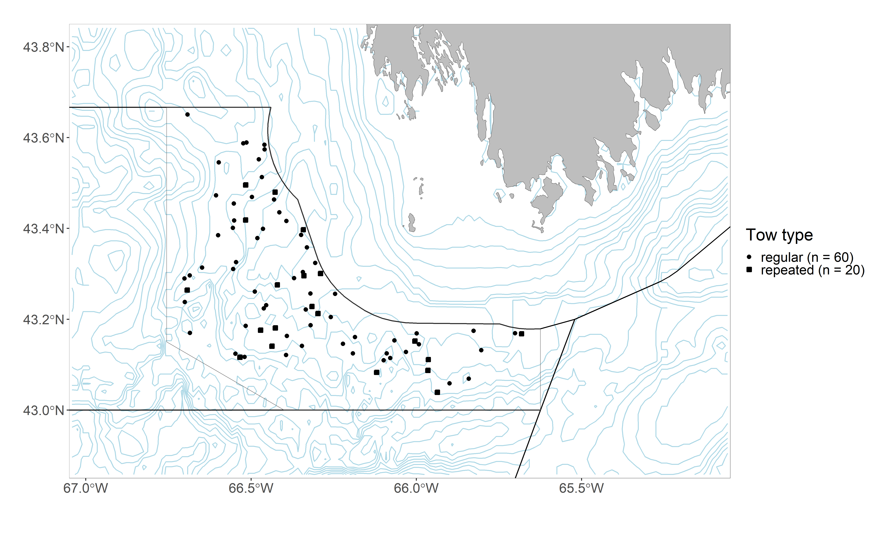
German Bank

Slide 33
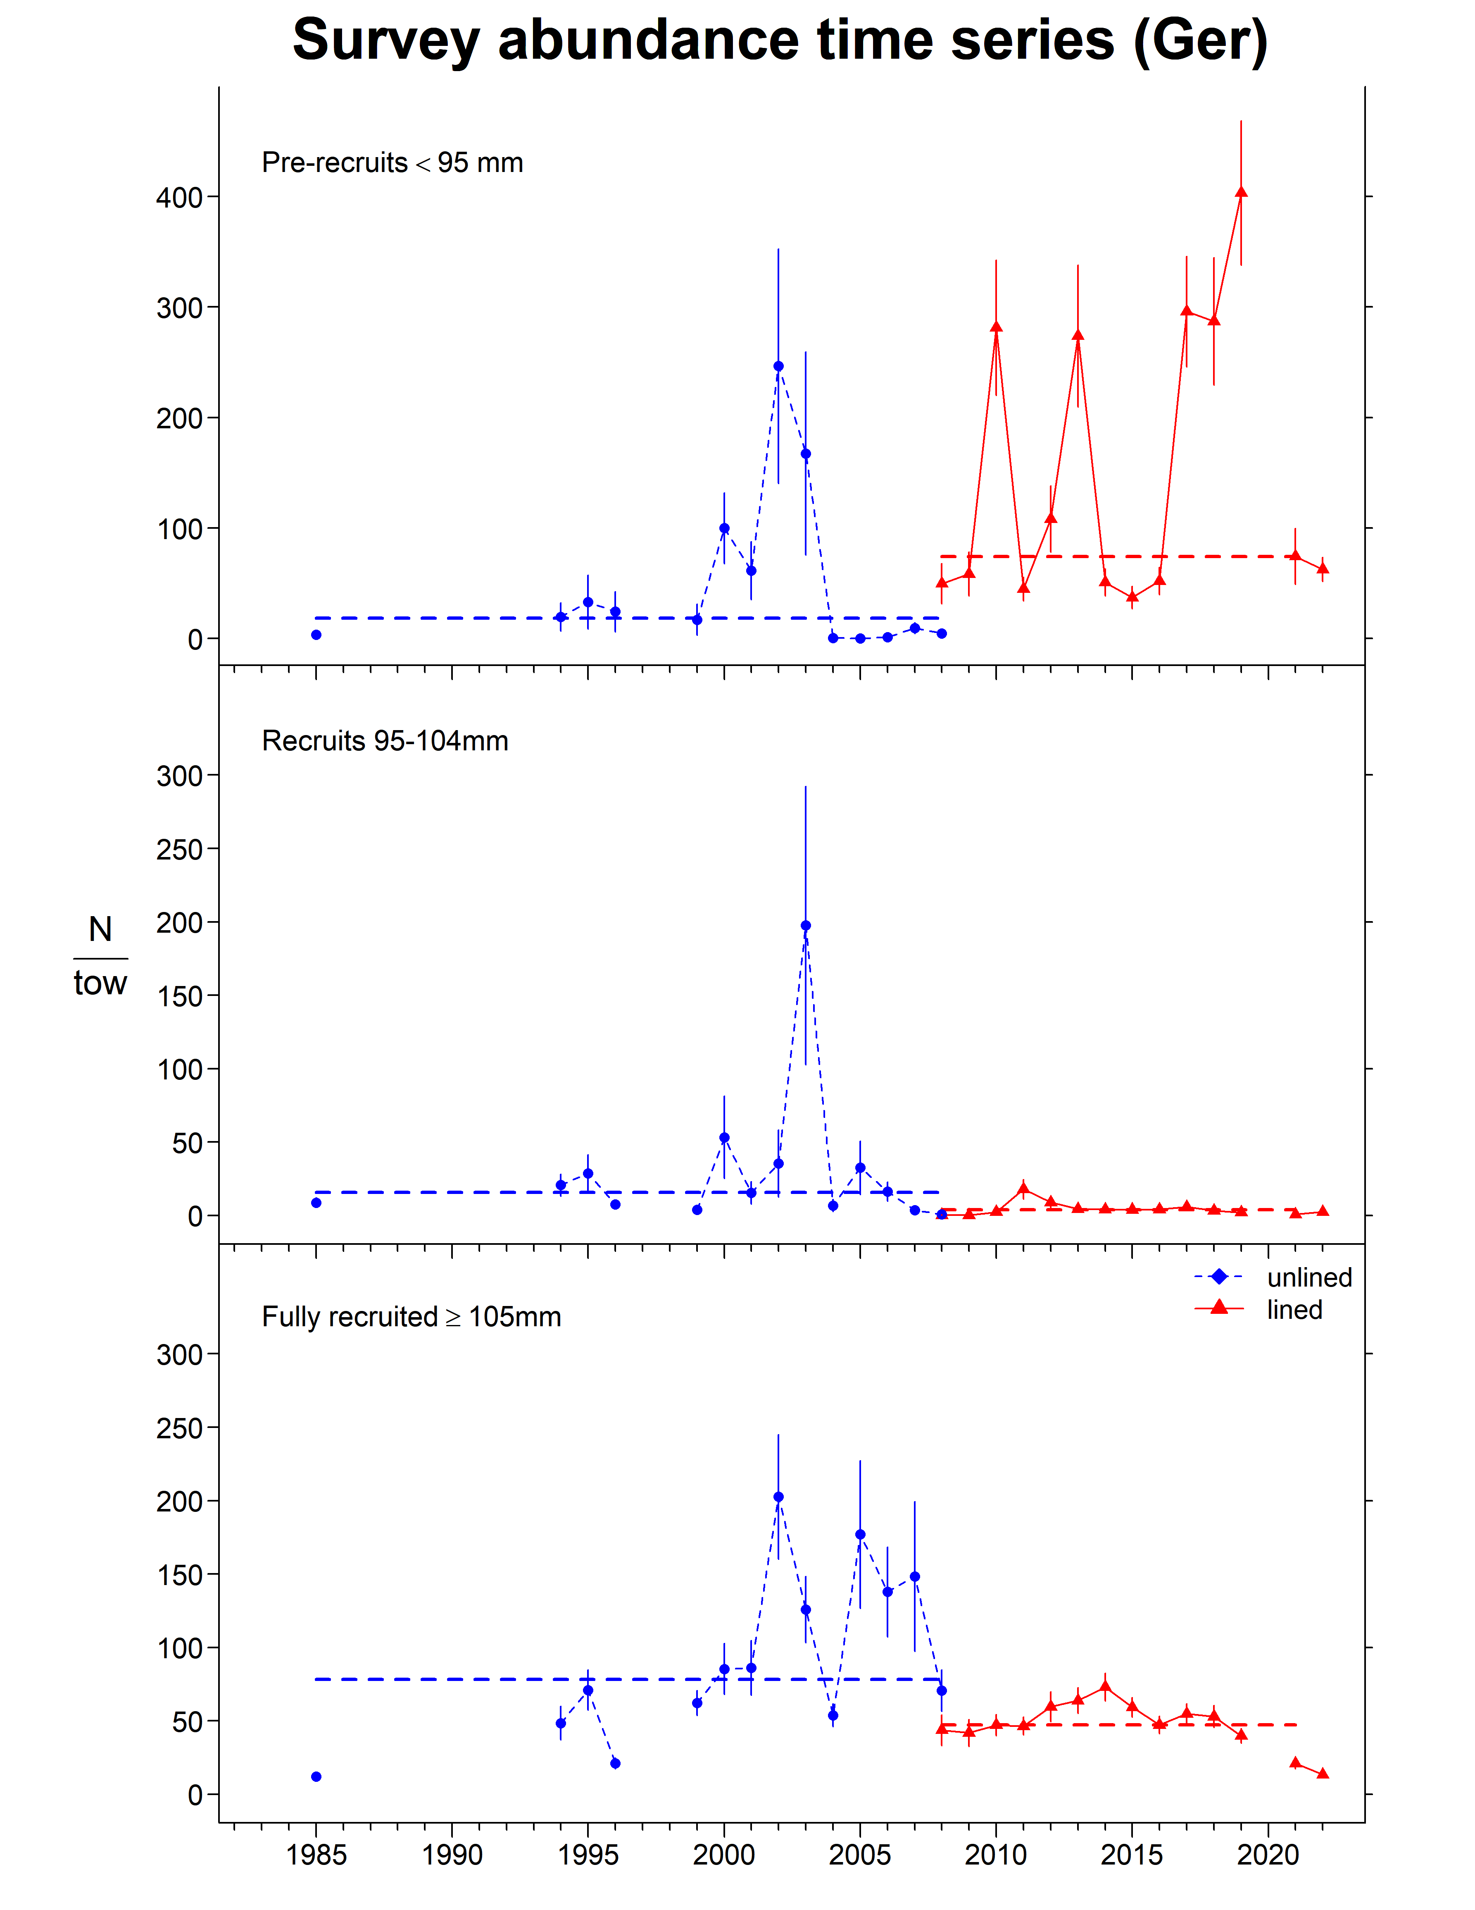
German Bank

Slide 34
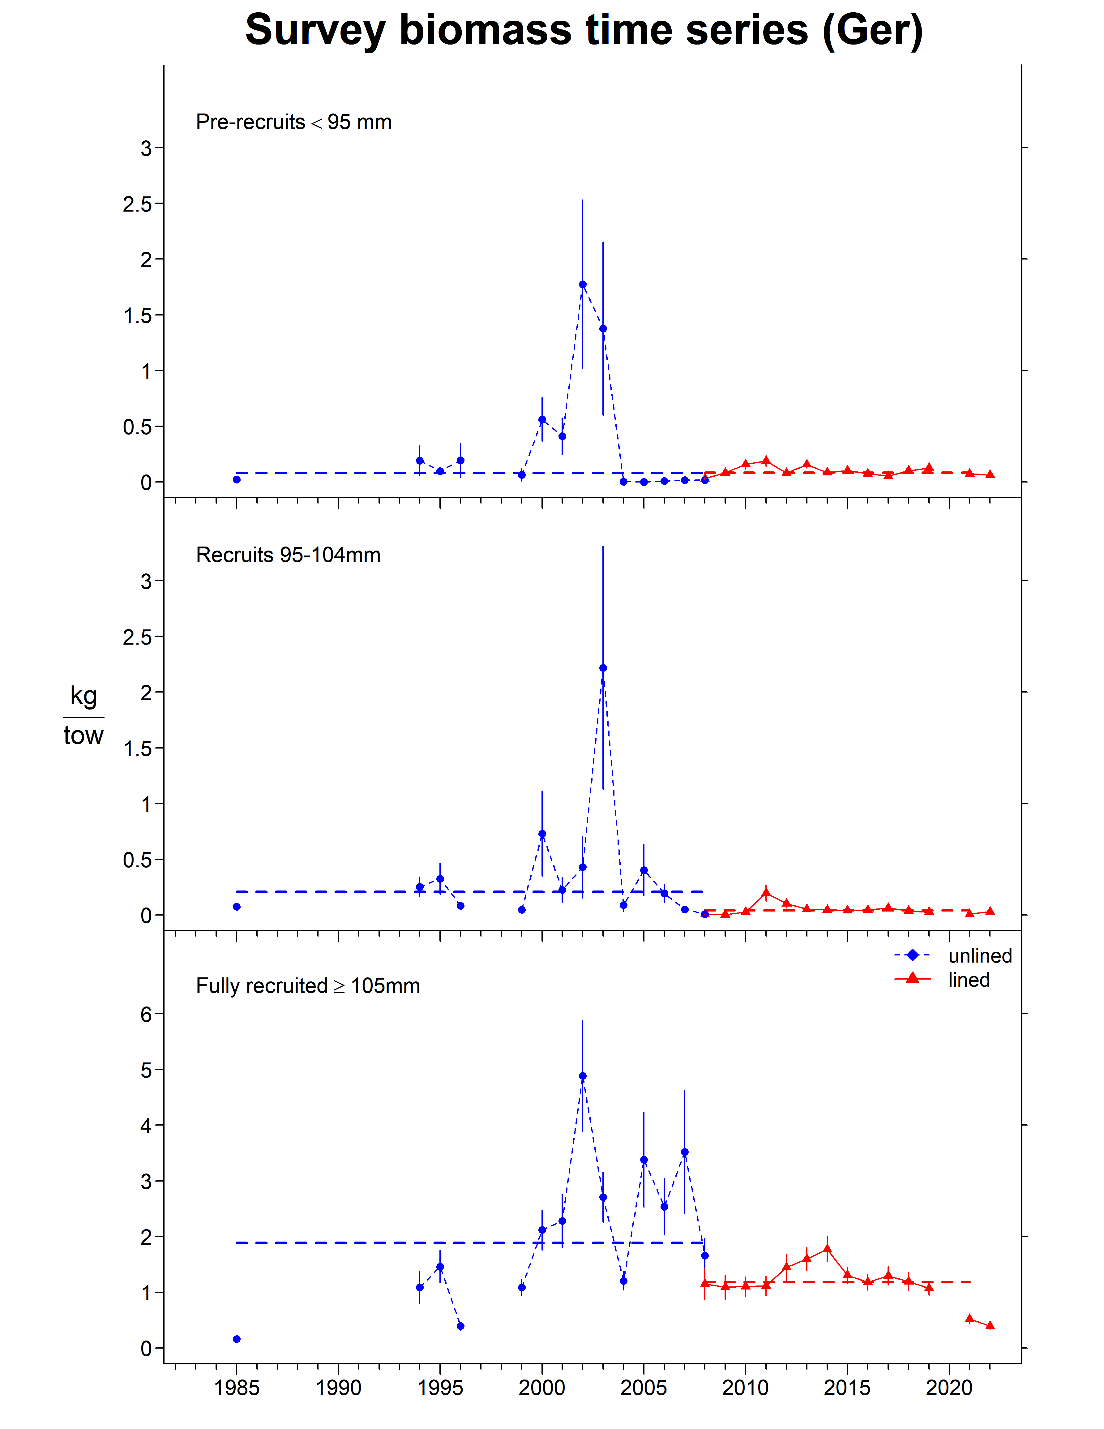
German Bank

Slide 35
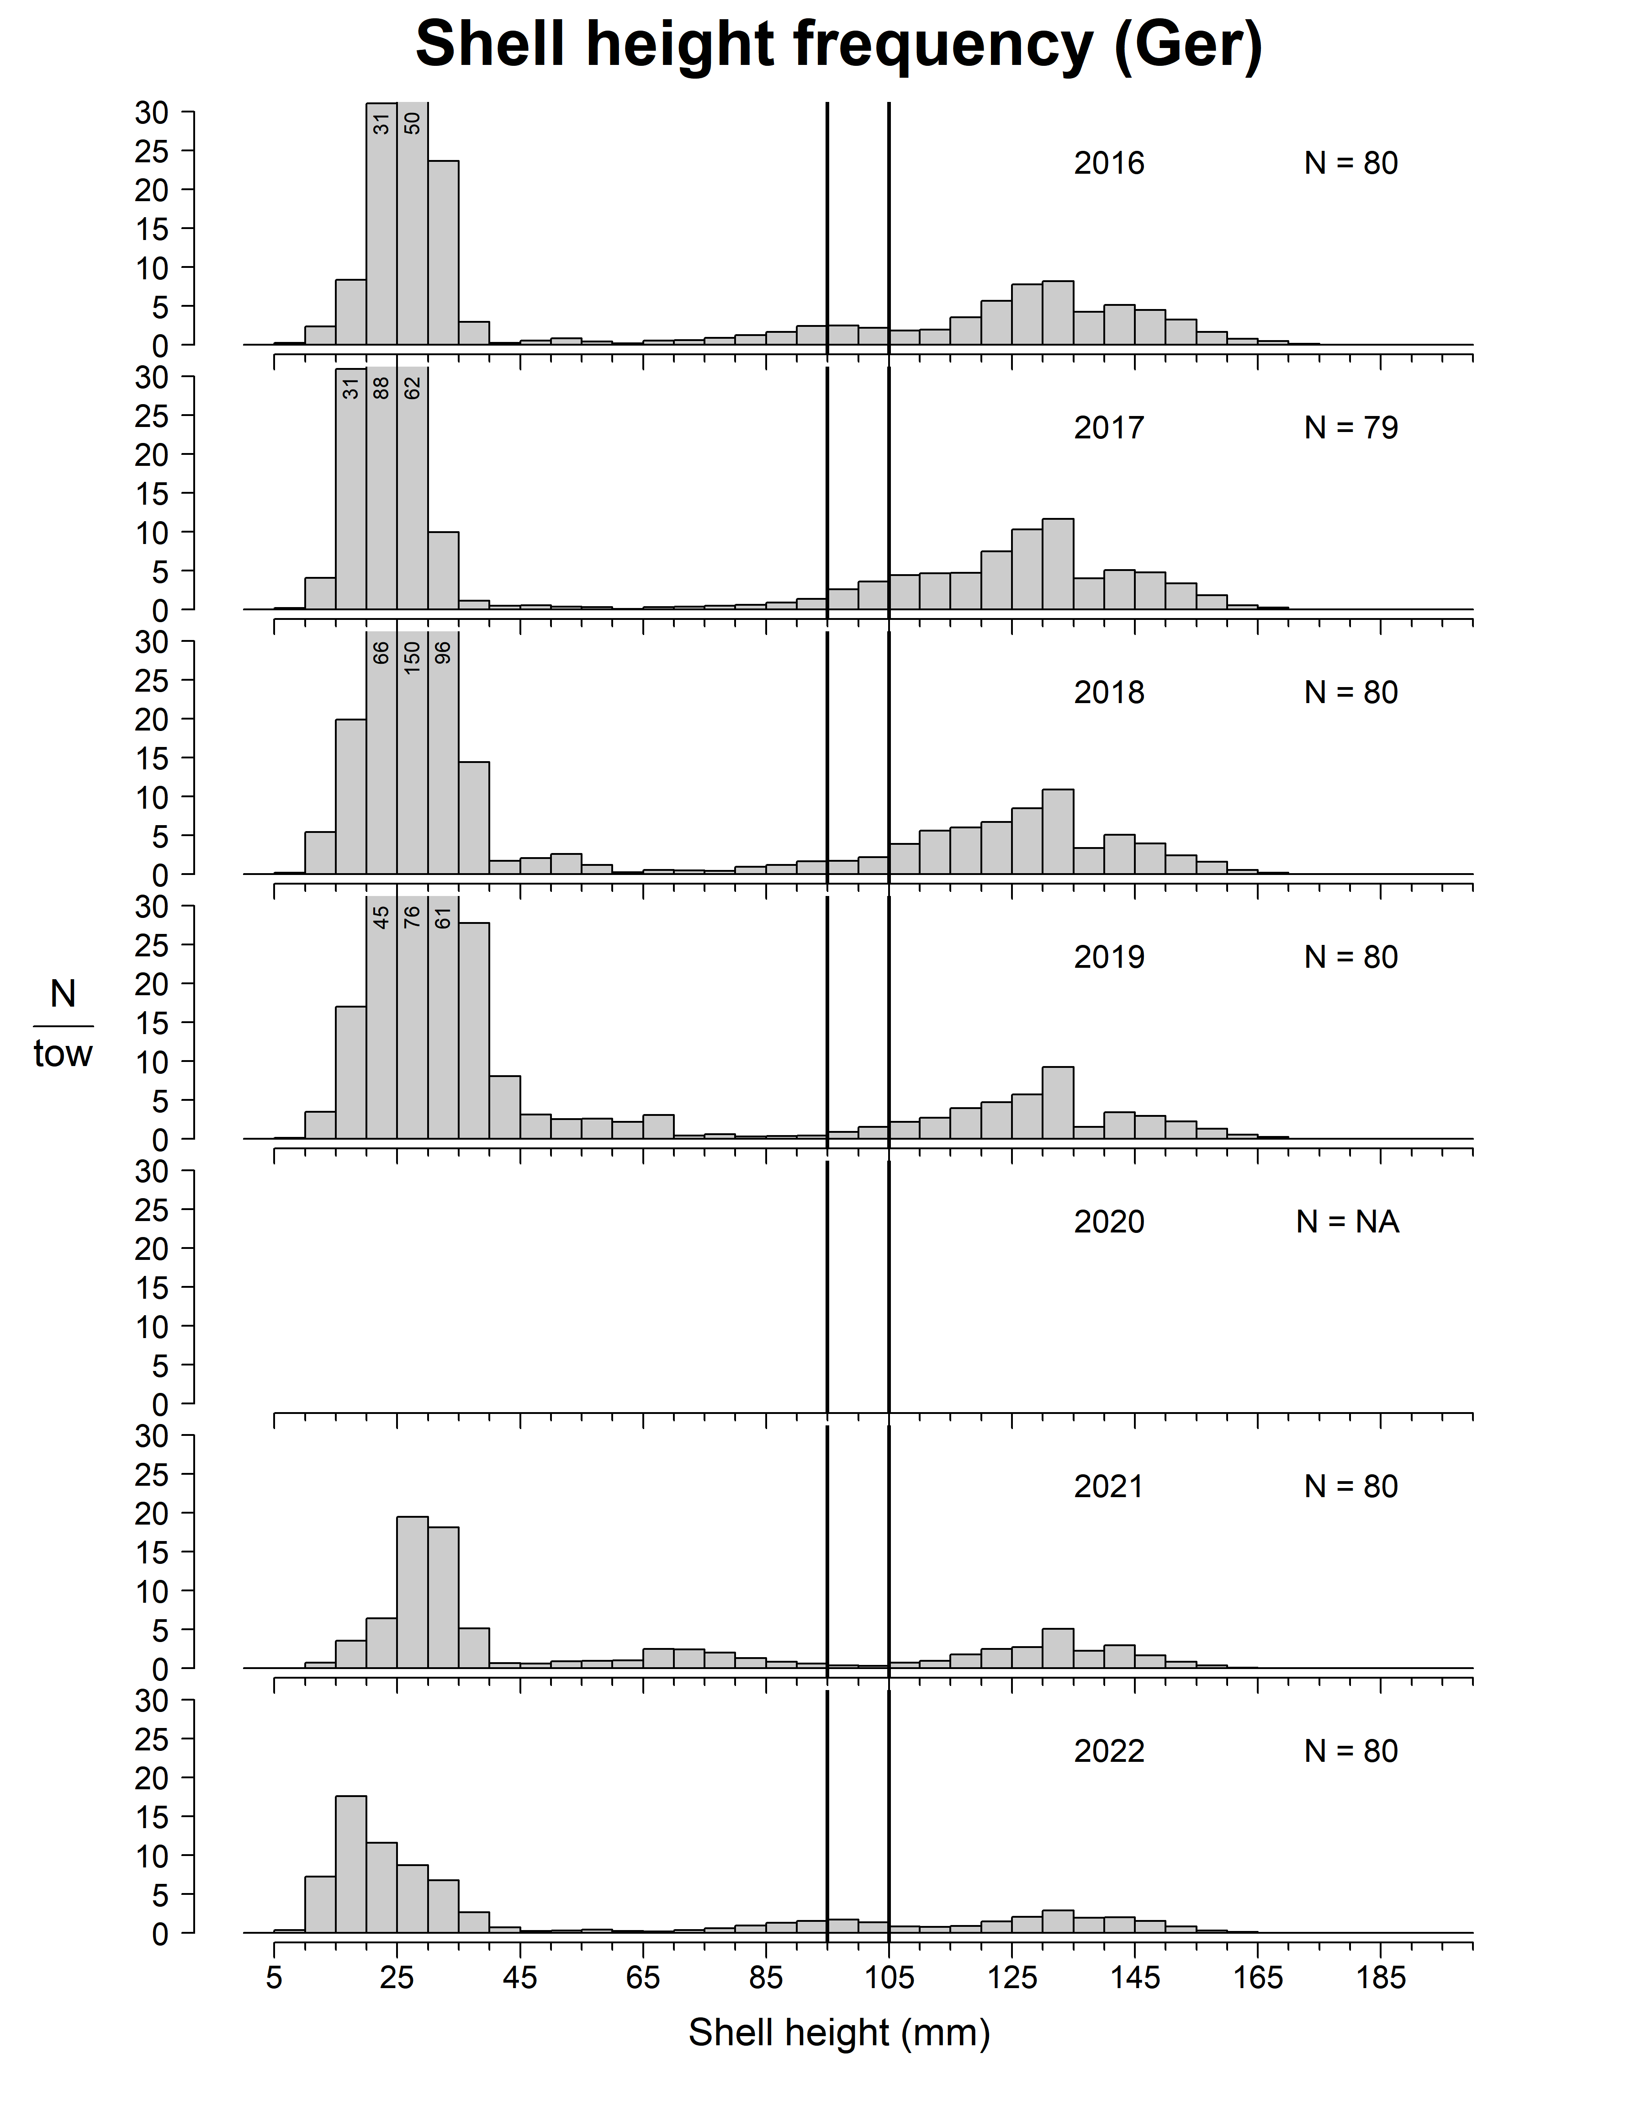
German Bank

Slide 36
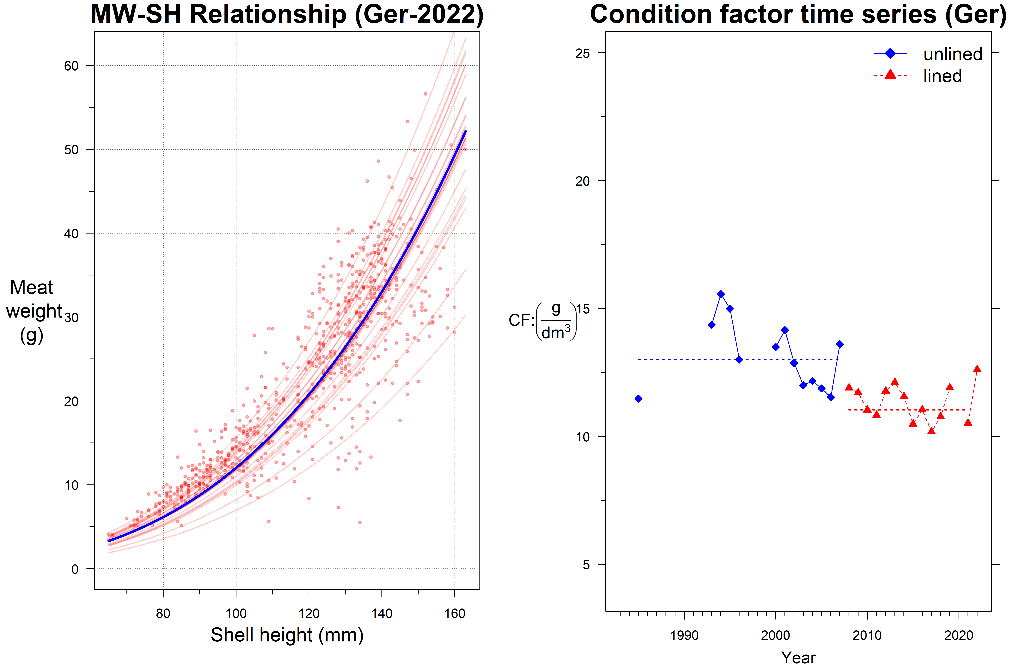
German Bank

Slide 37
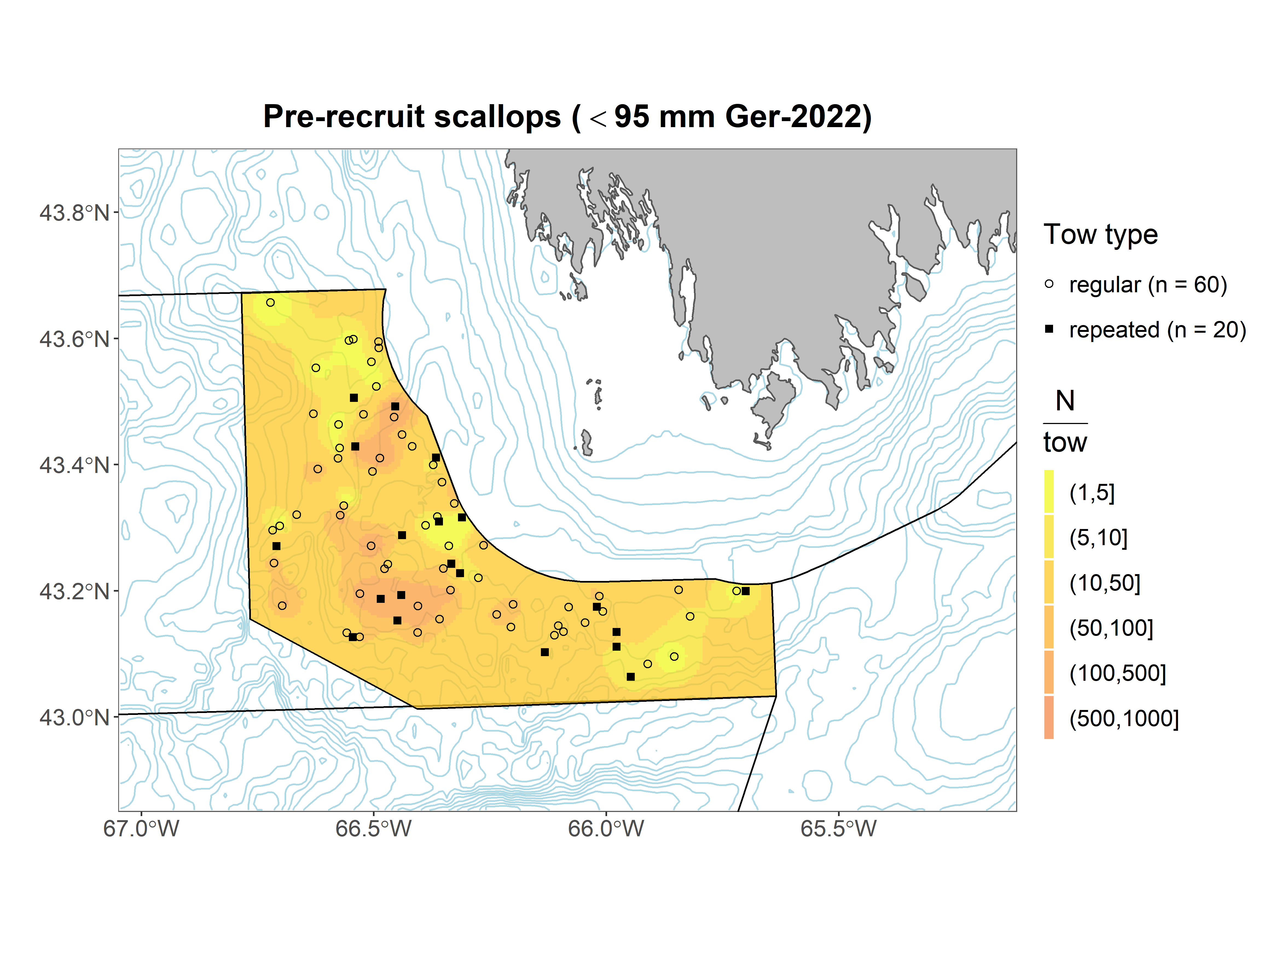
German Bank

Slide 38
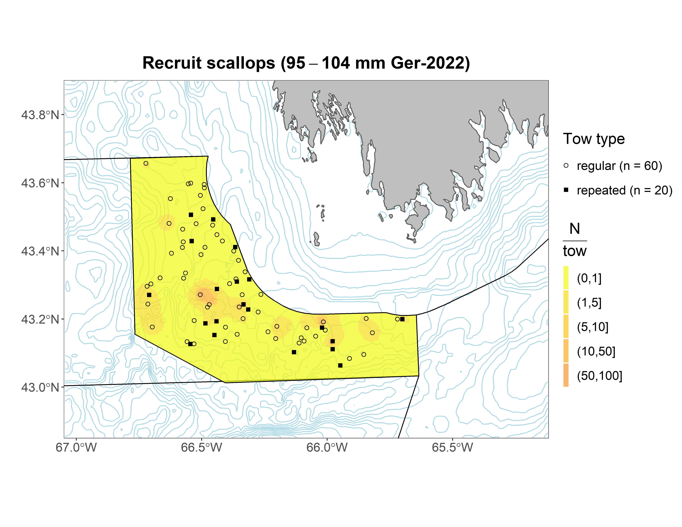
German Bank

Slide 39

German Bank

Slide 40
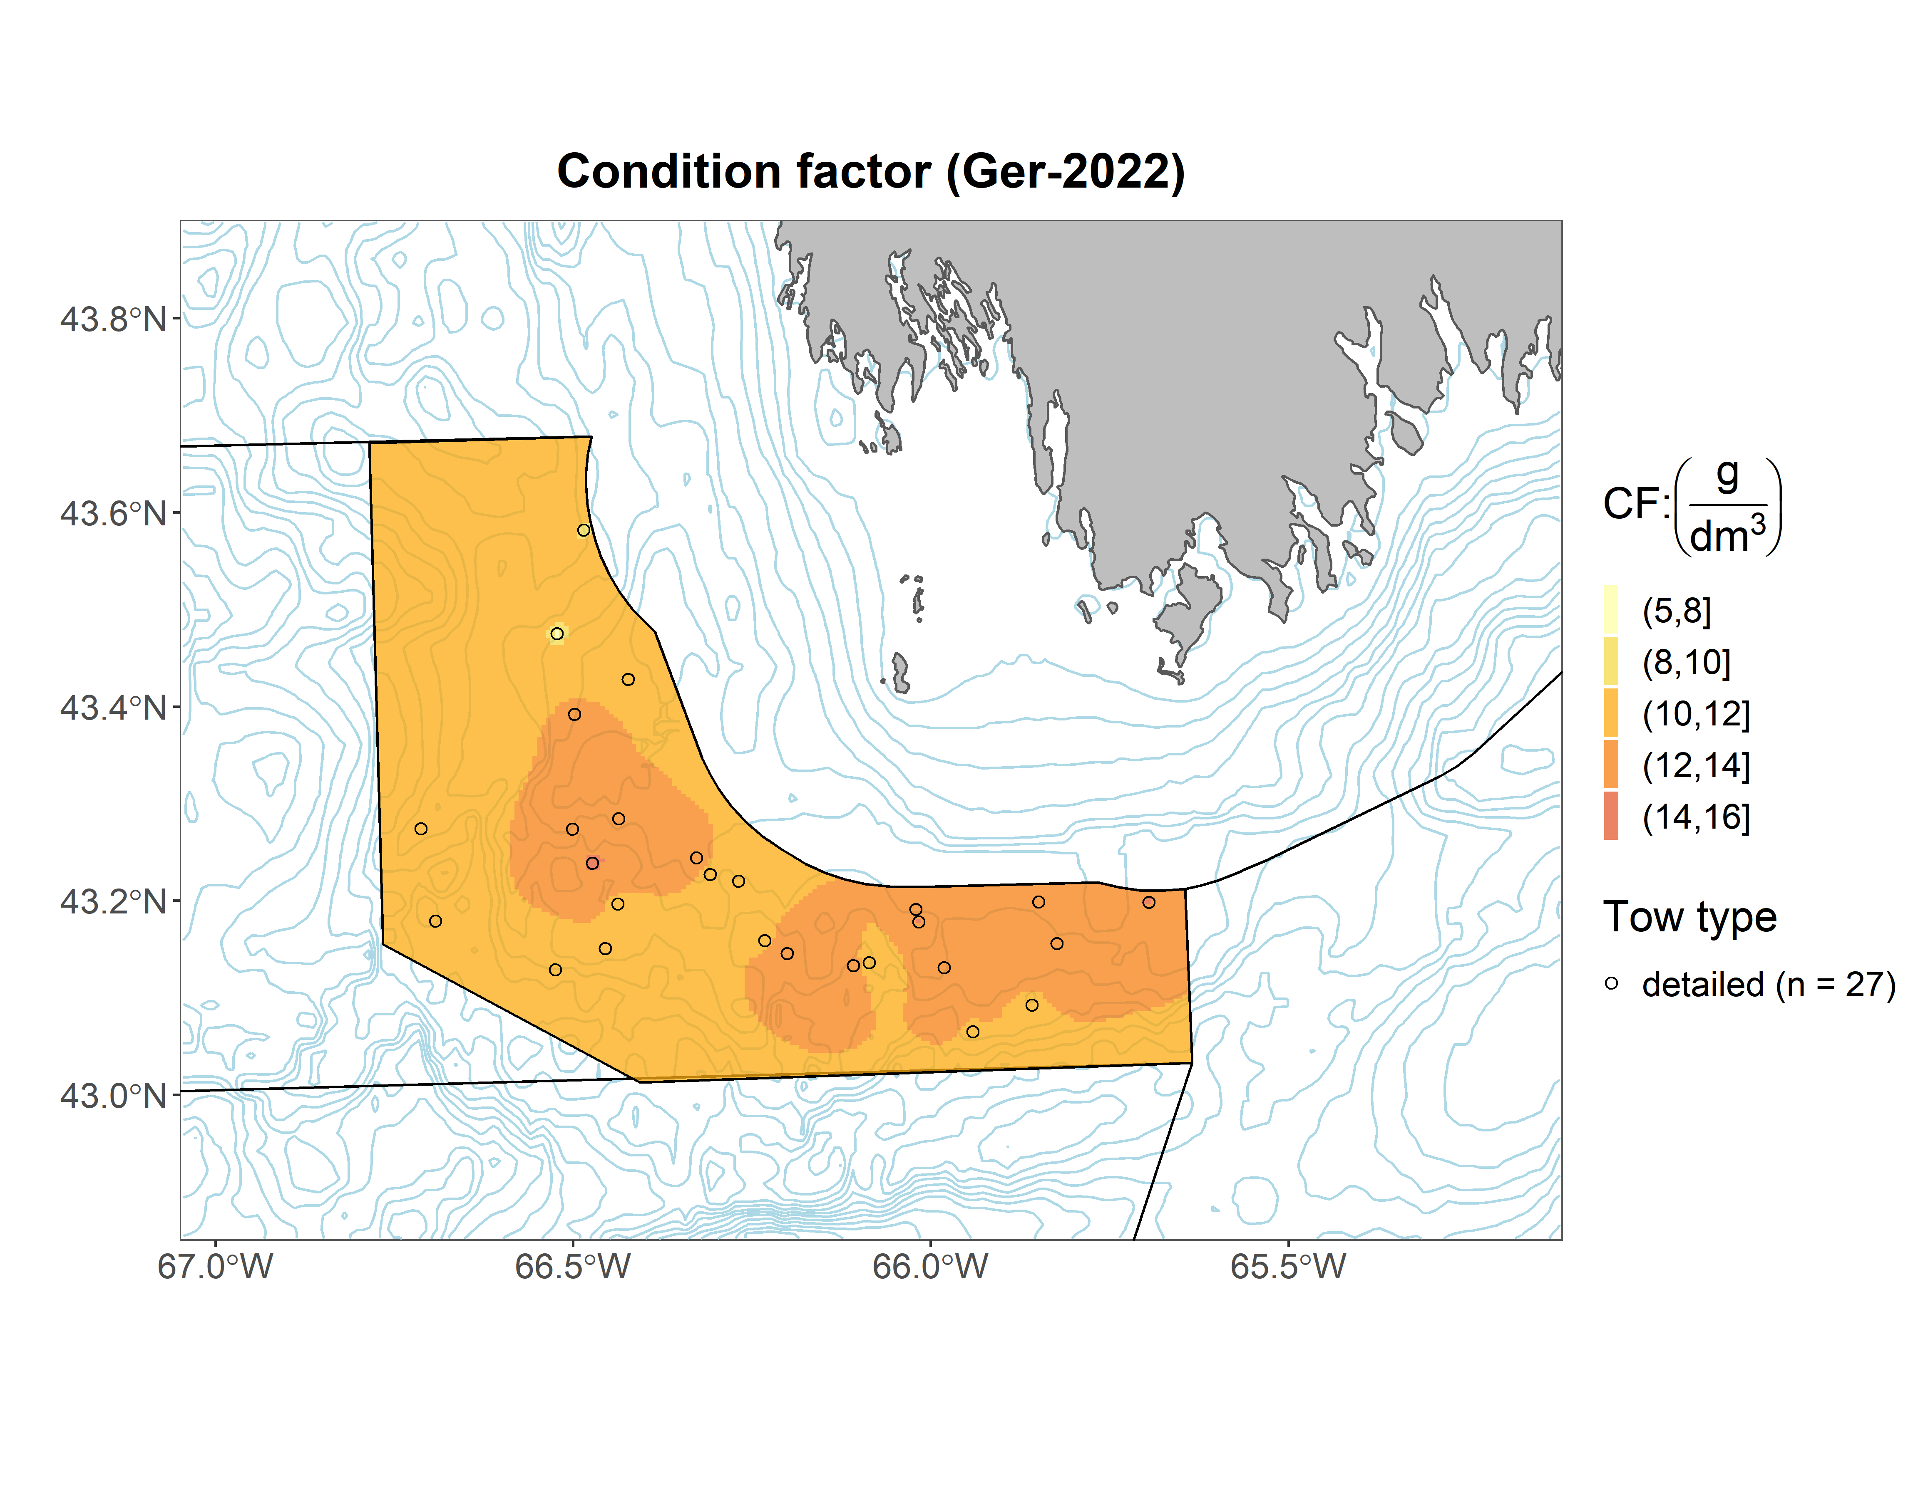
German Bank

Slide 41
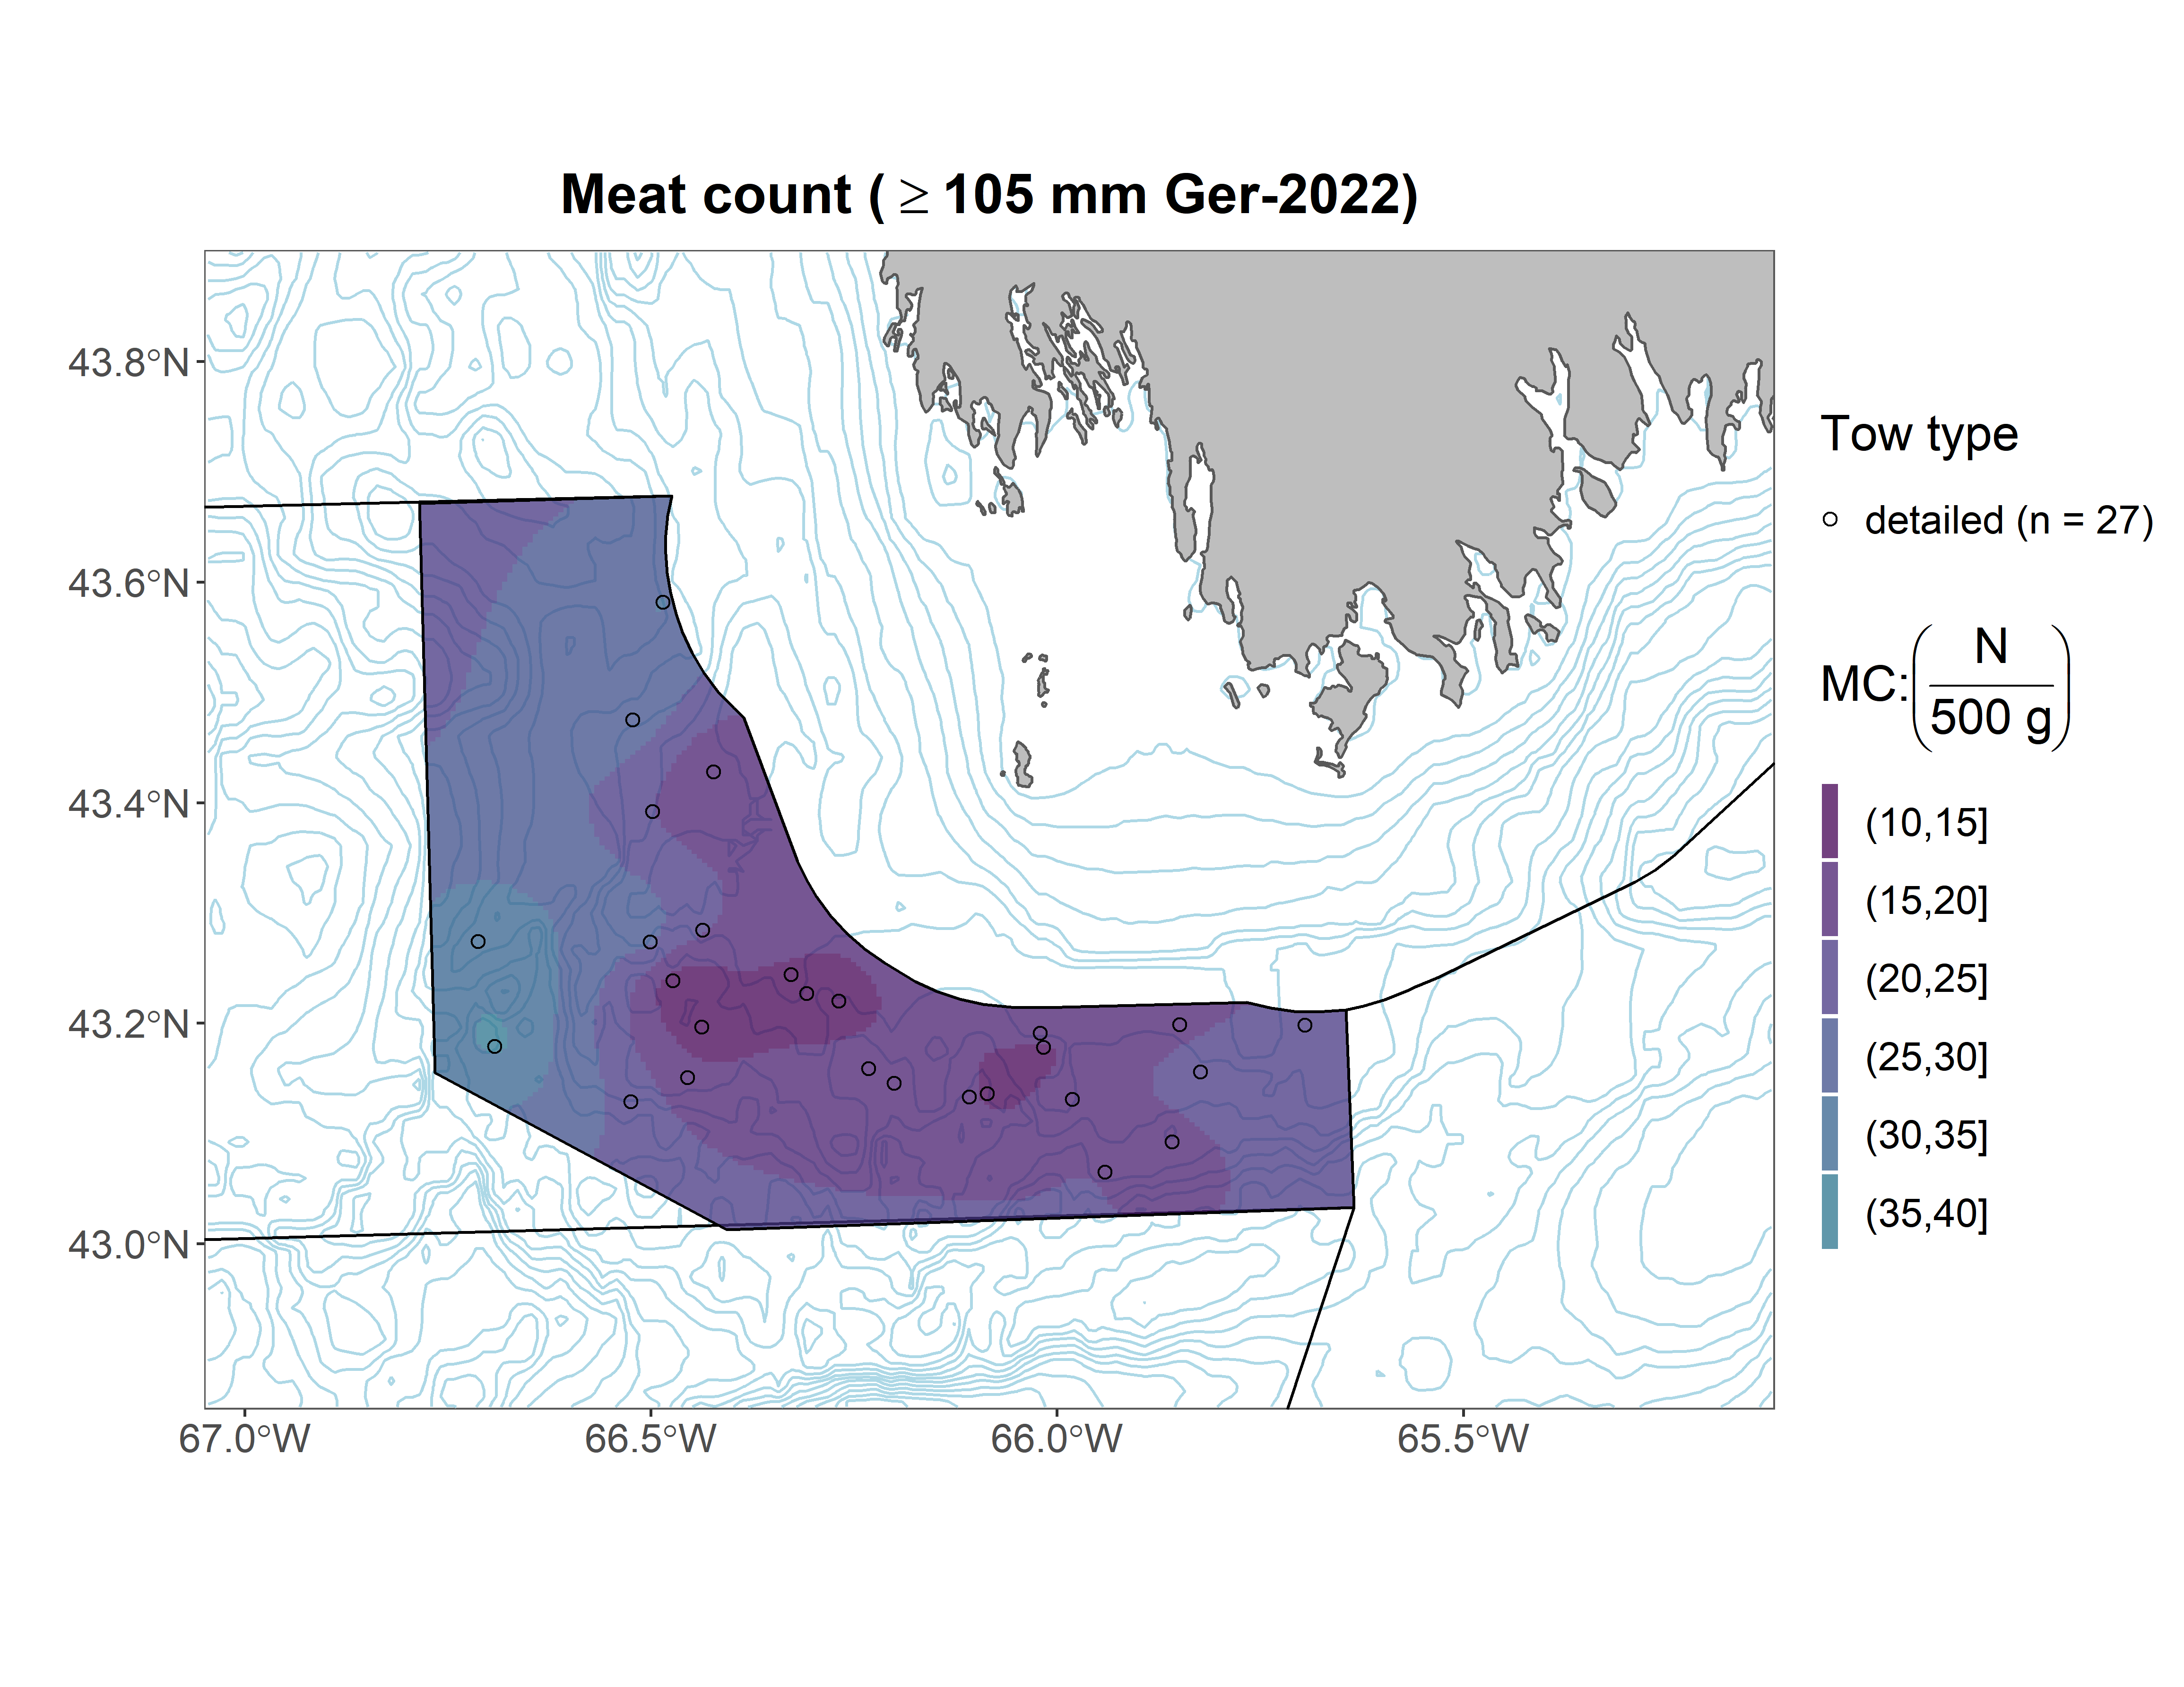
German Bank

Slide 42
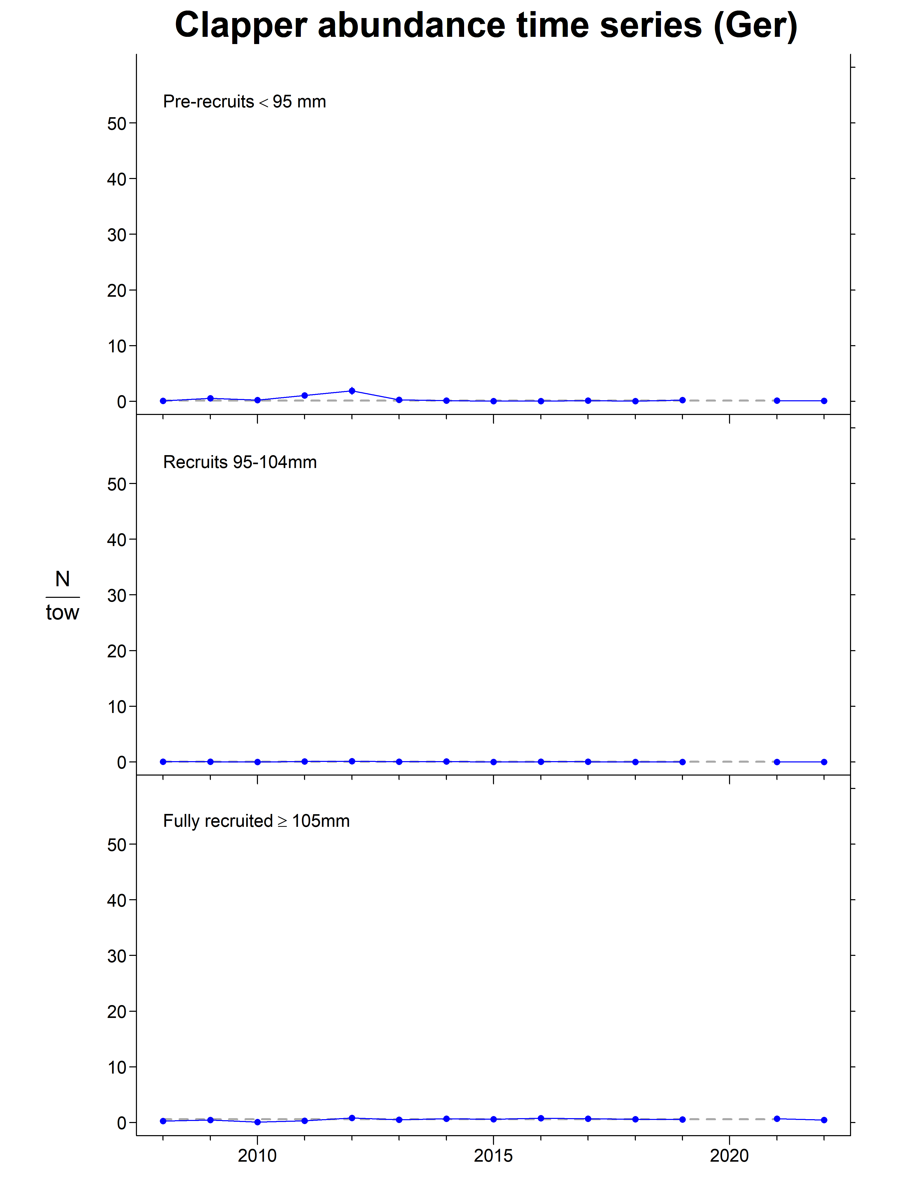
German Bank

Slide 43
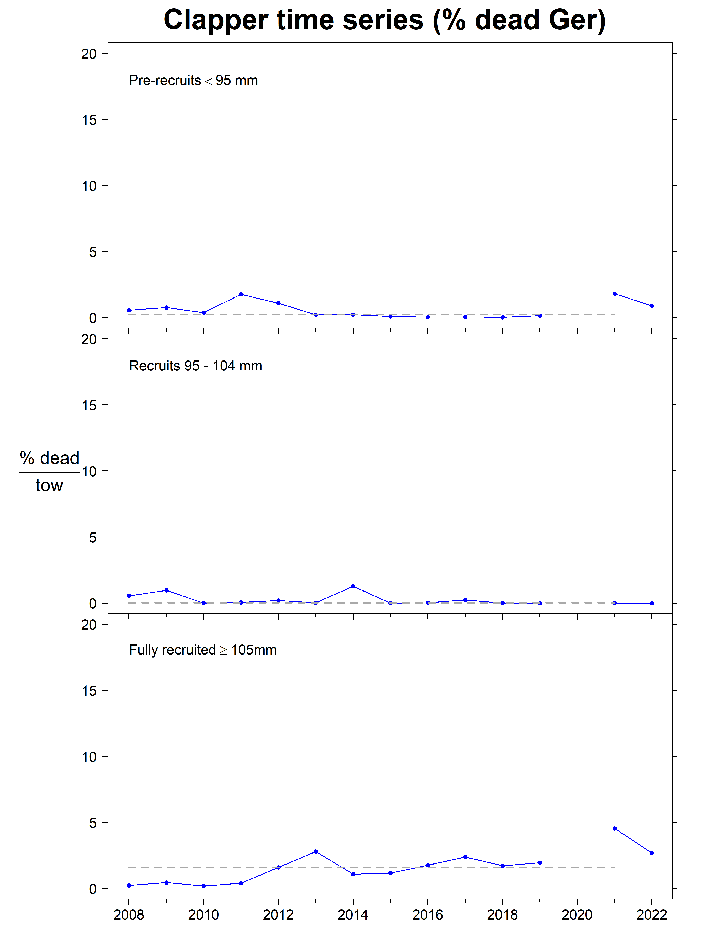
German Bank

Slide 44
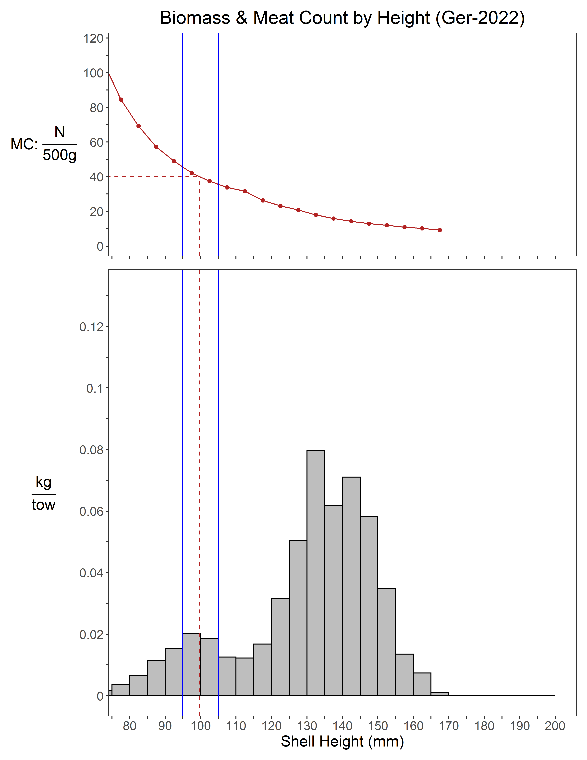
German Bank

Slide 45
German Bank
Summary
Abundance
Pre-recruit: -16% since 2021, near LTM
Recruit: +67% since 2021, below LTM
Fully-recruited: -36% since 2021, below LTM
Biomass
Pre-recruit: -16% since 2021, below LTM
Recruit: +74% since 2021, below LTM
Fully-recruited: -25% since 2021, below LTM
Condition factor
increased since 2021, above LTM

Slide 46
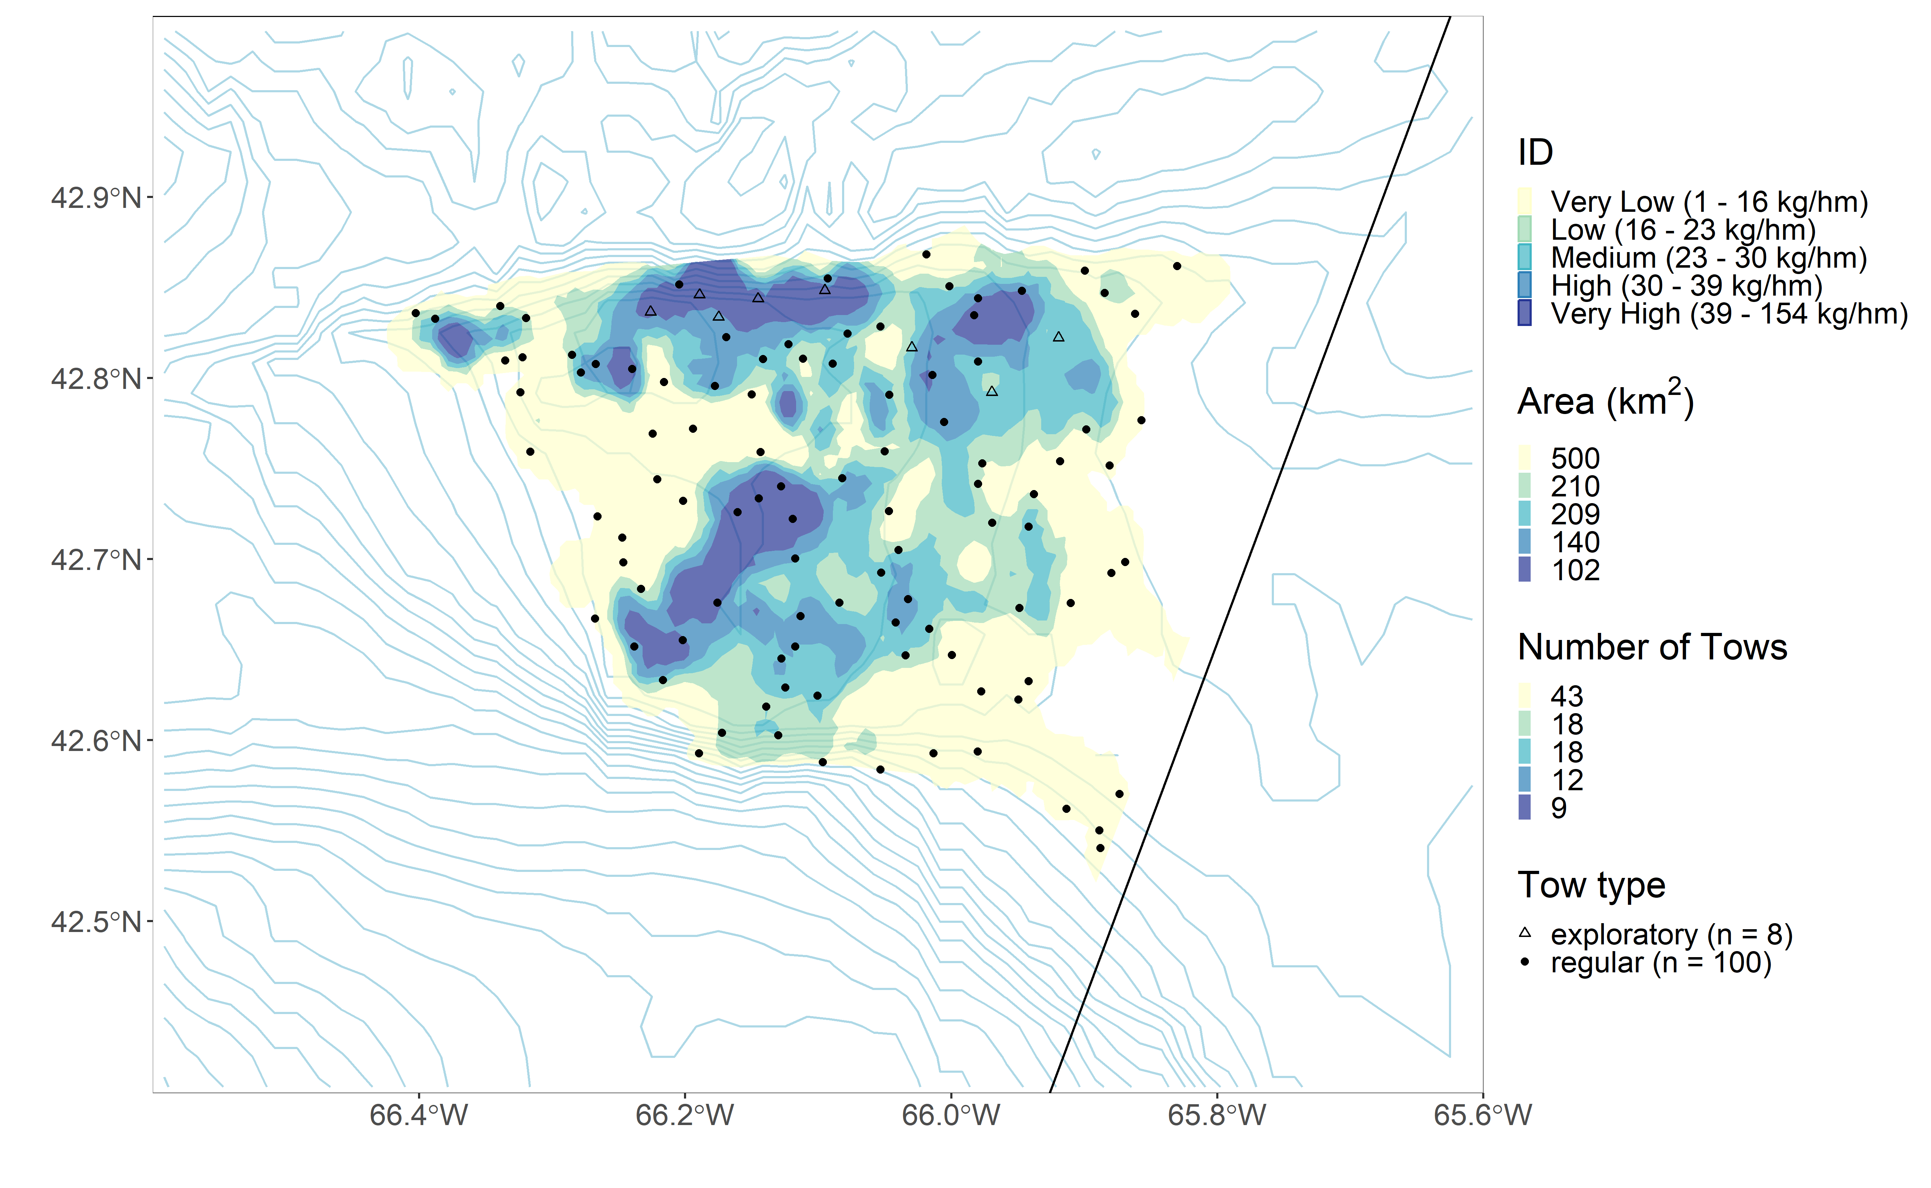
Browns North

Slide 47
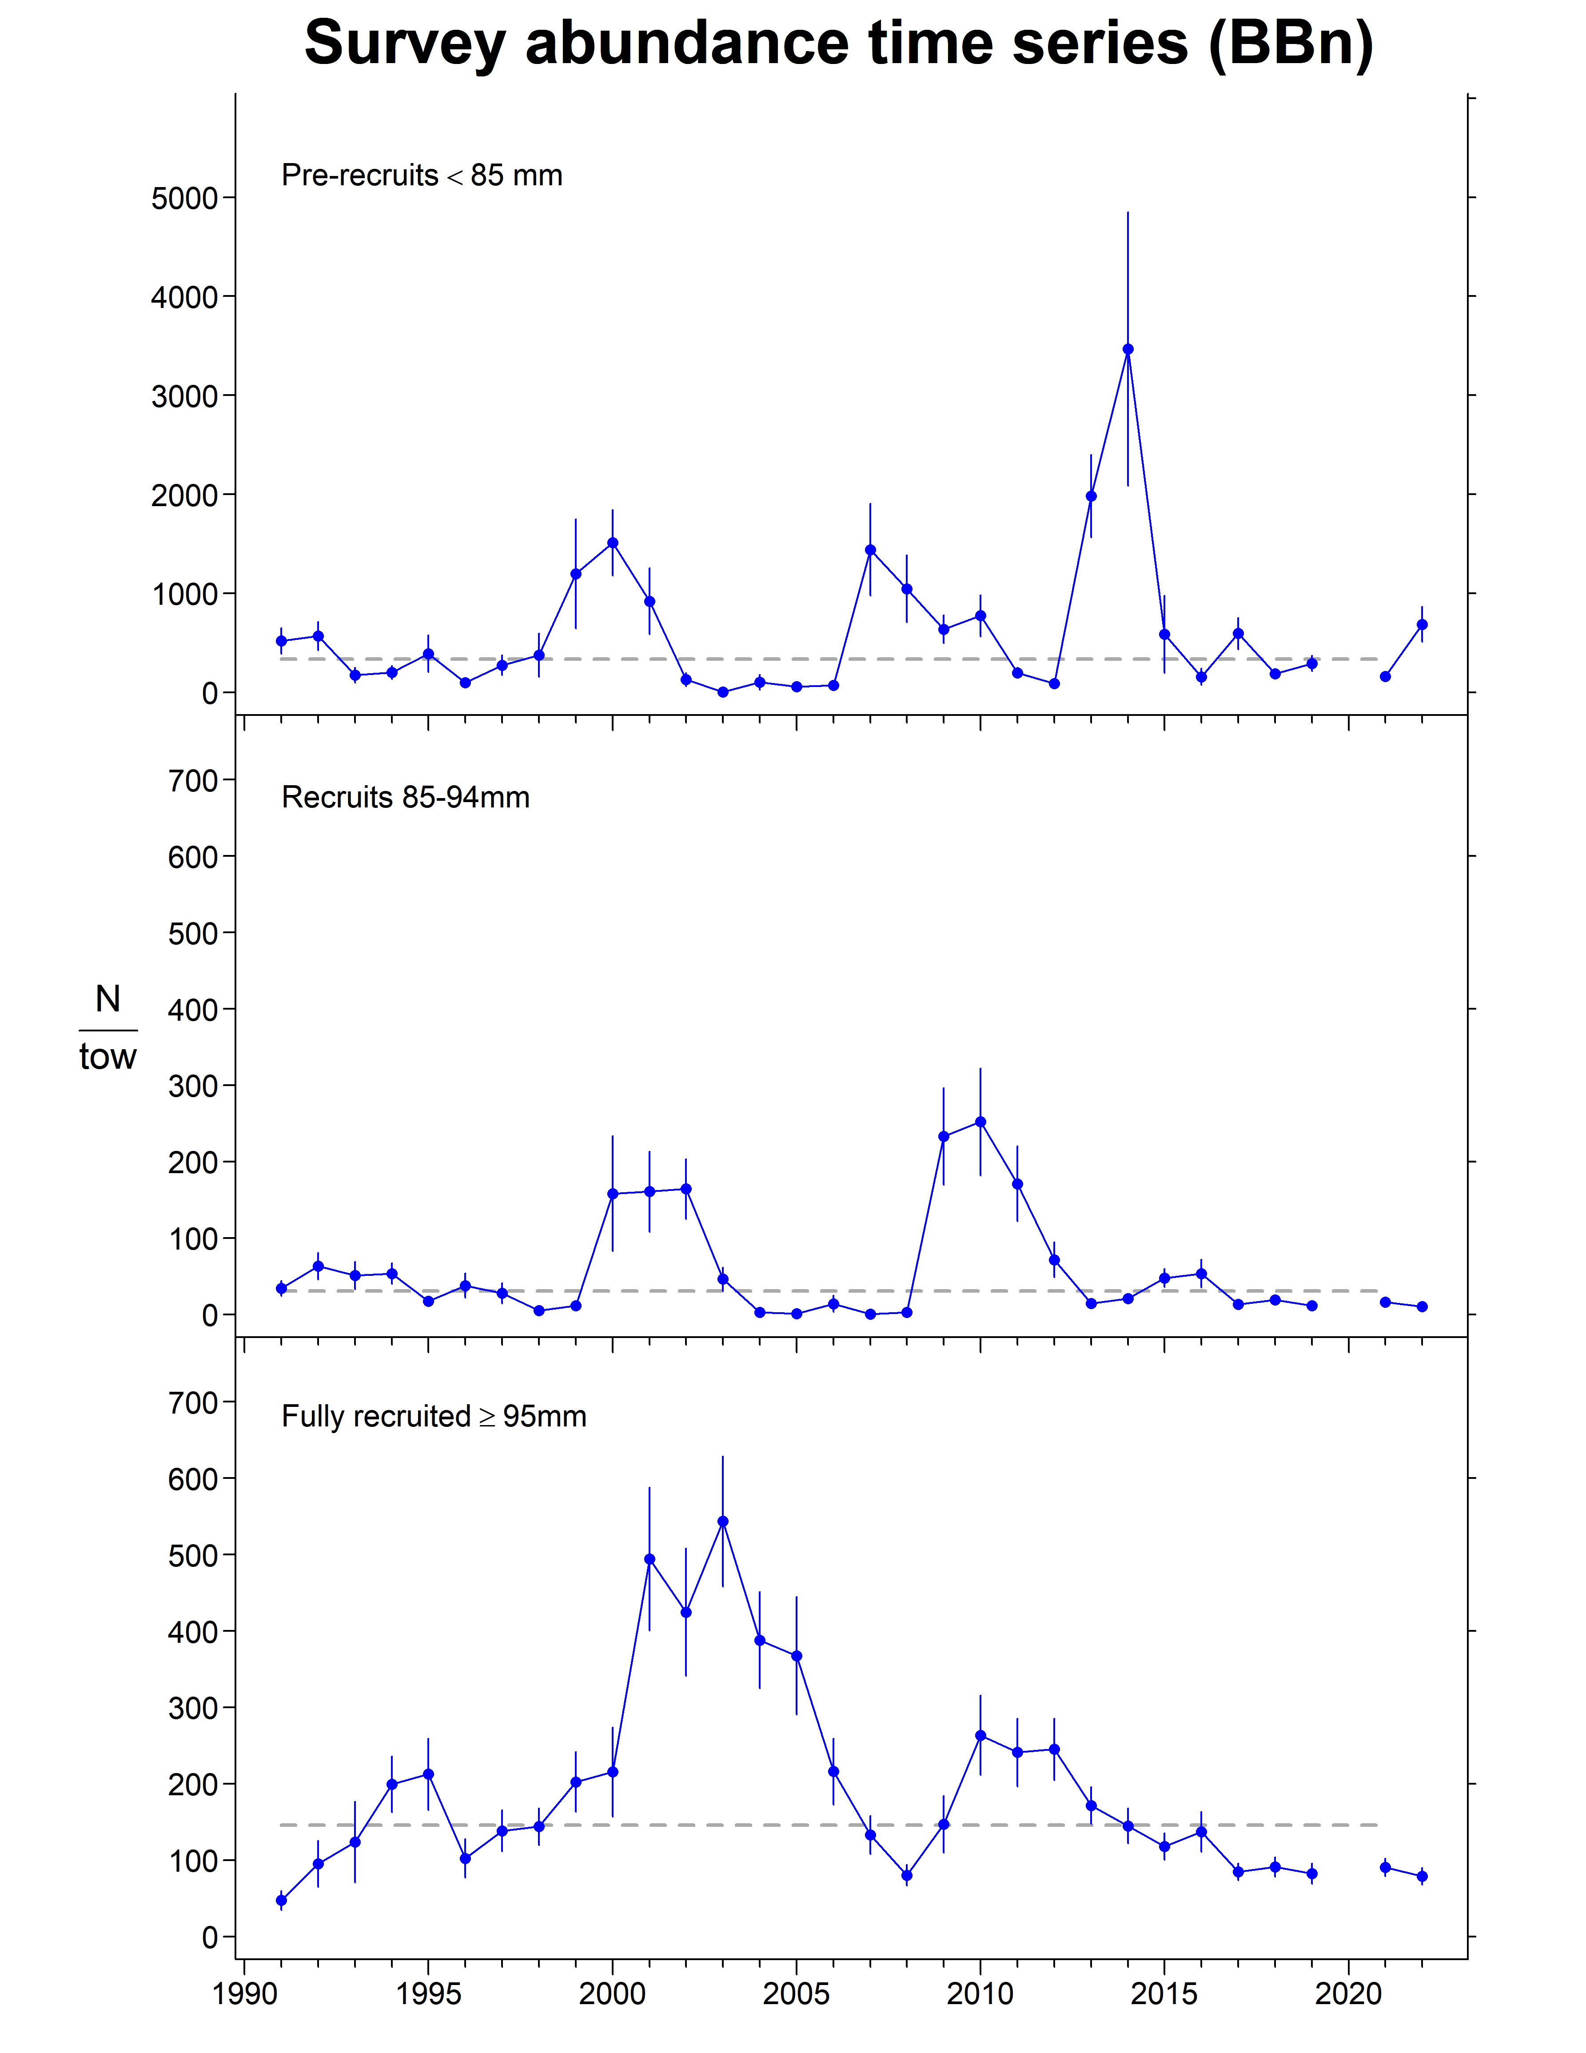
Browns North

Slide 48
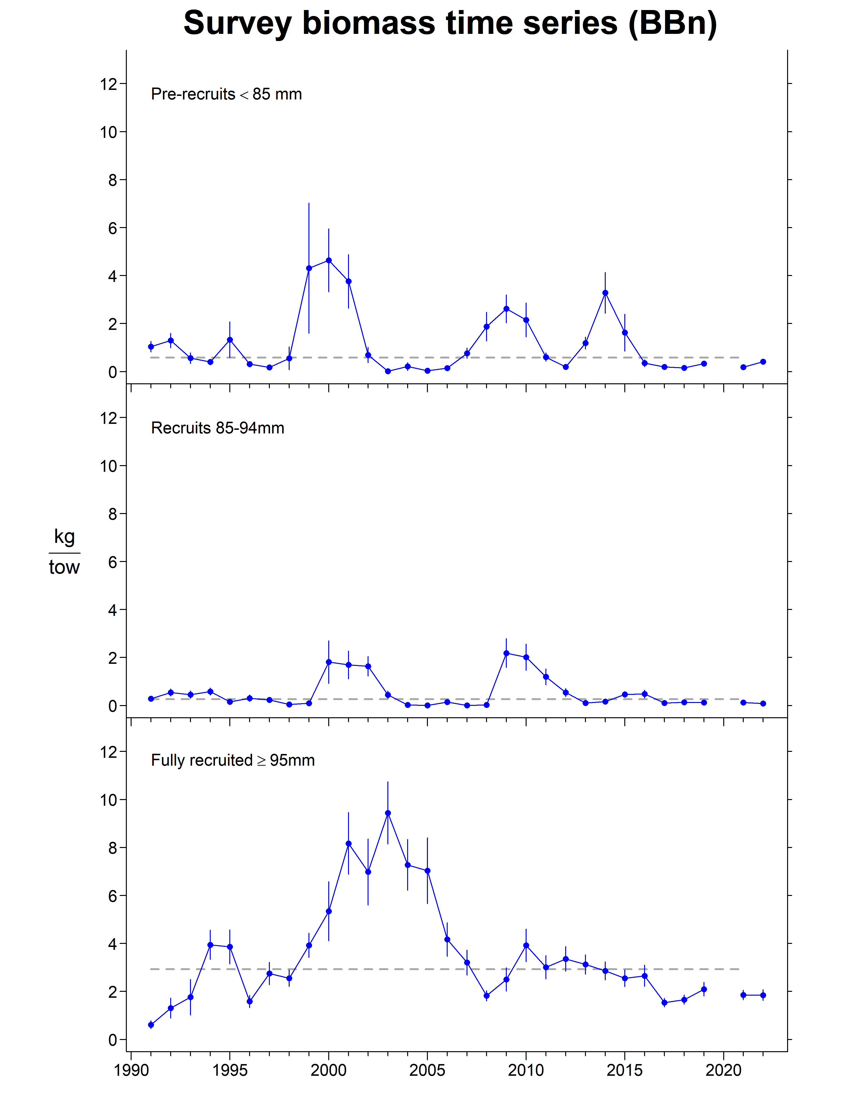
Browns North

Slide 49
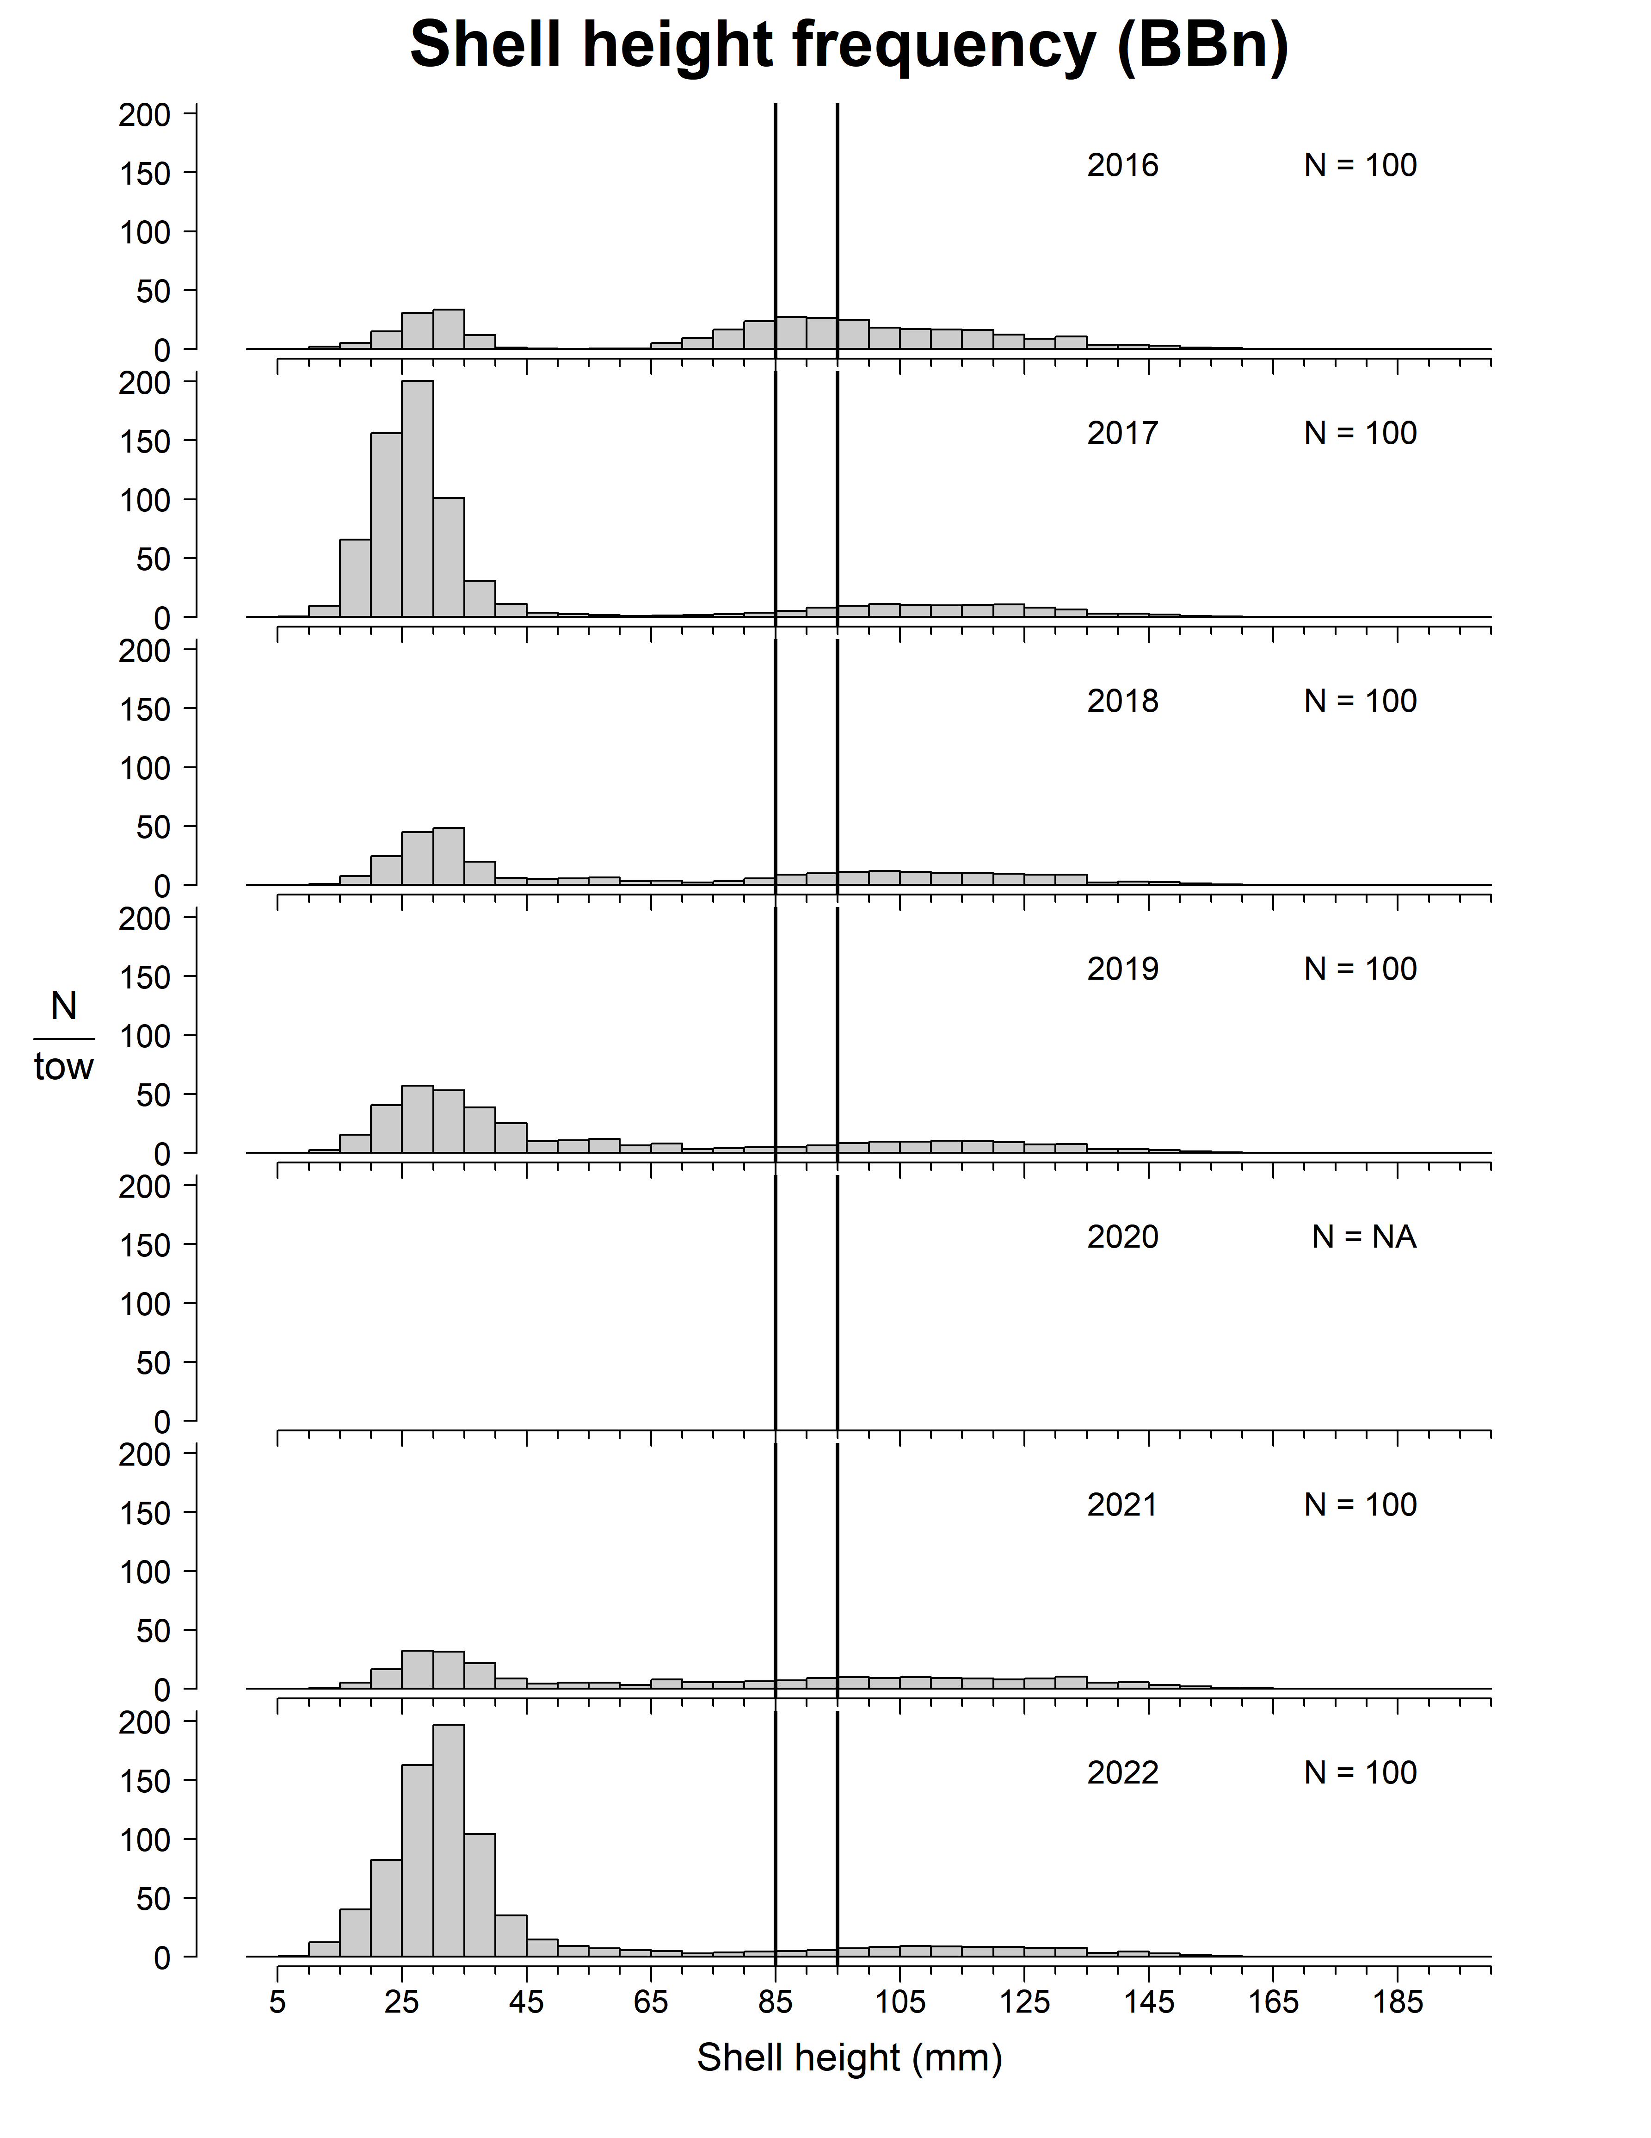
Browns North

Slide 50
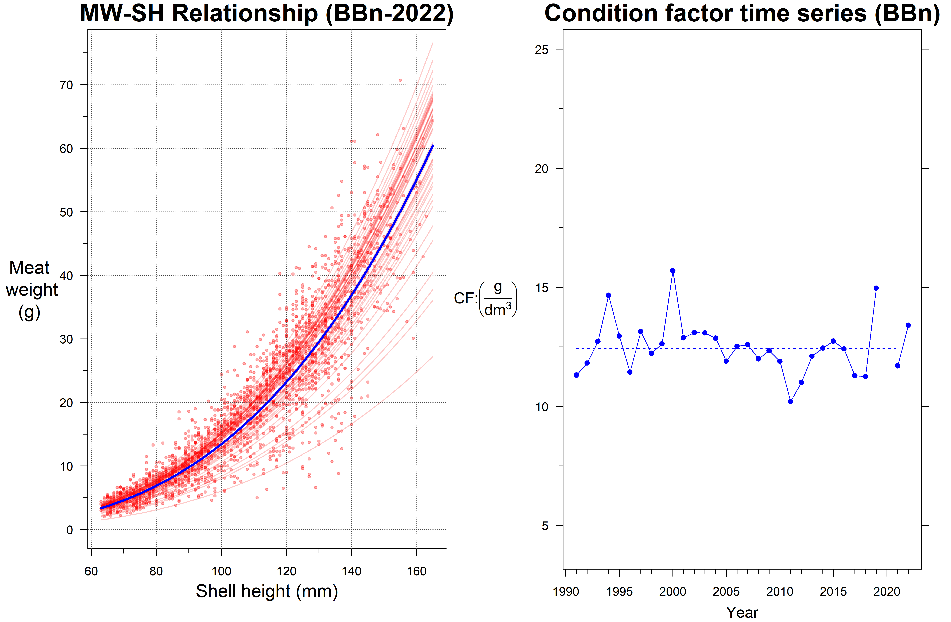
Browns North

Slide 51
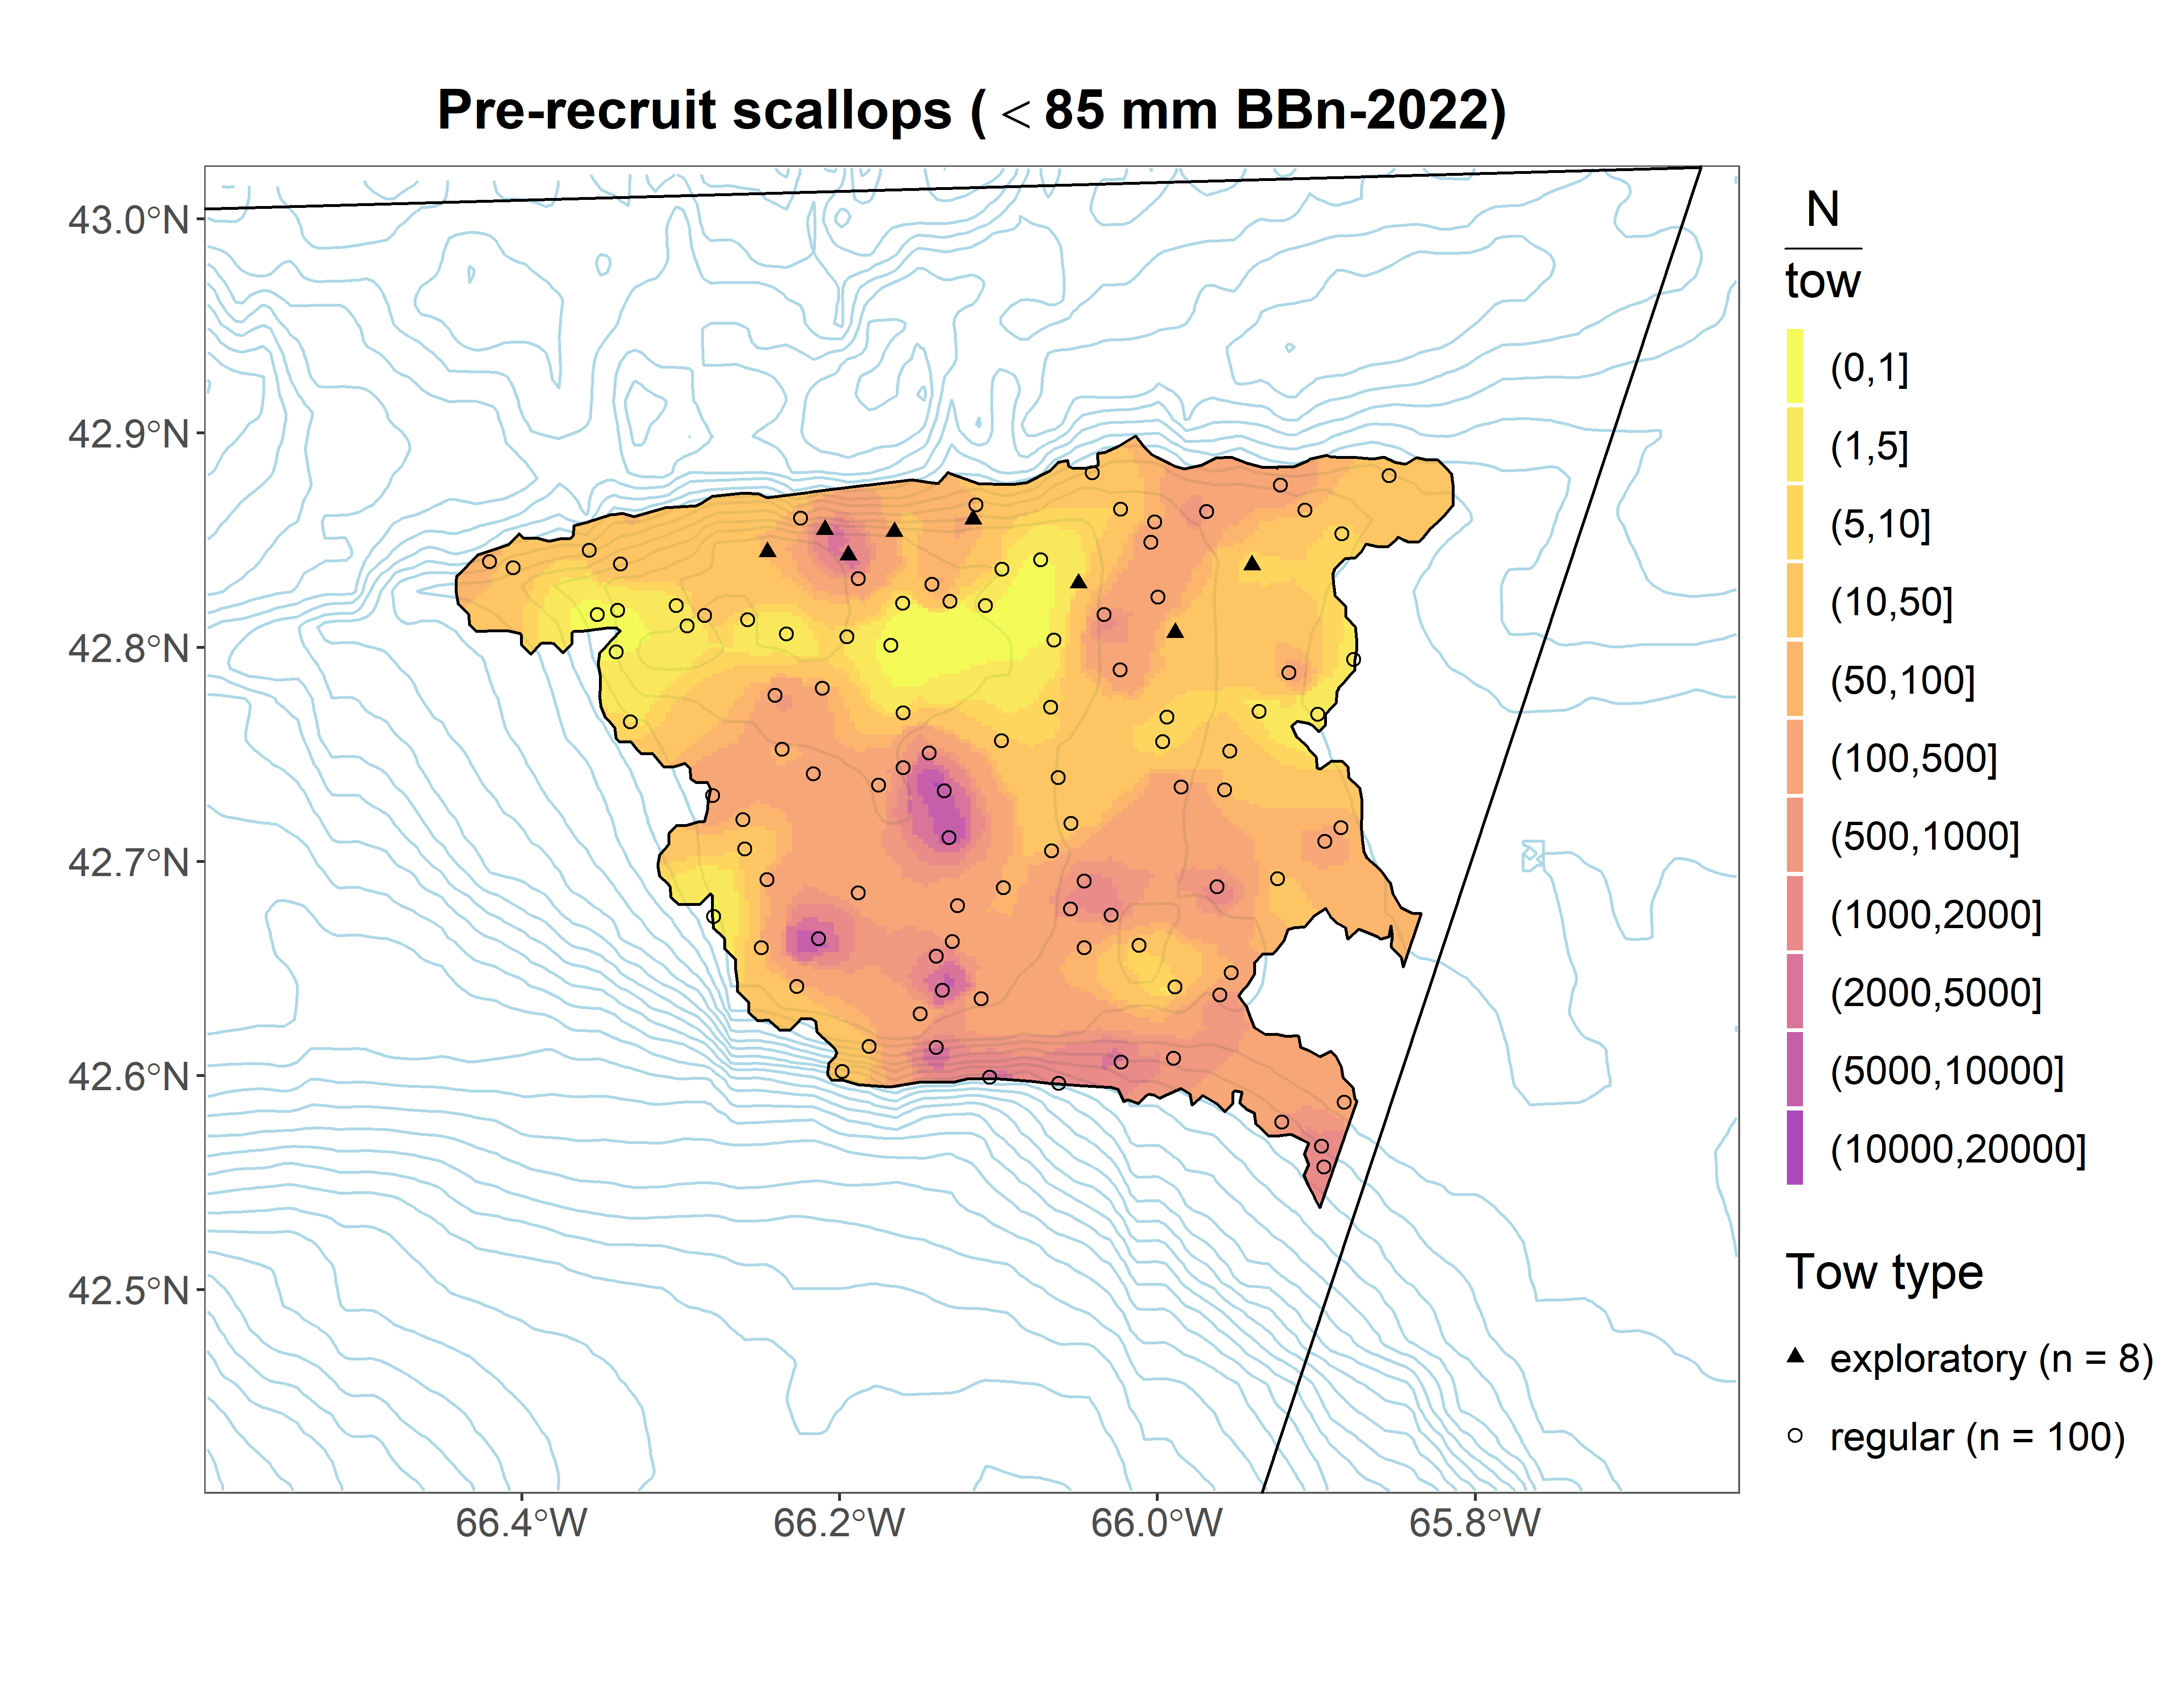
Browns North

Slide 52
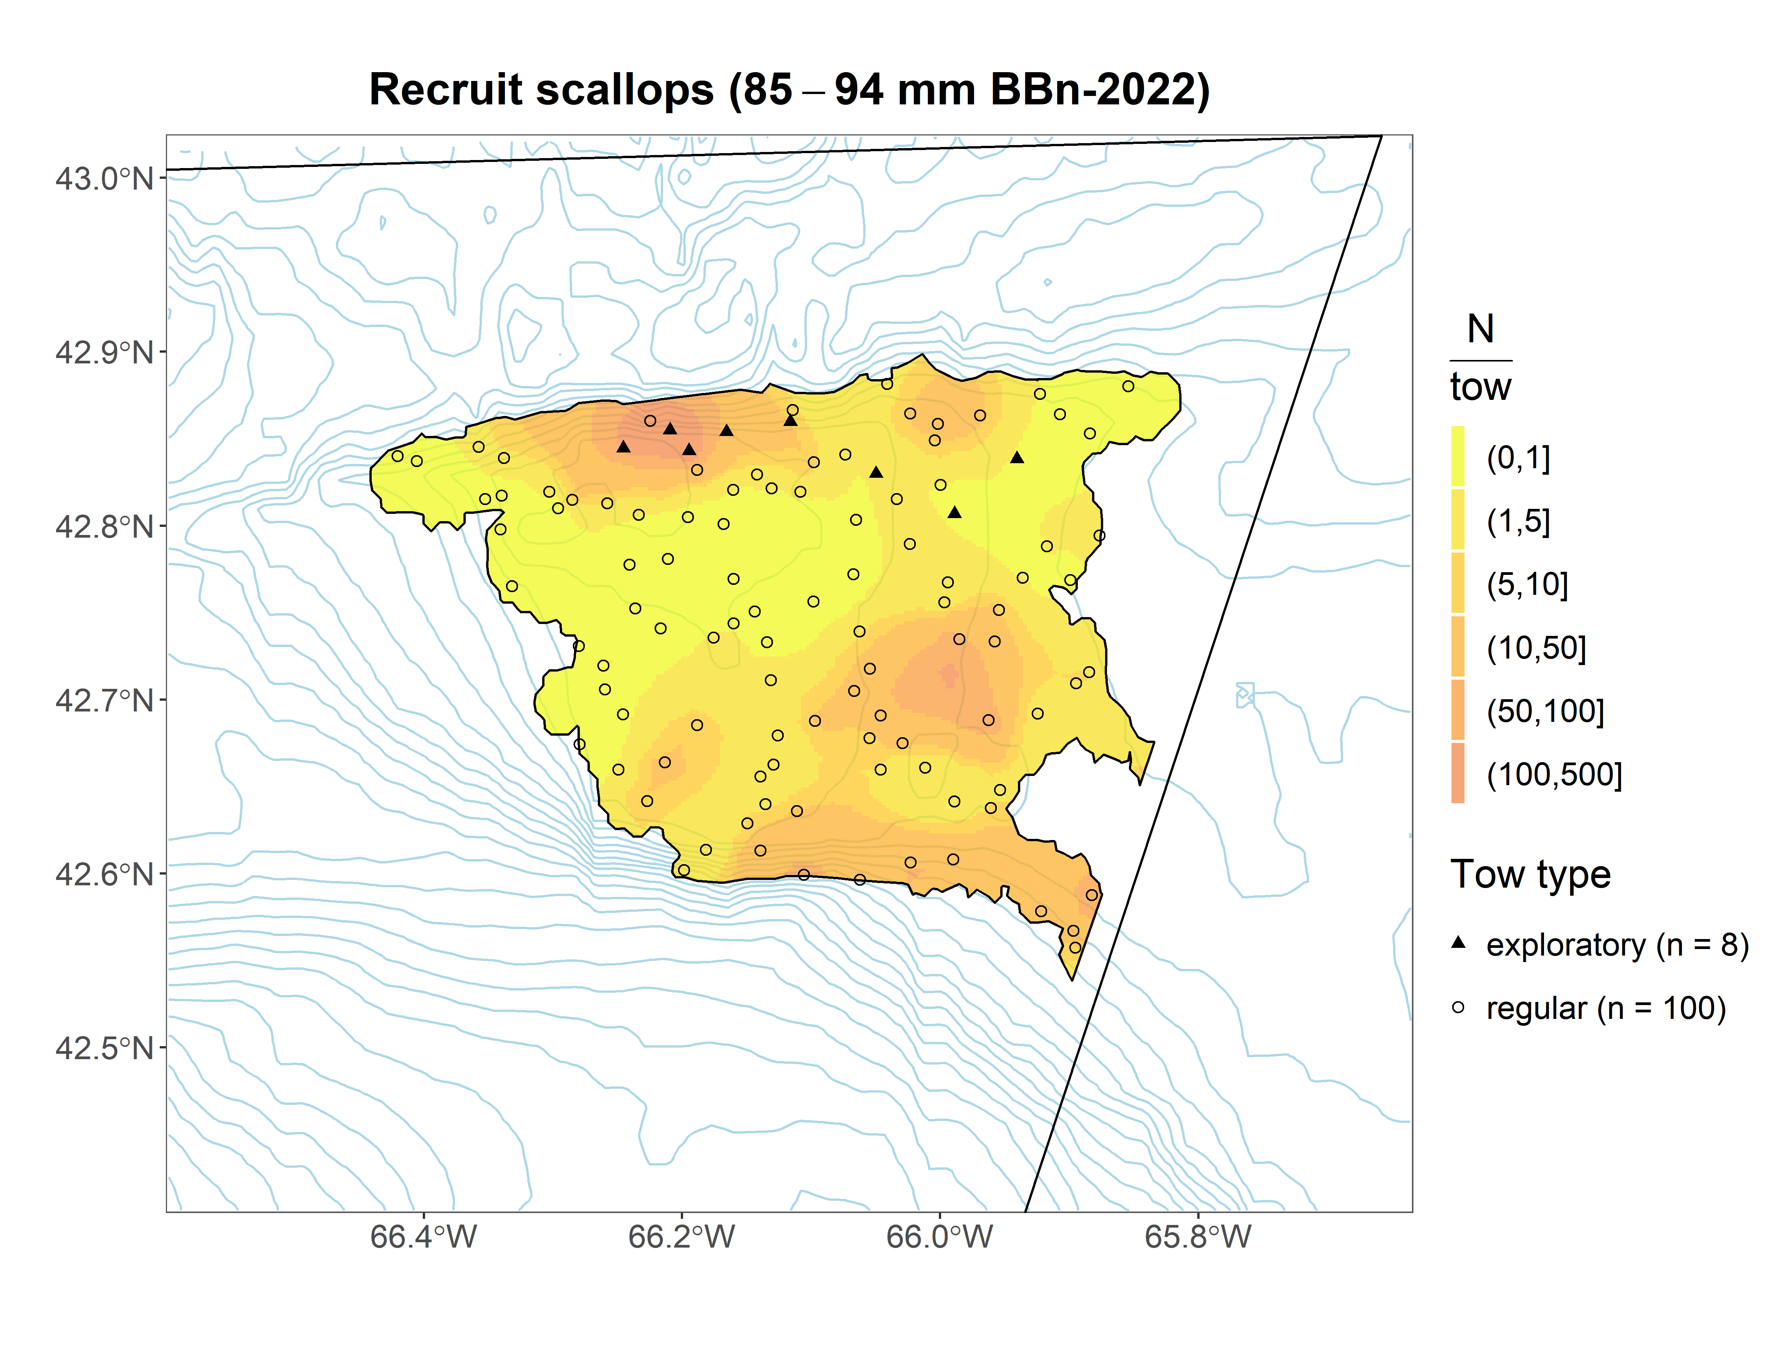
Browns North

Slide 53
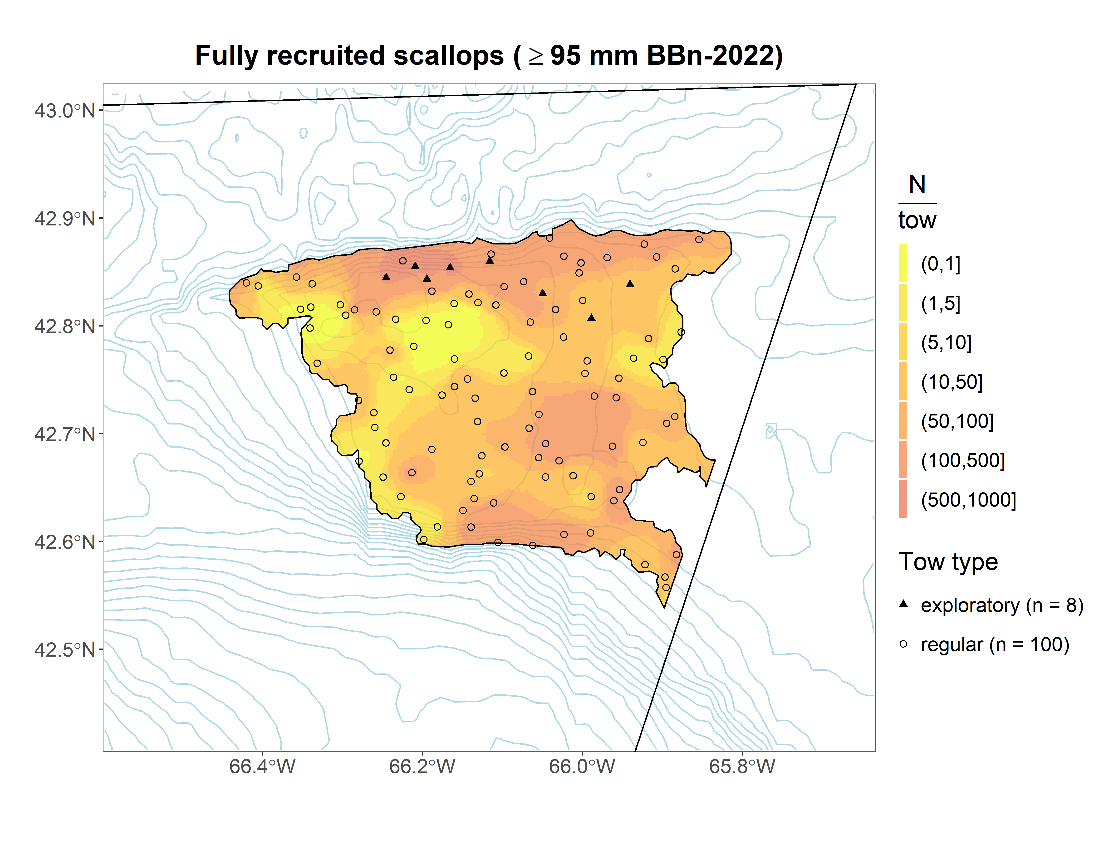
Browns North

Slide 54
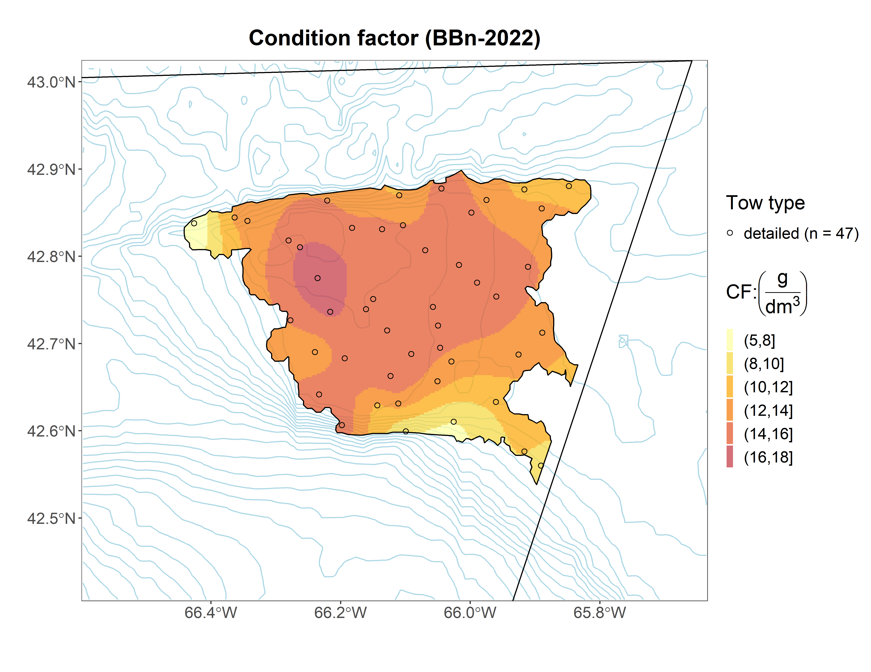
Browns North

Slide 55
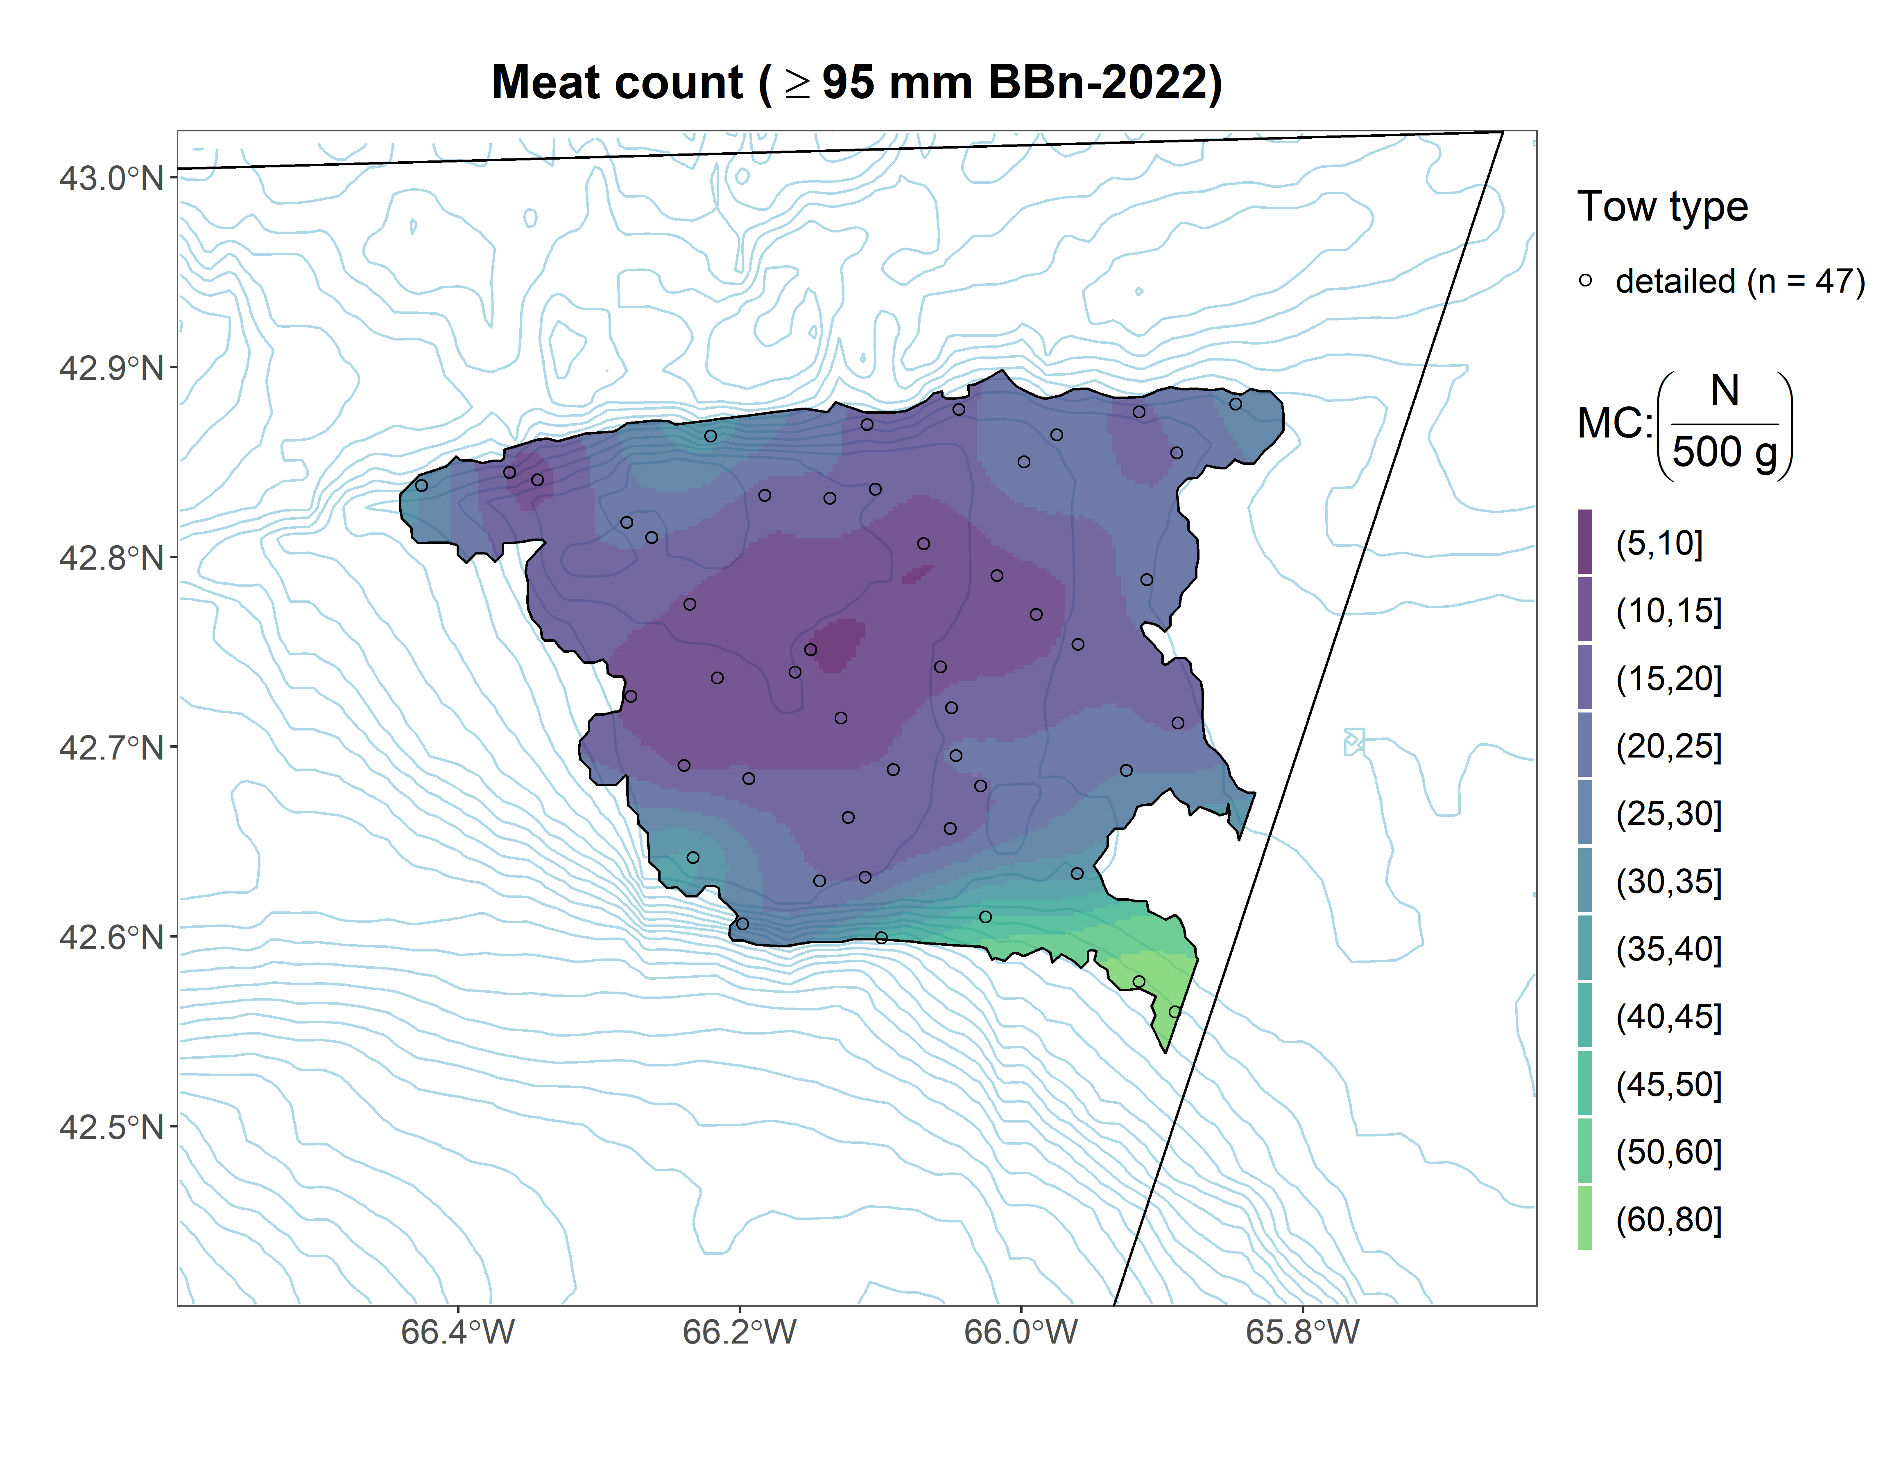
Browns North

Slide 56
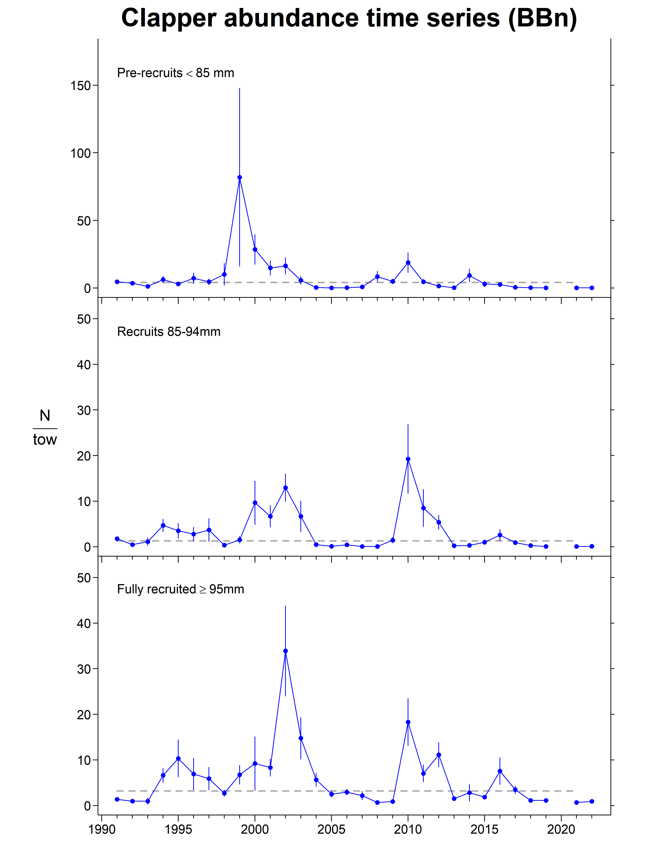
Browns North

Slide 57
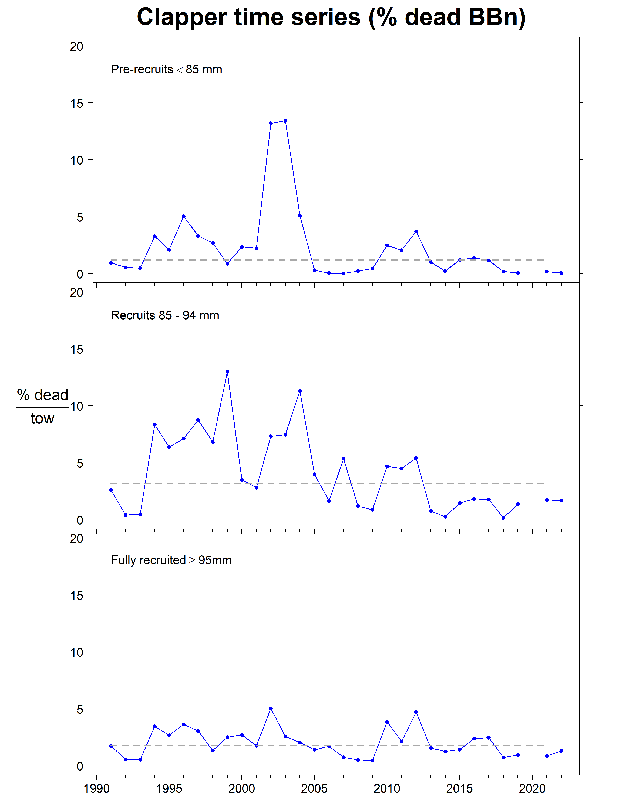
Browns North

Slide 58

Browns North

Slide 59
Browns North
Summary
Abundance
Pre-recruit: +77% since 2021, above LTM
Recruit: -37% since 2021, below LTM
Fully-recruited: -13% since 2021, below LTM
Biomass
Pre-recruit: +55% since 2021, below LTM
Recruit: -26% since 2021, below LTM
Fully-recruited: -0.6% since 2021, below LTM
Condition factor
increased since 2021, above LTM

Slide 60

Georges Bank (monitoring stations)

Slide 61

Georges Bank (monitoring stations)

Slide 62

Georges Bank (monitoring stations)

Slide 63

Georges Bank (monitoring stations)

Slide 64

Georges Bank (monitoring stations)

Slide 65

Georges Bank (monitoring stations)

Slide 66

Georges Bank (monitoring stations)

Slide 67

Georges Bank (monitoring stations)

Slide 68

Georges Bank (monitoring stations)

Slide 69

Georges Bank (monitoring stations)

Slide 70

Georges Bank (monitoring stations)

Slide 71

Georges Bank (monitoring stations)

Slide 72

Georges Bank (monitoring stations)

Slide 73
Georges Bank (monitoring stations)
Summary
Abundance
Pre-recruit: +77% since 2021, above LTM
Recruit: -37% since 2021, below LTM
Fully-recruited: +5.0% since 2021, above LTM
Biomass
Pre-recruit: +11% since 2021, above LTM
Recruit: -47% since 2021, below LTM
Fully-recruited: -17% since 2021, above LTM
Condition factor
decreased since 2021, above LTM

Slide 74

Georges 'a'

Slide 75

Georges 'a'

Slide 76

Georges 'a'

Slide 77

Georges 'a'

Slide 78

Georges 'a'

Slide 79

Georges 'a'

Slide 80

Georges 'a'

Slide 81

Georges 'a'

Slide 82

Georges 'a'

Slide 83

Georges 'a'

Slide 84

Georges 'a'

Slide 85

Georges 'a'

Slide 86

Georges 'a'

Slide 87
Georges 'a'
Summary
Abundance
Pre-recruit: +72% since 2021, above LTM
Recruit: +10% since 2021, below LTM
Fully-recruited: +31% since 2021, near LTM
Biomass
Pre-recruit: +34% since 2021, above LTM
Recruit: -0.9% since 2021, near LTM
Fully-recruited: +24% since 2021, above LTM
Condition factor
decreased since 2021, above LTM

Slide 88

Georges 'b'

Slide 89

Georges 'b'

Slide 90

Georges 'b'

Slide 91

Georges 'b'

Slide 92

Georges 'b'

Slide 93

Georges 'b'

Slide 94

Georges 'b'

Slide 95

Georges 'b'

Slide 96

Georges 'b'

Slide 97

Georges 'b'

Slide 98

Georges 'b'

Slide 99

Georges 'b'

Slide 100

Georges 'b'

Slide 101
Georges 'b'
Summary
Abundance
Pre-recruit: +70% since 2021, above LTM
Recruit: -13% since 2021, below LTM
Fully-recruited: +1.1% since 2021, above LTM
Biomass
Pre-recruit: +32% since 2021, near LTM
Recruit: -29% since 2021, below LTM
Fully-recruited: -9.3% since 2021, above LTM
Condition factor
decreased since 2021, above LTM

